Slide 1
Recommendations on Screening for Cognitive Impairment in Older Adults 2015 Canadian Task Force on Preventive Health Care (CTFPHC)
Putting Prevention into Practice
Canadian Task Force on Preventive Health Care Groupe d’étude canadien sur les soins de santé préventifs

Slide 2
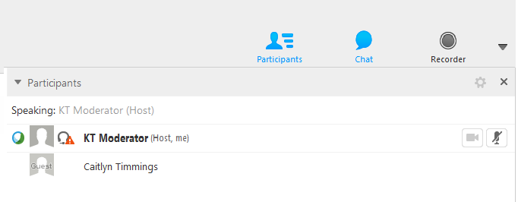
WebEx – How can I participate today?
Audio option- you can ask questions and participate directly in the discussion by unmuting your audio.
Mute or unmute your audio on your phone or by clicking on the microphone next to your name in the participant list.

Slide 3
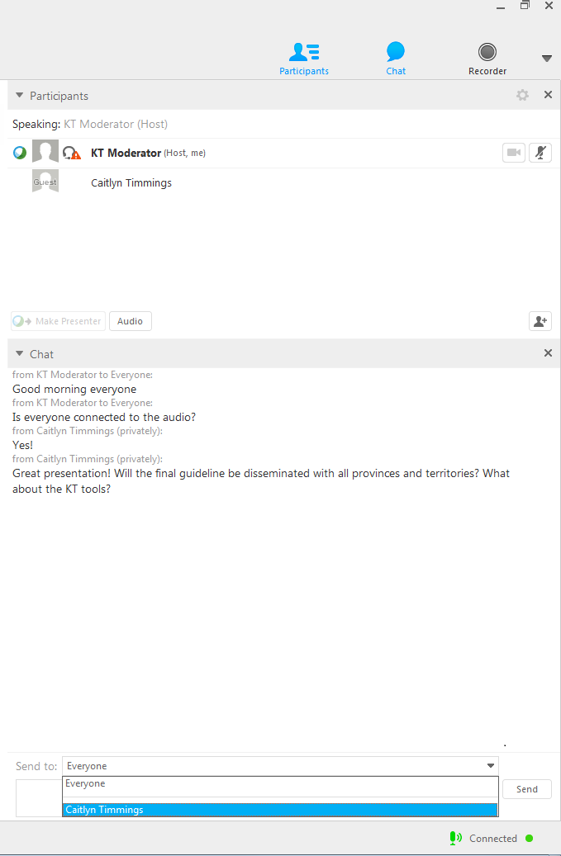
WebEx – How can I participate today?
Chat Box option- you can also type your questions or comments into the chat box.
You can send comments to everyone
You can send comments directly to the KT moderator (to read to the group) or to individual participants

Slide 4
Use of slide deck
These slides are made available publicly as an educational support to assist with the dissemination, uptake and implementation of the guidelines into primary care practice.
Some or all of the slides in this slide deck may be used in educational contexts.
The Screening for Cognitive Impairment Guideline was published online November 2015.

Slide 5
Cognitive Impairment Working Group
CTFPHC Members:
Kevin Pottie (Chair)
Richard Birtwhistle
Marcello Tonelli
Maria Bacchus
Neil Bell
Ainsley Moore*
Public Health Agency:
Alejandra Jaramillo*
Evidence Review and
Synthesis Centre:
Donna Fitzpatrick-Lewis*
Rachel Warren*
*non-voting member

Slide 6
Overview of Presentation
Background on Cognitive Impairment
Methods of the CTFPHC
Recommendations and Key Findings
Implementation of Recommendations
Conclusions
Questions and Answers

Slide 7
BACKGROUND
Screening for Cognitive Impairment

Slide 8
Background
Cognitive impairment occurs on a continuum that includes aging related cognitive decline, mild cognitive impairment (MCI), and dementia
Studies from the United States have reported prevalence of MCI ranging from 9.9% to 35.2% for adults aged 70 or older
The incidence of dementia in Canadian adults aged 65 to 79 years is 43 per 1000 persons and rises with age (to 212 per 1000 in Canadians aged 85 and older)
Available treatments for cognitive impairment include medications (e.g., cholinesterase inhibitors), dietary supplements/vitamins and non-pharmacological interventions

Slide 9
Screening Tools for Cognitive Impairment
Mini Mental State Examination (MMSE)
A 30-point questionnaire available with a fee ($68.00 US for 50 test forms)
Scored out of 30, cut-point varies based on age and education level:
Cognitive impairment = below 23
Montreal Cognitive Assessment (MoCA)
A free, quick test that assesses different cognitive domains
Scored out of 30 and provides interpretive guidance as follows:
Mild cognitive impairment = between 18-26
Moderate cognitive impairment = between 10-17
Severe impairment = less than 10
Alzheimer’s Disease Assessment Scale cognition subscale (ADAS-Cog)
Often used in clinical trials, consists of 11 tasks measuring disturbances of memory, language, praxis, attention and other cognitive abilities
Takes up to 45 minutes to conduct

Slide 10
Cognitive Impairment 2015 Guidelines
This guideline provides recommendations for practitioners on preventive health screening in a primary care setting:
This guideline applies to screening asymptomatic community dwelling adults ≥65 years for cognitive impairment
This guideline does not apply to men and women who:
Are concerned about their cognitive performance
Are suspected of having cognitive impairment by clinicians, family or friends.
Have symptoms suggestive of cognitive impairment
E.g., loss of memory, language, attention, visuospatial, or executive functioning, or behavioural or psychological symptoms

Slide 11
METHODS
Screening for Cognitive Impairment

Slide 12
Methods of the CTFPHC
Independent panel of:
Clinicians and methodologists
Expertise in prevention, primary care, literature synthesis, and critical appraisal
Application of evidence to practice and policy
Cognitive Impairment Working Group
6 Task Force members
Establish research questions and analytical framework

Slide 13
Methods of the CTFPHC
Evidence Review and Synthesis Centre (ERSC)
Undertakes a systematic review of the literature based on the analytical framework
Prepares a systematic review of the evidence with GRADE tables
Participates in working group and task force meetings
Obtain expert opinions

Slide 14
CTFPHC Review Process
Internal review process involving guideline working group, Task Force, scientific officers and ERSC staff
External review process involving key stakeholders
Generalist and disease specific stakeholders
Federal and P/T stakeholders
CMAJ undertakes an independent peer review journal process to review guidelines

Slide 15
Research Questions
The systematic review for screening for cognitive impairment included:
(2) key research question with (0) sub-questions
(4) supplemental or contextual questions
The systematic review for the treatment of cognitive impairment included:
(6) key research question with (4) sub-questions
(6) supplemental or contextual questions
For more detailed information please access the systematic review www.canadiantaskforce.ca

Slide 16
Analytical Framework: Screening
1
No MCI or Dementia
Screening outcomes:
Patient outcomes:
Function/QOL
Utilization
Safety
Family/Caregiver Outcomes:
QOL
Caregiver Burden
Societal Outcomes:
Safety
Community dwelling adults ≥ 65 years without a current diagnosis of cognitive impairment
Treatment outcomes:
cognition; function; behavior; global status; mortality
Screening
2, 6
MCI
Treatment
4
3
Dementia
5
Serious adverse events (hospitalization; death); psychosocial harms
unwanted or unexpected direction of effect on health outcomes, psychological harms, harms due to labeling, poor adherence to diagnostic follow up

Slide 17
Eligible Study Types
Population: community dwelling older adults (≥65 years of age) who do not have symptoms suggestive of cognitive impairment (such as loss of memory, language, attention, visuospatial, or executive functioning, or behavioural or psychological symptoms) and who are not suspected of having cognitive impairment by clinicians or non-clinicians such as family or friends.
Language: English, French
Study type: Randomized control trials (RCTs) with at least 6 months of follow-up data from baseline
Outcomes: patient important outcomes and the scales used to measure such outcomes were based on those selected and prioritized by Canadian clinicians and policymakers

Slide 18
How is Evidence Graded?
The “GRADE” System:
Grading of Recommendations, Assessment, Development & Evaluation
What are we grading?
1. Quality of Evidence
Degree of confidence that the available evidence correctly reflects the theoretical true effect of the intervention or service.
high, moderate, low, very low
2. Strength of Recommendation
the balance between desirable and undesirable effects; the variability or uncertainty in values and preferences of citizens; and whether or not the intervention represents a wise use of resources.
strong and weak

Slide 19
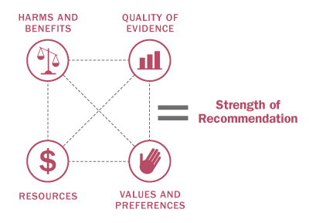
How is the Strength of Recommendations Determined?
The strength of the recommendations (strong or weak) are based on four factors:
Quality of supporting evidence
Certainty about the balance between desirable and undesirable effects
Certainty / variability in values and preferences of individuals
Certainty about whether the intervention represents a wise use of resources

Slide 20
Interpretation of Recommendations
Implications | Strong Recommendation | Weak Recommendations
For patients | Most individuals would want the recommended course of action; only a small proportion would not. | The majority of individuals in this situation would want the suggested course of action but many would not.
For clinicians | Most individuals should receive the intervention. | Recognize that different choices will be appropriate for individual patients; Clinicians must help patients make management decisions consistent with values and preferences.
For policy makers | The recommendation can be adapted as policy in most situations. | Policy making will require substantial debate and involvement of various stakeholders.

Slide 21
RECOMMENDATIONS & KEY FINDINGS
Screening for Cognitive Impairment

Slide 22
Screening For Cognitive Impairment
Recommendation: We recommend not screening asymptomatic adults (≥65 years of age) for cognitive impairment
Strong recommendation; low quality evidence
Basis of the recommendation:
The findings of the evidence review highlight:
The lack of high quality studies evaluating the benefits and harms of screening for cognitive impairment;
The lack of effective treatment for mild cognitive impairment
The effect of treatment on MCI was measured as most pathology detected would likely be MCI when screening for cognitive impairment in asymptomatic populations

Slide 23
Efficacy of Screening Tools
The likelihood of a false positive result from the most common screening tools are as follows:
MMSE:
10% to 14% when screening for dementia
13% when screening for MCI
MoCA
25% when screening for MCI
ADAS-Cog
Diagnostic accuracy was not reported as this tool is not used in primary care settings, but for research purposes

Slide 24
Benefits of Treatment for MCI on Cognition: Effect measured with ADAS-Cog
Treatment Intervention | Effect Mean Difference (95% CI) | No. Participants Treatment | No. Participants Control | No. Studies | Quality
AChEIs | -0.33 (-0.73 to 0.06)* | 2078 | 2110 | 4 | Low
Donepezil | -0.60 (-1.35 to 0.15)* | 632 | 637 | 2 | Low
Rivastigmine | 0 (-0.7987 to 0.7987)* | 508 | 510 | 1 | Low
Galantamine | -0.21 (-0.80 to 0.38)* | 938 | 963 | 1 | Low
Dietary Supplements | 0.85 (-0.32 to 2.02)* | 257 | 259 | 1 | Low
Non-pharma | -0.60 (-1.44 to 0.24)* | 47 | 45 | 1 | Moderate
*Not statistically significant
Note:
Negative and positive effects are outcome measure dependent
A decrease in score (negative values) indicates and improvement
Notes:
measured with: ADAS-Cog; Better indicated by lower values
Note: For all results on the outcome of cognition reported below it is important to note that negative and positive effects are outcome measure dependent. For MMSE an increase in score (positive values) indicates an improvement, however, for ADAS-cog a decrease in score (negative values) indicates an improvement.

Slide 25
Benefits of Treatment for MCI on Cognition: Effect measured with MMSE
Treatment Intervention | Effect Mean Difference (95% CI) | No. Participants Treatment | No. Participants Control | No. Studies | Quality
AChEIs | 0.17 (-0.13 to 0.47)* | 1140 | 1147 | 3 | Low
Donepezil | 0.24 (-0.19 to 0.66)* | 632 | 637 | 2 | Low
Rivastigmine | 0.10 (-0.32 to 0.52)* | 508 | 510 | 1 | Low
Dietary Supplements | 0.20 (-0.04 to 0.43)* | 511 | 519 | 4 | Low
Non-pharma | 1.01 (0.25 to 1.77) | 221 | 187 | 1 | Moderate
*Not statistically significant
Note:
Negative and positive effects are outcome measure dependent
An increase in score (positive values) indicates and improvement
Notes:
measured with: MMSE; Better indicated by higher values

Slide 26
Harms and Benefits for Screening and Treatment
No high quality studies evaluating the harms and benefits of screening for cognitive impairment
No evidence demonstrating clinically meaningful benefits of treatment of mild cognitive impairment
Possible harms related to screening include:
False positives that could result from the MoCA or MMSE
The cost of conducting unnecessary medical care
Opportunity cost lost because practitioners could spend their time instead on interventions that have been proven to be effective

Slide 27
Comparison of Screening for Cognitive Impairment Recommendations
Our recommendations on screening are consistent with those of other international guideline groups who recommend to not screen for cognitive impairment in asymptomatic adults:
NICE (2011)
BC Ministry of Health (2014)
USPSTF (2014)

Slide 28
IMPLEMENTATION OF RECOMMENDATIONS
Screening for Cognitive Impairment

Slide 29
Values and Preferences
Limited evidence available: one international study examined the willingness to be screened among first-degree relatives of persons with Alzheimer’s disease
32% were willing to be screening within the next year, 42% during the next 5 years
Willingness mainly related to obtaining help to prepare for the future
Factors that influenced participants’ willingness to be screened included:
Planning for future treatments and planning for their life
Dealing with the problem if there was one
Cost of evaluation and time

Slide 30
Knowledge Translation Tools
The CTFPHC creates KT tools to support the implementation of guidelines into clinical practice
A clinician FAQ has been developed for the cognitive impairment guideline
After the public release, these tools will be freely available for download in both French and English on the website: www.canadiantaskforce.ca

Slide 31
CONCLUSIONS
Screening for Cognitive Impairment

Slide 32
Conclusions
The CTFPHC recommends physicians to remain alert when patient, family members, or caregivers express concern about possible cognitive impairment and undertake appropriate diagnostic inquiry as warranted
There is a lack of direct evidence concerning the benefits of screening for cognitive impairment in asymptomatic adults
There is an absence of effective treatments for mild cognitive impairment
Improved screening tools for mild cognitive impairment are needed.
Available screening tools for mild cognitive impairment may incorrectly classify individuals as positive

Slide 33
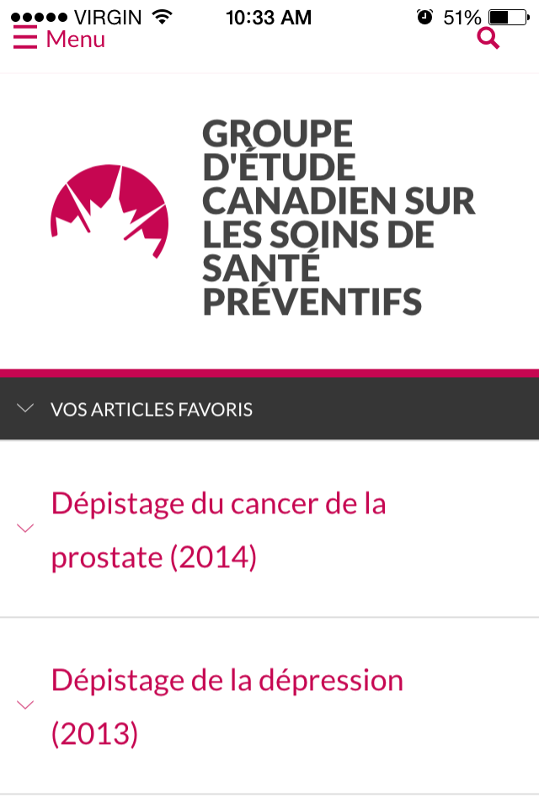
Update: CTFPHC Mobile App Now Available
The app contains guideline and recommendation summaries, knowledge translation tools, and links to additional resources.
Key features include the ability to bookmark sections for easy access, display content in either English or French, and change the font size of text.

Slide 34
Update: CTFPHC on Social Media
The CTFPHC is venturing into social media!
A Twitter policy and strategy is currently being developed
CTFPHC Twitter is expected to be released late 2015/early 2016
Please check the CTFPHC website for updates: http://canadiantaskforce.ca/

Slide 35
More Information
For more information on the details of this guideline please see:
Canadian Task Force for Preventive Health Care website: http://canadiantaskforce.ca/?content=pcp

Slide 36
Questions & Answers
Thank you

