Slide 1

Screening for Developmental Delay in Early Childhood 2016
Canadian Task Force on Preventive Health Care (CTFPHC)
Dr. Patricia Parkin
Putting Prevention
into Practice
Canadian Task Force on Preventive Health Care
Groupe d’étude canadien sur les soins de santé préventifs

Slide 2
Use of slide deck
These slides are made available publicly as an educational support to assist with the dissemination, uptake and implementation of the guidelines into primary care practice.
Some or all of the slides in this slide deck may be used in educational contexts.
The Screening for Developmental Delay Guideline was published online March 28, 2016.
Guideline is also available in Canadian Medical Association Journal and on CTFPHC website: http://canadiantaskforce.ca/

Slide 3
CTFPHC DD Working Group Members
Task Force Members:
Marcello Tonelli (Chair)
Patricia Parkin
Brett Thombs
Paula Brauer
Kevin Pottie
Canadian Paediatric Society
Denis Leduc*
*non-voting members
Public Health Agency of Canada:
Anne-Marie Ugnat*
Alejandra Jaramillo Garcia*
Wendy Martin*
Marianna Ofner *(part of ASD-GC & ASD-AC)
Sarah Connor Gorber* (PHAC/CIHR)
Lesley Dunfield (previously with PHAC)

Slide 4
CTFPHC DD Working Group Acknowledgements
Members of the McMaster Evidence Review and Synthesis Centre:
Rachel Warren
Meghan Kenny
Donna Fitzpatrick-Lewis
Maureen Rice
Muhammad Usman Ali
Andy Bayer
Sharon Peck-Reid
Donna Ciliska
Diana Sherifali
Parminder Raina
Clinical expert: Dr. Teresa Bennett
ERSC Peer-reviewers: Dr. Alice Carter, Dr. Sharon Smile, Dr. Isabel Smith,
Dr. Lisa Hartling, Dr. Brian Reichow, Dr. Leslie Anne Campbell

Slide 5
Overview of Presentation
Introduction to CTFPHC
Background on Developmental Delay
Methods for Guideline Development
Recommendations and Key Findings
Implementation of Recommendations
Conclusions
Questions and Answers

Slide 6
Canadian Task Force on Preventive Health
The CTFPHC is an independent panel of primary care clinicians and methodologists that develop recommendations on clinical preventive services in primary care
      Expertise in prevention, primary care, literature synthesis, critical appraisal
Mandate is to develop and disseminate clinical practice guidelines for primary and preventive care, based on systematic analysis of scientific evidence
  Intended to support application of evidence to practice and policy
  The CTFPHC recommendations focus on primary and secondary preventive services Primary prevention: prevention of a target condition in healthy patients
  Secondary prevention: directed to asymptomatic individuals who have risk factors for a condition or preclinical disease but who do not have clinically evident disease
CTFPHC uses a standard, transparent process to review and synthesize evidence, weigh the balance of benefits and harms, and make recommendations (GRADE system)

Slide 7
BACKGROUND
Screening for Developmental Delay

Slide 8
Background Developmental Delay Guideline
Developmental delay (DD) refers to significant delay in achieving age-expected norms within any of the following domains: gross & fine motor skills, speech-language, cognition , social and personal skills, and activities of daily living
DD may be transitory or sustained
Children with sustained DD are at higher risk for learning difficulties, behavioural problems, and functional impairments later in life
There is considerable interest in the possibility that early identification and intervention might improve health outcomes among children with DD
Therefore, the CTFPHC assessed the evidence on:
  the effectiveness of population-based screening for DD in primary care
  the accuracy of screening tools to identify undetected DD, and
  the effectiveness of behavioural interventions for DD.

Slide 9
Screening, Surveillance and Case Finding
There is a great variation in terminology related to the detection of developmental delay which can lead to misunderstandings
Screening: refers to the use of a standardized tool to detect developmental delay in populations where there are no overt signs suggestive of possible DD and no concerns about development
Developmental surveillance: is often used to describe the ongoing monitoring of development, identification of risk factors, and elicitation of parental concerns
Case finding: refers to the identification of DD in populations that are at increased risk of developmental delays and often does not involve the use of a specific tool
Developmental surveillance, though a common term in developmental paediatrics, is what the CTFPHC would normally consider to be part of standard clinical practice for children

Slide 10
Developmental Delay 2016 Guideline
This guideline provides recommendations on screening for developmental delay in a primary care settings
  It does not offer guidance about surveillance, case finding or diagnosis
This guideline applies to screening children aged 1 to 4 years with no apparent signs of DD and whose parents and clinicians have no concerns about development.
These are children for whom there is no concern about sequential acquirement of age-appropriate developmental milestones for gross and fine motor, social/emotional, language, and cognitive domains.
Milestone ages should be based on the oldest age by which the skill should have been achieve
This guideline does not apply to children:
  Whose development is being closely monitored because of risk factors such as premature birth or low birth weight
  Whose parents, caregivers or clinicians suspect there may be a delay in development or atypical development
  Have signs suggestive of developmental delay

Slide 11
METHODS
Screening for Developmental Delay

Slide 12
Methods for DD Guideline
Work lead by Developmental Delay Work Group 5 CTFPHC members & 1 member of Canadian Paediatric Society (1 CTFPHC member also with CPS)
Established key questions, analytic framework, clinical and patient important outcomes (research protocol)
Commissioned an independent systematic review & quality assessment of evidence
Formulated recommendations based on a comprehensive assessment of the balance of benefits and harms of screening, treatment, accuracy of screening tests, patient values and preferences, and resource considerations
All members of CTFPHC reviewed and approved each phase of guideline development process
CTFPHC sent guideline for external peer and stakeholder review
CMAJ also carried out an independent peer review process

Slide 13
Research Questions
The systematic review for screening and treatment of developmental delay included:
  5 key research questions
    Effectiveness of screening, incidence of harms of screening, effectiveness of treatment, etc.
  3 contextual questions
    Cost effectiveness and feasibility, values and preferences of primary caregivers, etc.
Outcomes of interest:
  improvement to gross and fine motor skills, speech-language, and cognition and performance, academic performance, adaptive functioning, overall quality of life, mental health, survival, and functionality as an adult.
For more detailed information please access : www.canadiantaskforce.ca

Slide 14
Evidence Review Analytic Framework
KQ1
Stage I - Screening - KQ1 and KQ2
Stage II - Treatment - KQ3 and KQ4
Stage III - Test Properties - KQ5

Slide 15
Stage I: Screening
KQ1. What is the effectiveness of screening children aged 1 to 4 years without suspected DD to improve outcomes?
What is the optimal interval for screening for DD
Outcomes of interest:
  Process outcomes: referral rates for early intervention; time to referral to early intervention;
  Clinical outcomes: cognitive function; academic performance; incidence of mental health conditions; overall quality of life; survival; functionality as an adult
  KQ2. What is the incidence of harms of screening children aged 1 to 4 years without suspected DD?

Slide 16
Eligible Study Types: Screening KQ1 & KQ2
Population: children aged 1-4 years of age not at high risk* or suspected of having DD.
  High risk has been defined as those born prematurely (gestational age less than 37 completed weeks at birth) or with low birth weight (birth weight less than 2,500 g) and/or children with other known disorders that may be associated with or affect development.
Intervention: developmental screening tools
Comparator: no screening/ standard care
Study type: Randomized control trials (RCTs), controlled trials, controlled cohort studies, with at least 6 months of follow-up data from baseline
Setting: primary care or public health setting
Outcomes: patient important outcomes and the scales used to measure such outcomes were based on those selected and prioritized by Canadian clinicians and policymakers (clinical and process outcomes)
Language: English, French

Slide 17
Stage II: Treatment
KQ3. What is the effectiveness of treatment for children diagnosed with DD to improve outcomes?
Outcomes of interest:
  Clinical outcomes: cognitive function; academic performance; incidence of mental health conditions; overall quality of life; survival; functionality as an adult; and improvement to gross and fine motor skills, language, adaptive functioning, and cognition and performance (for domain specific delays)
KQ4.What is the incidence of harms of treatment for children diagnosed with DD?

Slide 18
Eligible Study Types: Treatment KQ3 & KQ4
Population: Children aged 1 to 6 diagnosed with domain specific developmental delay (DD) in one or more of the domains (gross and fine motor skills; speech and language; social and personal activities of daily living; performance and cognition).
  Treatment intervention had to have been initiated between the ages of 1-6 years.
Interventions: any behavioral, psychological, or pharmacological
Comparator: no treatment or standard care
Study Design and Comparison Groups: Systematic reviews and RCTs using comparison groups receiving usual care or no intervention were considered.
Outcomes: patient important outcomes and the scales used to measure such outcomes were based on those selected and prioritized by Canadian clinicians and policymakers
Language: English or French.

Slide 19
Stage III - Test Properties KQ5
KQ5 . What is the sensitivity, specificity, positive and negative predictive values, and likelihood ratios of the various screening tests to assess DD in children aged 1 to 4 years who are not already suspected of having DD?

Slide 20
Eligible Study Types – Test Properties KQ5
Population: children aged 1 to 4 without suspected DD
Intervention: any short screening test, tool or questionnaire that could be administered in a primary care setting or currently in use in Canada:
  Ex. Ages and Stages Questionnaire (ASQ);); Parents’ Evaluation of Developmental (PEDS); Nipissing District Developmental Screen (NDDS);
Study design: RCTs, cohort and case-control studies; Index and reference tests administered concurrently or within a brief time interval;
Reference Standard: clinical or diagnostic evaluations using:
  Ex. Bayley Scale of Infant Development (BSID) or BSID-II; Wechsler Preschool and Primary Scale of Intelligence (WPPSI); Vineland Adaptive Behavior Scale (VABS);
  Language: English or French
  Exclusions: prognostic tools, predictive tools, diagnostic tools

Slide 21
Contextual Questions
Three Contextual Questions:
What is the cost-effectiveness and feasibility of screening for DD in children aged 1- 4?
What are parent/care givers values and preferences for screening?
What is the evidence for higher burden of disease, differential performance for screening and/or treatment response for DD or barriers to implementation of screening in subgroups

Slide 22
How is Evidence Graded?
The “GRADE” System:
Grading of Recommendations, Assessment, Development & Evaluation
What are we grading?
1. Quality of Evidence
  Degree of confidence that the available evidence correctly reflects the theoretical true effect of the intervention or service.
  high, moderate, low, very low
2. Strength of Recommendation
  the balance between desirable and undesirable effects; the variability or uncertainty in values and preferences of citizens; and whether or not the intervention represents a wise use of resources.
  strong and weak

Slide 23
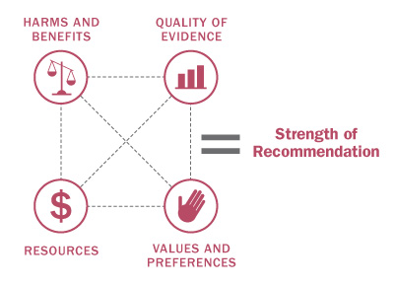
How is the Strength of Recommendations Determined?
The strength of the recommendations (strong or weak) are based on four factors:
Quality of supporting evidence
Certainty about the balance between desirable and undesirable effects
Certainty / variability in values and preferences of individuals
Certainty about whether the intervention represents a wise use of resources

Slide 24
Interpretation of Recommendations
Implications | Strong Recommendation | Weak Recommendations
For patients | Most individuals would want the recommended course of action; only a small proportion would not. | The majority of individuals in this situation would want the suggested course of action but many would not.
For clinicians | Most individuals should receive the intervention. | Recognize that different choices will be appropriate for individual patients; Clinicians must help patients make management decisions consistent with values and preferences.
For policy makers | The recommendation can be adapted as policy in most situations. | Policy making will require substantial debate and involvement of various stakeholders.

Slide 25
KEY FINDINGS & RECOMMENDATIONS
Screening for Developmental Delay

Slide 26
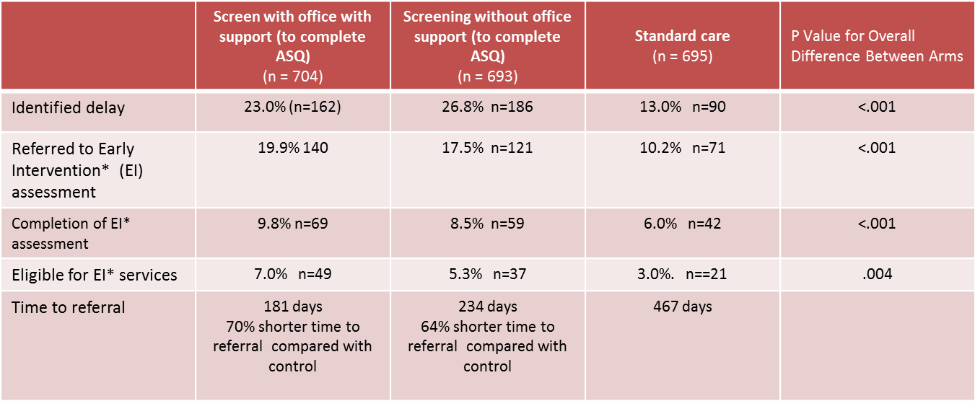
Evidence: Screening for DD
One moderate quality American study (n=2,103) measured whether screening for DD improves time to referral, percentage of early referrals, and eligibility for early intervention services (process outcomes)
  Compared children screening (with and without office support) using ASQ-II at 9, 18, 30 months and M-CHAT at 18 & 24 months with usual care (age appropriate milestones were assessed at well child visits)
* NB early intervention refers to programs offered in the US as part of American Individuals with Disability Education Act, intended to ensure that children with disabilities have access to free individualized public education programs and interventions. Due to potential differences in legislation and the availability of programs and services in different countries results related to early intervention may not be generalizable.

Slide 27
Evidence: Screening for DD
One low quality cluster RCT conducted in the Netherlands reported on academic outcomes of children screened for language delay
Compared outcomes at 8 years of age for children screened at 15-18 months and 24 months using the VroegTijdige Onderkenning Ontwikkelingsstoornissen (VTO) Language Screening instrument with control group (standard care)
  Post-screening, the study did not offer an intervention and did not indicate whether children received interventions elsewhere
  no significant differences in educational attainment between children identified with language delay through screening or through usual care (no screening).
    RR 0.99 for repeating a grade (95% CI 0.81, 1.21)
  Little difference in performance on standardized tests between screened and non-screened children
    RR 0.88 for performance on oral tests <10th percentile (95% CI 0.63, 1.2)
    RR 1.00 (95% CI 0.72, 1.40) for reading tests <10th percentile
  Some difference in performance on standardized spelling test
    RR 0.68 (95% CI 0.41 to1.13) for spelling tests <10th percentile

Slide 28
Evidence: Treatment of DD
3 structured language-based interventions (n=239 total) for children with speech/language impairments offered some improvement
  Standard Mean Difference (SMD) of 0.81 [95%CI 0.02, 1.60]
2 systematic reviews examining intensive behavioural interventions improved cognitive function in children with known DD due to ASD
  Applied Behavioural Analysis (n=129) showed an SMD of 1.34 (0.60, 2.08))
  Early Intensive Behavioural Intervention (n=172) showed an SMD of 0.76 (95% CI 0.04 to 1.11).
1 systematic review of parent-mediated interventions had no effect on cognitive outcomes
No harms from treatment identified
Treatment findings based on non-screen detected DD
No studies identified that reported on treatment outcomes for academic performance, fine and/or gross motor skills, mental health, adaptive function, social skills, survival, or functionality as an adult

Slide 29
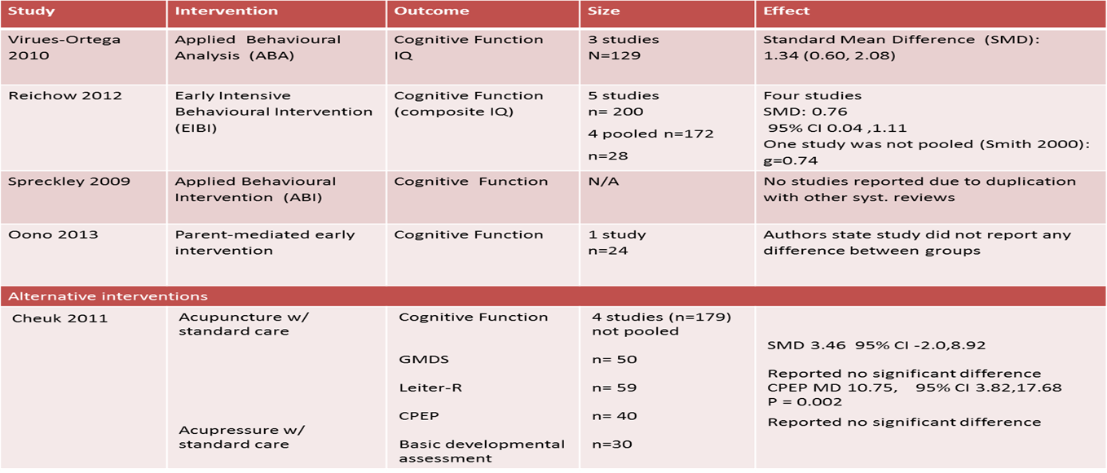
Evidence: Treatment of DD
CTFPHC also reviewed evidence from 5 systematic reviews on treatment for ASD

Slide 30
Evidence: Diagnostic Accuracy of Screening Tests¹
Commonly used screening tests were found to have inconsistent accuracy and moderate to low specificity
Ages and Stages Questionnaire (ASQ)
  n= 331 children (34 cases, 297 non-cases) aged 12 to 60 months without a documented history of DD in general primary care settings
  sensitivity 82%; specificity 78% (22% false positive rate)
  n= 565 children (13 cases) aged 18 to 42 months
  sensitivity of 62%; specificity of 84% (16% false positive rate)
Parents’ Evaluation of Developmental Status (PEDS)
  n= 331 children (34 cases, 297 non-cases) aged 12 to 60 months
  sensitivity 74%; Specificity 64% (36% false positive rate)
Nipissing District Development Screen (NDDS)
  n= 812 (31 cases)
  moderate re-test reliability (78%)
  sensitivity 29-63%; specificity 65-88% (12-35% false positive rate)
  varies based on age and cut-points used
  currently no peer reviewed studies on NDDS
  ¹ based on reports from the primary studies

Slide 31
Summary: Harms & Benefits of Screening
Lack of RCT evidence demonstrating any clinical benefits associated with screening for DD
Possible harms related to screening include:
  False positives among children without DD
  Anxiety and labelling among children without DD
  The cost of conducting unnecessary medical care (e.g., investigation, referral, treatment)

Slide 32
Summary Harms & Benefits of Treatment
Some evidence suggesting that treatment of certain types of DD is beneficial compared with no treatment
  there was no evidence that screening was necessary to obtain this benefit

Slide 33
Evidence: Contextual Questions
The systematic review was unable to locate any studies reporting on parents values, preferences or willingness to have their children screened
No evidence reporting on the cost-effectiveness and feasibility of screening for DD in children was identified in the evidence review
The evidence review did not find any studies reporting on higher burden of disease, differential performance for screening and/or treatment response for DD or barriers to implementation of screening in subgroups

Slide 34
Values and Preferences
The evidence review did not find any studies investigating the values and preferences of parents or primary caregivers about screening for Developmental Delay.

Slide 35
CTFPHC Recommendation:
Recommendation: We recommend against screening for developmental delay using standardized tools in children aged 1 to 4 years with no apparent signs of DD and whose parents and clinicians have no concerns about development
Strong recommendation; low quality evidence
This recommendation applies to children* aged 1 to 4 years with no apparent signs of DD and whose parents or clinicians have no concerns about development.
  *These are children whose age-appropriate developmental milestones have been sequentially acquired for gross and fine motor, social/emotional, language, and cognitive domains. Milestone ages should be based on the oldest age by which the skill should have been achieved.
This recommendation does not apply to children who present with signs, symptoms, or parental concern that could indicate developmental delay; or whose development is being closely monitored because of identified risk factors such as premature birth or low birth weight.

Slide 36
Basis for the recommendation
No evidence from RCTs that screening children for developmental delay improves health outcomes
No evidence that screening tools would consistently identify otherwise unrecognized cases
Evidence that the low specificity would lead to a high number of false positive tests
CTFPHC places a relatively higher value on the absence of evidence showing that screening is beneficial, the poor diagnostic accuracy of screening tests, the risk of false positives that could result from screening, and the potential for screening to divert resources from the treatment of children with clinically evident DD
The CTFPHC places a relatively lower value on the few relatively small studies that suggest a benefit of treating certain forms of clinically evident DD, and on the lack of evidence on harms and parents/caregivers preferences and values in relation to screening
The evidence supporting this recommendation is rated overall as low quality:
  The systematic review found low quality evidence examining the effect of screening on academic performance; and no evidence reporting on the other clinical outcomes
  A small number of moderate quality studies examining the effect of treatment on language impairment and cognition
  The review did not identify any evidence for the remaining 6 outcomes: improvement to gross and fine motor skills, adaptive functioning, incidence of mental health conditions, overall quality of life, survival, and functionality as an adult.

Slide 37
Research Gaps
High quality studies examining the benefits of screening for DD and the long-term effectiveness of treatment are lacking
Rigorous, controlled studies evaluating the effects of various treatment programs for children with known DD should be an urgent priority
Further research to needed to determine the most effective methods and tools for identifying DD

Slide 38
Comparison of Other Guidelines
Source | Recommendation
CTFPHC, 1994 | Recommended assessing developmental milestones at each visit. Recommended against the use of Denver Developmental Screening Test; Insufficient evidence to support the inclusion or exclusion of other screening instruments
Canadian Paediatric Society, 2011 | Recommends screening for DD using a standardized tool such as NDDS at 18 month well baby visit
USPSTF, 2015 | Insufficient evidence to assess the balance of benefits and harms of screening for screening for Speech & Language Delay
USPSTF, 2016 | ASD Guideline - insufficient evidence to assess the balance of benefits and harms of screening for screening for ASD
American Academy of Pediatrics, 2016 (2006) | Recommends screenings for DD using a standardized screening tool at 9, 18 and 30 month pediatric visits; screening for ASD at 18, 24 months
NICE (UK), 2011 | No guidance on developmental delay; recommends against population-based screening for autism spectrum disorder
SIGN (Scotland), 2007 | No guidance on developmental delay; population-based screening for autism spectrum disorder is not recommended.

Slide 39
IMPLEMENTATION OF RECOMMENDATIONS
Screening for Developmental Delay

Slide 40
Implementation in Practice
Clinicians should continue ongoing monitoring of development including:
  identifying risk factors for DD (e.g., low birth weight, family history of DD)
  remaining alert to any social, economic or environmental factors (e.g., maternal education, mental illness, neglect)
  talking with parents about their child’s development and eliciting any parental concerns
  being alert to signs of DD (i.e., delays in a developmental domain)
Clinicians should proceed with case finding for children they believe may be at risk of DD
Clinicians should proceed with clinical evaluation when possible signs of DD are detected in individual patients
  referring children for specialist evaluation as clinically indicated

Slide 41
Knowledge Translation Tools
The CTFPHC creates KT tools to support the implementation of guidelines into clinical practice
A clinician FAQ has been developed for the developmental delay guideline.
After the public release, these tools will be freely available for download in both French and English on the website: www.canadiantaskforce.ca

Slide 42
CONCLUSIONS
Screening for Developmental Delay

Slide 43
Key Points
CTFPHC recommends against screening for developmental delay using standardized tools in children aged 1 to 4 years with no apparent signs of DD and whose parents and clinicians have no concerns about development. Strong recommendation; low quality evidence
  No RCT evidence to suggest that population-based screening for developmental delay (DD) improves health outcomes
  No evidence that screening tools would consistently identify otherwise unrecognized cases; there is evidence that low specificity would lead to high proportion of false positive tests
  High-quality RCT evidence on treatment for known DD is lacking; A few small trials suggest that speech and language therapy may improve language impairment and that treatment of autism may improve cognitive function
Primary care providers are encouraged to continue with standard clinical practice, including the identification of risk factors for DD, being alert to signs and symptoms of DD, and eliciting any parental concerns about development
Clinicians should proceed with case finding for children they believe may be at risk of DD and clinical evaluation when possible signs of DD are detected in individual patients

Slide 44
Conclusions
The CTFPHC recommends physicians to remain vigilant in monitoring a child’s development at each clinical encounter and focus on confirming the diagnosis of DD among children in whom it is suspected
Studies examining the benefits of screening for developmental delay and the long-term effectiveness of treatment are lacking
Studies evaluating the best ways to treat children with known DD should be an urgent priority –especially given the promising findings about the potential benefits of treating diagnosed DD

Slide 45
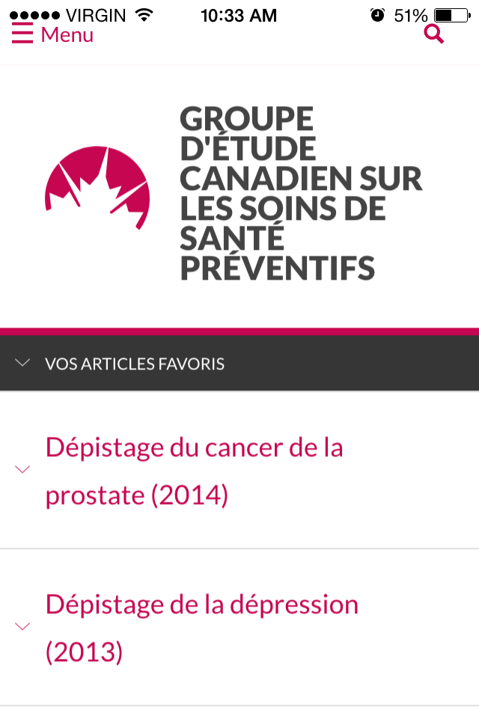
Update: CTFPHC Mobile App Now Available
The app contains guideline and recommendation summaries, knowledge translation tools, and links to additional resources.
Key features include the ability to bookmark sections for easy access, display content in either English or French, and change the font size of text.

Slide 46
More Information
For more information on the details of this guideline please see:
Canadian Task Force for Preventive Health Care website: http://canadiantaskforce.ca/?content=pcp

Slide 47
Questions & Answers
Thank you

