Slide 1
Screening for Cervical Cancer: Recommendations 2013 Canadian Task Force on Preventive Health Care Presentation for free use to disseminate Guidelines. Feb 2013
Putting Prevention into Practice
Canadian Task Force on Preventive Health Care Groupe d’étude canadien sur les soins de santé préventifs

Slide 2
CTFPHC Cervical Cancer Working Group Members
Task Force Members
Dr. James Dickinson (Chair)
Dr. Marcello Tonelli
Dr. Richard Birtwhistle
Dr. Gabriela Lewin
Dr. Michel Joffres
Dr. Elizabeth Shaw
Dr. Harminder Singh
Evidence Review and
Synthesis Centre:
Donna Fitzpatrick-Lewis*
Pan-Canadian Cervical Cancer Screening Initiative (PCCSI)
Dr. C. Meg McLachlin
Dr. Verna Mai
Public Health Agency:
Eva Tsakonas*
Dr. Sarah Connor Gorber*
*non-voting member

Slide 3
Background
This guideline (2013) updates previous CTFPHC cervical cancer screening guidelines (1994).
1994:
Much of the profession continued annual screening
<20 years | 20 to 69 years | 70+ years
Annual screening with cervical cytology following initiation of sexual activity, or at age 18 years. | After 2 normal Pap smears, screening recommended every 3 years (frequency may be increased in presence of risk factors). | Routine screening not recommended.

Slide 4
Goal of the 2013 Guideline
To provide recommendations for the prevention of cervical cancer related morbidity and mortality.
To clarify the age of screening initiation, cessation and the optimum screening interval.
To form the recommendations on an updated systematic review of the literature and the current epidemiology and diagnosis of the disease in Canada.

Slide 5
Evidence Search
Searched for studies of Cancer incidence and mortality reduction
NOT intermediate outcomes
LSIL, HSIL
CIN2, 3
HPV infection
Unclear (but high) proportion regress
Small proportion progress, unclear time scale

Slide 6
New Understanding of Cervical Cancer
Biology
Balance of harms/benefits
Canadian changes in epidemiology
Lifetime probability of Death or Incidence
 | 1952 | 1972 | 2002
Mortality | 0.94 | 0.66 | 0.22
Incidence | Not known | 1.54 | 0.66

Slide 7
Current Epidemiology of Cervical Cancer
1200
16
14
1000
Incidence
12
800
Cases of cervical cancer
10
600
8
No. of women
Rate per 100 000 women
Mortality
6
400
4
200
2
Deaths from cervical cancer
0
0
15-19
20-24
25-29
30-34
35-39
40-44
45-49
50-54
55-59
60-64
65-69
70-74
75-79
80-84
Age group (years)
Canadian Task Force on Preventive Health Care. Recommendations on screening for cervical cancer. CMAJ 2013 Jan 8; 185(1):35-45
Notes:
Note other presentation on changes in cervical cancer over time, and refs: Dickinson et al BMC Public Health 2012, and Popaduik et al JOGC 2012

Slide 8
The Natural History of HPV Infection and Cervical Cancer
Viral persistence
and progression
Normal
cervix
HPV-infected
cervix
Precancerous
lesion
Cancer
Clearance
Regression
Invasion
HPV
Precancer
Cancer
15 yrs
30 yrs
45 yrs
Pap tests
HPV vaccination
HPV test 1
HPV test 2
Adapted from Schiffman M, Castle PE. The promise of global cervical-cancer prevention. NEJM 2005; 353(20):2101-4

Slide 9
Abnormal Smears by Age: Percent (%)
 | 20-29 | 30-39 | 40-49 | 50-59 | 60-69
Abnormal | 9.8 | 4.5 | 3.5 | 2.4 | 1.6
ASC-H | 0.4 | 0.2 | 0.1 | 0.1 | 0.1
HSIL+ | 1.1 | 0.6 | 0.3 | 0.2 | 0.1
2006-2008 From Cervical Cancer Screening in Canada
Monitoring Program Performance - Report
Notes:
In Alberta about half of the women with abnormal test had a colposcopy.

Slide 10
Mortality from Invasive Cervical Cancer in Canada in Periods from 1972 to 2006
30
28
26
24
1972-1976
22
20
1977-1981
18
1982-1986
16
Rate per 100,000
1987-1991
14
12
1992-1996
10
1997-2001
8
2002-2006
6
4
2
0
15-19
20-24
25-29
30-34
35-39
40-44
45-49
50-54
55-59
60-64
65-69
70-74
75-79
80-84
Age group (years)
Notes:
Questions about what to do at the ends of the distribution, where evidence is less.

Slide 11
Different Approach to Assessment
From:
Is preventive maneuver effective?
To:
Is it a good decision for the person?
More patient-centered approach

Slide 12
Change in Approach
GRADE method
GRading of
Assessment
Development and
Evaluation system
12

Slide 13
Decision Balance
Benefits
Harms
Reduced risk of death
Complication of treatment
Reduced morbidity
Over-diagnosis
Anxiety
13

Slide 14
Emerging Evidence of Harms
Cone biopsy/treatment
Cervical incompetence: double risk
Early pregnancy loss
Premature labour
Cervical scarring: cannot dilate
Affect young >> completed families
14
Notes:
Systematic reviews: double risk
UK: Sasieni – no effect
Scarring: Inadequate evidence: not systematically collected.

Slide 15
GRADE Outcome
Strength of evidence
Based on quality of study design, implementation
Strength of effect
Consistency
External validity
How confident that evidence correctly reflects true effect of service?
THEN
Strength of recommendation
Balance of evidence for harm vs benefit
Uncertainty or variability in values and preferences
Use of resources
15

Slide 16
GRADEs of Recommendation
Strong recommendations
Most individuals in this situation would want the recommended course of action.
Most individuals should receive the intervention
Adopt as policy
Weak Recommendations
The majority of individuals in this situation would want the suggested course of action,
Different choices will be appropriate for individual patients and clinicians must help each patient arrive at a management decision
Policy-making will require substantial debate
16

Slide 17
Cervical Screening
Change in recommendations
GRADE approach
Decisions reflect continuous change in evidence with age
Strong: screen
Weak: do
Weak: do
Weak: not
Weak: not
Strong: not
17
Notes:
Continuous change in the balance of evidence with age, therefore boundaries between them are somewhat arbitrary. Not sudden change at age x.

Slide 18
RECOMMENDATIONS
Screening for Cervical Cancer

Slide 19
Considerations
These recommendations apply to women who:
are 15+ years of age;
are asymptomatic for cervical cancer; and who
are or have been sexually active.
These recommendations do not apply to women:
who do not have a cervix (due to hysterectomy) No screening needed
who have limited life expectancy such that they would not benefit from screening.
with symptoms of cervical cancer (e.g., abnormal cervical bleeding)
who are immunosuppressed (e.g., organ transplantation)

Slide 20
Summary of the recommendations
For a balance of potential benefits and harms, the CTFPHC recommends screening asymptomatic women aged 25-69 with cytology (Pap test) every 3 years.
Cytology screening is recommended (conventional or liquid-based, manual or computer-assisted).
We decided to make no recommendation on Human Papillomavirus (HPV) testing (alone or in combination with Pap).
Evidence was summarized, and recommendations made, for age groups:
<20 yrs; 20 to 24 yrs; 25 to 29 yrs; 30 to 69 yrs; 70+ yrs

Slide 21
Findings: women <20 years
Evidence of screening effectiveness
No evidence found for effectiveness in women <20 years.
Used epidemiological estimates to determine potential benefit of screening.
Incidence is very low with no deaths from cervical cancer in Canada from 2002-2006.
Therefore cannot reduce it further!
Evidence of harms of screening
No national data on prevalence of abnormal findings in this age group.
Data from AB show that 10% of women screening <20 years referred for colposcopy (potential for harms)¹.
1. Towards Optimized Practice Program. Guideline and screening for cervical cancer. http://www.topalbertadoctors.org/download/587/cervical+cancer+guideline.pdf. Updated 2011. Accessed 04/20, 2012.

Slide 22
Recommendation: women <20 years
For women aged <20 years, we recommend not routinely screening for cervical cancer (strong recommendation; high quality evidence)
This recommendation is based on:
Very low incidence of cervical cancer and no deaths due to cervical cancer
No studies addressing effectiveness in this age group; and
Evidence of minor harms to 10% of those screened
Some may develop more severe harms later:
Potential pregnancy losses subsequent to cervical treatment.
Strong recommendation reflects judgment of the CTFPHC that the potential harms outweigh the benefits.

Slide 23
Findings: women 20 to 24 years, and 25 to 29 years
Evidence of screening effectiveness
No evidence on effectiveness of screening on mortality.
UK study found incidence of cervical cancer in women up to age 30 was not affected by screening women aged 20-24¹.
No reduction in mortality in Canada among women 20-24 years since 1970s².
Evidence of harms of screening
Specificity for pre-cancer lesions lower & risk of false-positives higher for <30 years.
High incidence of minor harms³ and pregnancy-related harms.
Potential for early pregnancy loss or premature labour (after cervical treatment).
Sasieni P, Castanon A, Cuzick J. Effectiveness of cervical screening with age: population based case-control study of prospectively recorded data. British Medical Journal. 2009;339:b2968.
Canadian Cancer Registry (1992-2006) and the National Cancer Incidence Reporting System (1972-1991)
TOMBOLA (Trial of management of borderline and other low-grade abnormal smears), Sharp L, Cotton S, Cochran C, et al. After-effects reported by women following colposcopy, cervical biopsies and LLETZ: Results from the TOMBOLA trial. International Journal of Obstetrics and Gynaecology. 2009;116:1506.

Slide 24
Recommendation: women 20 to 24 years
For women aged 20 to 24 we recommend not routinely screening for cervical cancer (Weak recommendation; moderate quality evidence)
This recommendation is based on:
low incidence and mortality of cervical cancer among this age group;
uncertain benefit of screening among this age group;
lack of benefit found in older ages from screening at this age;
higher risk of false positive tests (and associated harms) among women <30 compared to older women.
The CTFPHC conclude that the harms outweigh the benefits, but assign a weak recommendation given the uncertainty of the evidence.

Slide 25
Recommendation: women 25 to 29 years
For women aged 25 to 29 we recommend routine screening for cervical cancer every 3 years. (Weak recommendation; moderate quality evidence)
This recommendation is based on:
higher incidence and mortality of cervical cancer in this age group;
however, the limitations to Pap testing are similar to those among 20-24 year olds
Weak recommendation reflects concerns about:
the rate of false positives; and
the harms of overtreatment

Slide 26
Findings: women 30 to 69 years
Evidence of screening effectiveness
Strong association between introduction of screening and reduced incidence of cervical cancer (cohort studies).
RCT in rural India showed that 1-time screening found non-significant impact on 8-year mortality and incidence (external validity?).
Screening associated with decrease in incidence (cohort study, 3-yr follow-up).
Odds of having 1+ Pap tests were lower among women with invasive cancer (meta-analysis of 12 case-control studies).
Evidence of harms of screening
Abnormal findings and high grade lesions declined with age¹.
Rate of biopsy/treatment decrease with age.
Pregnancy-related harms become less important.
1. Canadian Partnership Against Cancer. Cervical cancer screening in Canada monitoring program performance - report 2006-2008. 2011.

Slide 27
Recommendations: women 30 to 69 years
For women aged 30 to 69 we recommend routine screening for cervical cancer every 3 years. (Strong recommendation; high quality evidence)
This recommendation is based on:
evidence for the positive effect of screening;
higher cervical cancer incidence and mortality in this age group; and
lower rates of potential harms, compared to younger women.
Strong recommendation based on the CTFPHC’s confidence that desirable effects of screening outweigh the undesirable effects.

Slide 28
Findings: women 70+ years
Evidence of screening effectiveness
Limited evidence re: when to stop screening.
Limited evidence suggests protective effect of screening in women 70+^{1,2}
Mortality and incidence rates of cervical cancer remain high in this age group (Canada).
Possible benefit in screening if not adequately screened previously.
1. Andrae B, Kemetli L, Sparén P, et al. Screening-preventable cervical cancer risks: Evidence from a nationwide audit in Sweden. Journal of the National Cancer Institute. 2008;100:622.
2. Hoffman M, Cooper D, Carrara H, et al. Limited pap screening associated with reduced risk of cervical cancer in South Africa. International Journal of Epidemiology. 2003;32:573.

Slide 29
Recommendations: women 70+ years
For women aged ≥70 adequately screened (i.e. 3 successive negative Pap tests in last 10 years), we recommend that routine screening may cease. (Weak recommendation: low quality evidence)
Recommendation based on:
Limited evidence that screening up to this age prevents cervical cancer development therafter; fewer harms in this age range, but speculum exam may be uncomfortable/difficult.
For women aged ≥70 not adequately screened, we recommend continued screening until 3 negative test results have been obtained. (Weak recommendation: low quality evidence)
Recommendation places high value on:
Limited evidence for screening effectiveness; and potential to detect and treat cervical cancer in this age group

Slide 30
Recommended screening interval: 3 years
Screening intervals ≤5 years offer protection
13 case-control, 2 cohort studies
Greater benefit seen in shorter intervals in some of the studies.
CTFPHC recommends 3 year interval;
balances potential for benefit from smaller intervals, with
greater potential for harm from more frequent screening
Most countries outside North America use 3-5 year intervals

Slide 31
Protective efficacy by duration since last smear
Age 20-39 years
Age 40-54 years
Age 55-69 years
5.0
5.0
5.0
2.0
2.0
2.0
1.0
1.0
1.0
Relative risk
0.5
0.5
0.5
0.2
0.2
0.2
0.1
0.1
0.1
0
1
2
3
4
5
6
0
1
2
3
4
5
6
0
1
2
3
4
5
6
Years since last negative smear
Years since last negative smear
Years since last negative smear
Sasieni P, Adams J and Cuzick J. Br J Cancer. 2003 Jul 7;89(1):88-93
31

Slide 32
Summary of the recommendations (1)
Cytology (conventional or liquid-based, manual or computer-assisted)
For women aged <20, we recommend not routinely screening for cervical cancer (Strong recommendation; high quality evidence)
For women aged 20 to 24, we recommend not routinely screening for cervical cancer (Weak recommendation; moderate quality evidence)
For women aged 25 to 29, we recommend routine screening for cervical cancer every 3 years. (Weak recommendation; moderate quality evidence)

Slide 33
Summary of the recommendations (2)
For women aged 30 to 69, we recommend routine screening for cervical cancer every 3 years. (Strong recommendation; high quality evidence)
For women aged ≥70 who have been adequately screened (i.e. 3 successive negative Pap tests in the last 10 years), we recommend that routine screening may cease. For women aged 70 or over who have not been adequately screened, we recommend continued screening until 3 negative test results have been obtained. (Weak recommendation; low quality evidence)

Slide 34
Special risk groups?
Many suggested high risk groups
Start sexual activity young
Multiple partners
Aboriginal
Attending STI clinics
Minimal evidence: no specific recommendations
Women sex with women
Limited evidence that they are at risk

Slide 35
Duration from onset of sexual activity
NO evidence
Notes:
It would be good to be able to say: it takes at least 5, 10… years to develop invasive cancer, so start screening 2 years before that.
Need for research for new evidence.

Slide 36
“Jade Goody” effect
Starting screening early?
Rapidly advancing cancer among young women
Screening works for chronic, common disease
Must be treatable: criteria for screening
Little effect for patients under 25:
Rapidly advancing but rare
Adenocarcinoma: unclear whether increasing
36
Notes:
UK reality show star. Developed and died of cervical cancer at age 27.
Had ignored call for return to treat abnormality.
Led to increase in screening rates for young women, and calls for screening policy to change to include 20-24. Policy was reviewed but not changed.
Some cancer advance too rapidly for screening or treatment to be effective. No point in causing harm to many for slim possibility of helping a few.

Slide 37
Response to anecdotes re young women
Women whose “lives were saved” by a pap test in teenage or young 20s
Cancer very rare at these ages, but possible
Majority likely to have been high grade abnormalities, not cancer
Most would have regressed if left alone:
“HPV infection defeated by immune system”
High grade abnormality rate much higher than lifetime cancer risk
Small, if any, preventive effect for young
Some rapidly advancing cancers:
screening and treatment ineffective
Balance of very small benefit against harms of treatment
GRADE approach recognizes different opinions about balance
Notes:
Doctors need to know how to respond to anecdotes in newspaper, or from their patients who had or know someone who had treatment that “saved their life” This is possible by given the number of such stories, unlikely. Many misunderstandings about treatmentneed for and effectiveness of HSIL or CIN

Slide 38
“Yes but…” questions. What about: Chlamydia screening? Vaginal examinations? Teaching annual physicals?
Chlamydia screening by urine testing
Vaginal exams poor screening test for ovarian, uterine cancer
Should not do annual physicals:
periodic health assessment
Notes:
Those who are reluctant to stop often suggest that women need to come in annually to have other services.
This may be true for some, but annual speculum exams are not needed.

Slide 39
WHAT ABOUT HPV TESTING?
Screening for Cervical Cancer

Slide 40
The CTFPHC Position on HPV Testing
Search for studies showing lower incidence/mortality of cancer
The CTFPHC felt it premature to make a recommendation on HPV testing alone (primary testing), or in combination with cytology (co-testing or as a secondary reflex triage test).
Canadian Partnership Against Cancer (CPAC):
HPV Testing for Cervical Cancer Screening
Expert panel: summary of evidence
29 March 2012
Summarized that the evidence is still unclear and to proceed cautiously
Notes:
Controversial component of recommendations.
Much of difference compared to others is review focusing on incidence and mortality, not intermediate outcomes.
Most HPV studies do not have enough numbers or duration to detect reduction of cancer incidence. This will change

Slide 41
HPV testing: Canada
Ontario
Primary HPV screening is recommended and implementation is being considered.
May 2012 cervical screening guideline, initiated by the Ontario Cervical Screening Program in conjunction with the Program in Evidence-based Care, an initiative of Cancer Care Ontario.
For the interim, cytology recommendations are in place including an additional HPV testing (triage) as an optional test for women 30 years and older with certain abnormal Pap test results.
Alberta, Quebec and NWT recommend triage testing

Slide 42
HPV testing: International
Australia and Scotland: No recommendation on HPV testing
US Task Force on Preventive Health Care (USPSTF)
For women ages 30 to 65 years who want to lengthen the screening interval, screening with a combination of cytology and human papillomavirus (HPV) testing every 5 years (co-testing with Pap)
Needs further evaluation in long-term trials
Whitlock et al. Ann Int Med 2011; 155:687-97
England: Triage testing for 25 years and older.
Netherlands: recommendation for primary HPV testing, but as a triage test if cytology is used.

Slide 43
Considerations for implementation of recommendations (1)
Emphasis should be placed on strong vs. weak recommendations
Women who:
place relatively higher value on avoiding cervical cancer
and
relatively lower value on potential harms/benefits
Are more likely to choose screening
There should be increased/decreased screening by risk profile.
Values, preferences and beliefs
Should be discussed in context of potential benefits/harms of screening process
Clinicians should help patient make a decision consistent with her values, preferences and risk exposure

Slide 44
Considerations for implementation of recommendations (2)
Current recommendations vary by P/T. Most currently begin screening at age 21, cease at age 70, and have a 1-3 year screening interval.
Some P/T have recently updated their guidelines
Some P/T make recommendations on HPV testing

Slide 45
GUIDELINE COMPARISON: International
Screening for Cervical Cancer

Slide 46
CTFPHC vs. International Guidelines (1)
Organization | <20 years | 20-24 years | 25-29 years | 30-69 years | 70+ years | HPV testing*
Task Force 2012 Canada* | Recommend against routine screening | Recommend against routine screening | Recommend routine screening every three years with cervical cytology | Recommend routine screening every three years with cervical cytology | Recommend routine screening every three years with cervical cytology if inadequately screened. Otherwise screening may cease. | No recommendation made. Will revisit the issue of HPV testing as new data becomes available.
Previous Task Force (1994) Canada | Annual screening with cervical cytology following initiation of sexual activity or at age 18 | After 2 normal Pap tests, screening then recommended every three years to age 69. Frequency of screening may be increased in the presence of risk factors |  |  | Screening not recommended | Not applicable
USPSTF 2012 United States | Recommend against routine screening under the age of 21 | Recommend against routine screening under the age of 21 Recommend screening for cervical cancer in women ages 21 to 65 years with Pap test every 3 years Recommend against screening for cervical cancer in women older than age 65 years who have had adequate prior screening and are not otherwise at high risk for cervical cancer |  |  | Recommend against screening for cervical cancer in women older than age 65 years who have had adequate prior screening and are not otherwise at high risk for cervical cancer | For women ages 30 to 65 years who want to lengthen the screening interval, screening with a combination of cytology and human papillomavirus (HPV) testing every 5 years (co-testing)
* Recommendations for primary (HPV testing alone), co-testing (with Pap test), or triage/reflex testing (after abnormal Pap test) were considered

Slide 47
CTFPHC vs. International Guidelines (2)
Organization | <20 years | 20-24 years | 25-29 years |  | 30-69 years | 70+ years | HPV testing*
Australian Government Australia (May 2011) | First Pap test around age 18 to 20, or a year or two after first having sex, whichever is the later | Regular Pap tests recommended every two years |  |  |  | Practitioner may advise that it is safe to stop having Pap tests if previous tests have been normal | No recommendation made
NHS Cervical Screening Program England (August 2011) | Not invited to screen | Not invited to screen | Women aged 25-49 invited to screen every three years with cervical cytology Women aged 50-64 invited to screen every 5 years with cervical cytology Women aged 65+ screened only if not screened since age 50 or have had recent abnormal tests |  |  | Women aged 65+ screened only if not screened since age 50 or have had recent abnormal tests | Additional (triage) HPV testing is recommended for women 25 years and older with abnormal Pap test results in some circumstances
Health Council of the Netherlands Netherlands (May 2011) | Not invited to screen | Not invited to screen | Not invited to screen | Women aged 30-40 invited to screen every 5 years. Women aged 50-60 invited to screen every 10 years. (Women would be tested at the ages of 30, 35, 40, 50 and 60) |  | Not invited to screen | Recommendation that HPV testing should replace cytology as the primary screening method. If cytology testing, additional (triage) HPV testing is recommended for women 30 years and older with abnormal Pap test results in some circumstances
* Recommendations for primary (HPV testing alone), co-testing (with Pap test), or triage/reflex testing (after abnormal Pap test) were considered

Slide 48
CTFPHC vs. International Guidelines (3)
Organization | <20 years | 20-24 years | 25-29 years | 30-69 years | 70+ years | HPV testing*
National Cancer Screening Service Ireland (2011) | Not invited to screen | Not invited to screen | Women aged 25 to 44 invited to screen every 3 years. Women aged 45 to 60 invited every 5 years. Regardless of the age of a woman when she has her first screen, she needs to have two normal results - 3 years apart, before moving to a 5 year screening interval. |  | Not invited to screen | No recommendation made
NHS Scotland Scotland (2010) | Not invited to screen | Women aged 20 – 60 invited to screen every 3 years. |  |  | Not invited to screen | No recommendation made
*Recommendations for primary (HPV testing alone), co-testing (with Pap test), or triage/reflex testing (after abnormal Pap test) were considered

Slide 49
CONCLUSIONS
Screening for Cervical Cancer

Slide 50
Conclusions
This guideline encourages practitioners to help women understand the potential benefits and harms of cervical cancer screening and make informed decisions in collaboration with their health practitioner.
Recommendations are in line with those of several other countries.
The greatest reduction in cervical cancer will be achieved by screening eligible women who have not been previously screened, not by screening women earlier or more often.

Slide 51
Providers role
Must understand guidelines and reasons behind
Must explain to patients, especially controversies
Controversial components:
When to start
Interval
Stopping
Help women to make their own decisions
Provide service, and assist reminder process
Promote service to underserved groups
Where greatest gains possible
Notes:
Note: GRADE emphasizes that not fixed rules, but women can make own choices around when to start and stop.
Provincial registers will assist publicity, recall/reminders. Medical practices need to ensure recall/reminder

Slide 53
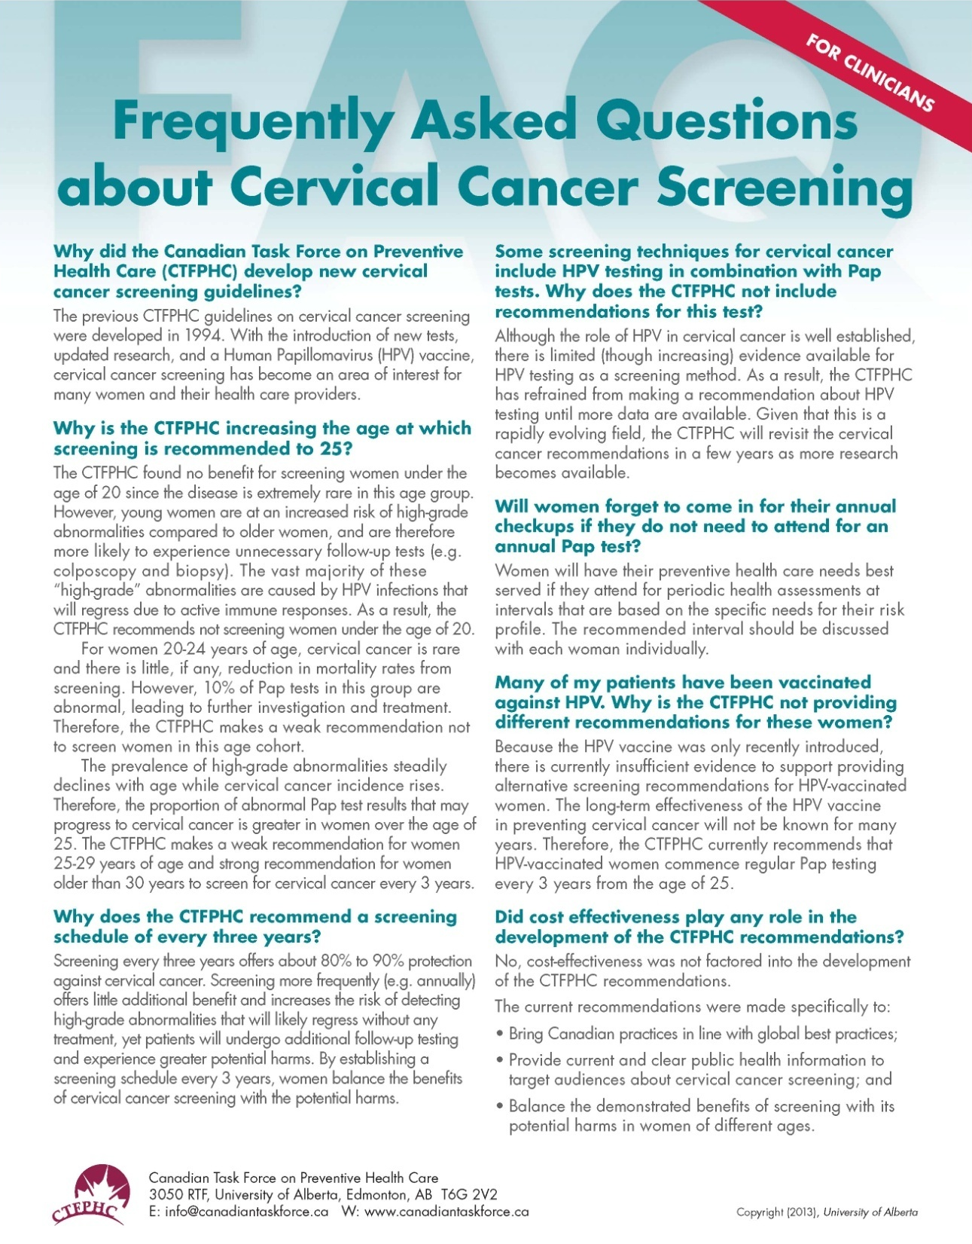

Slide 54
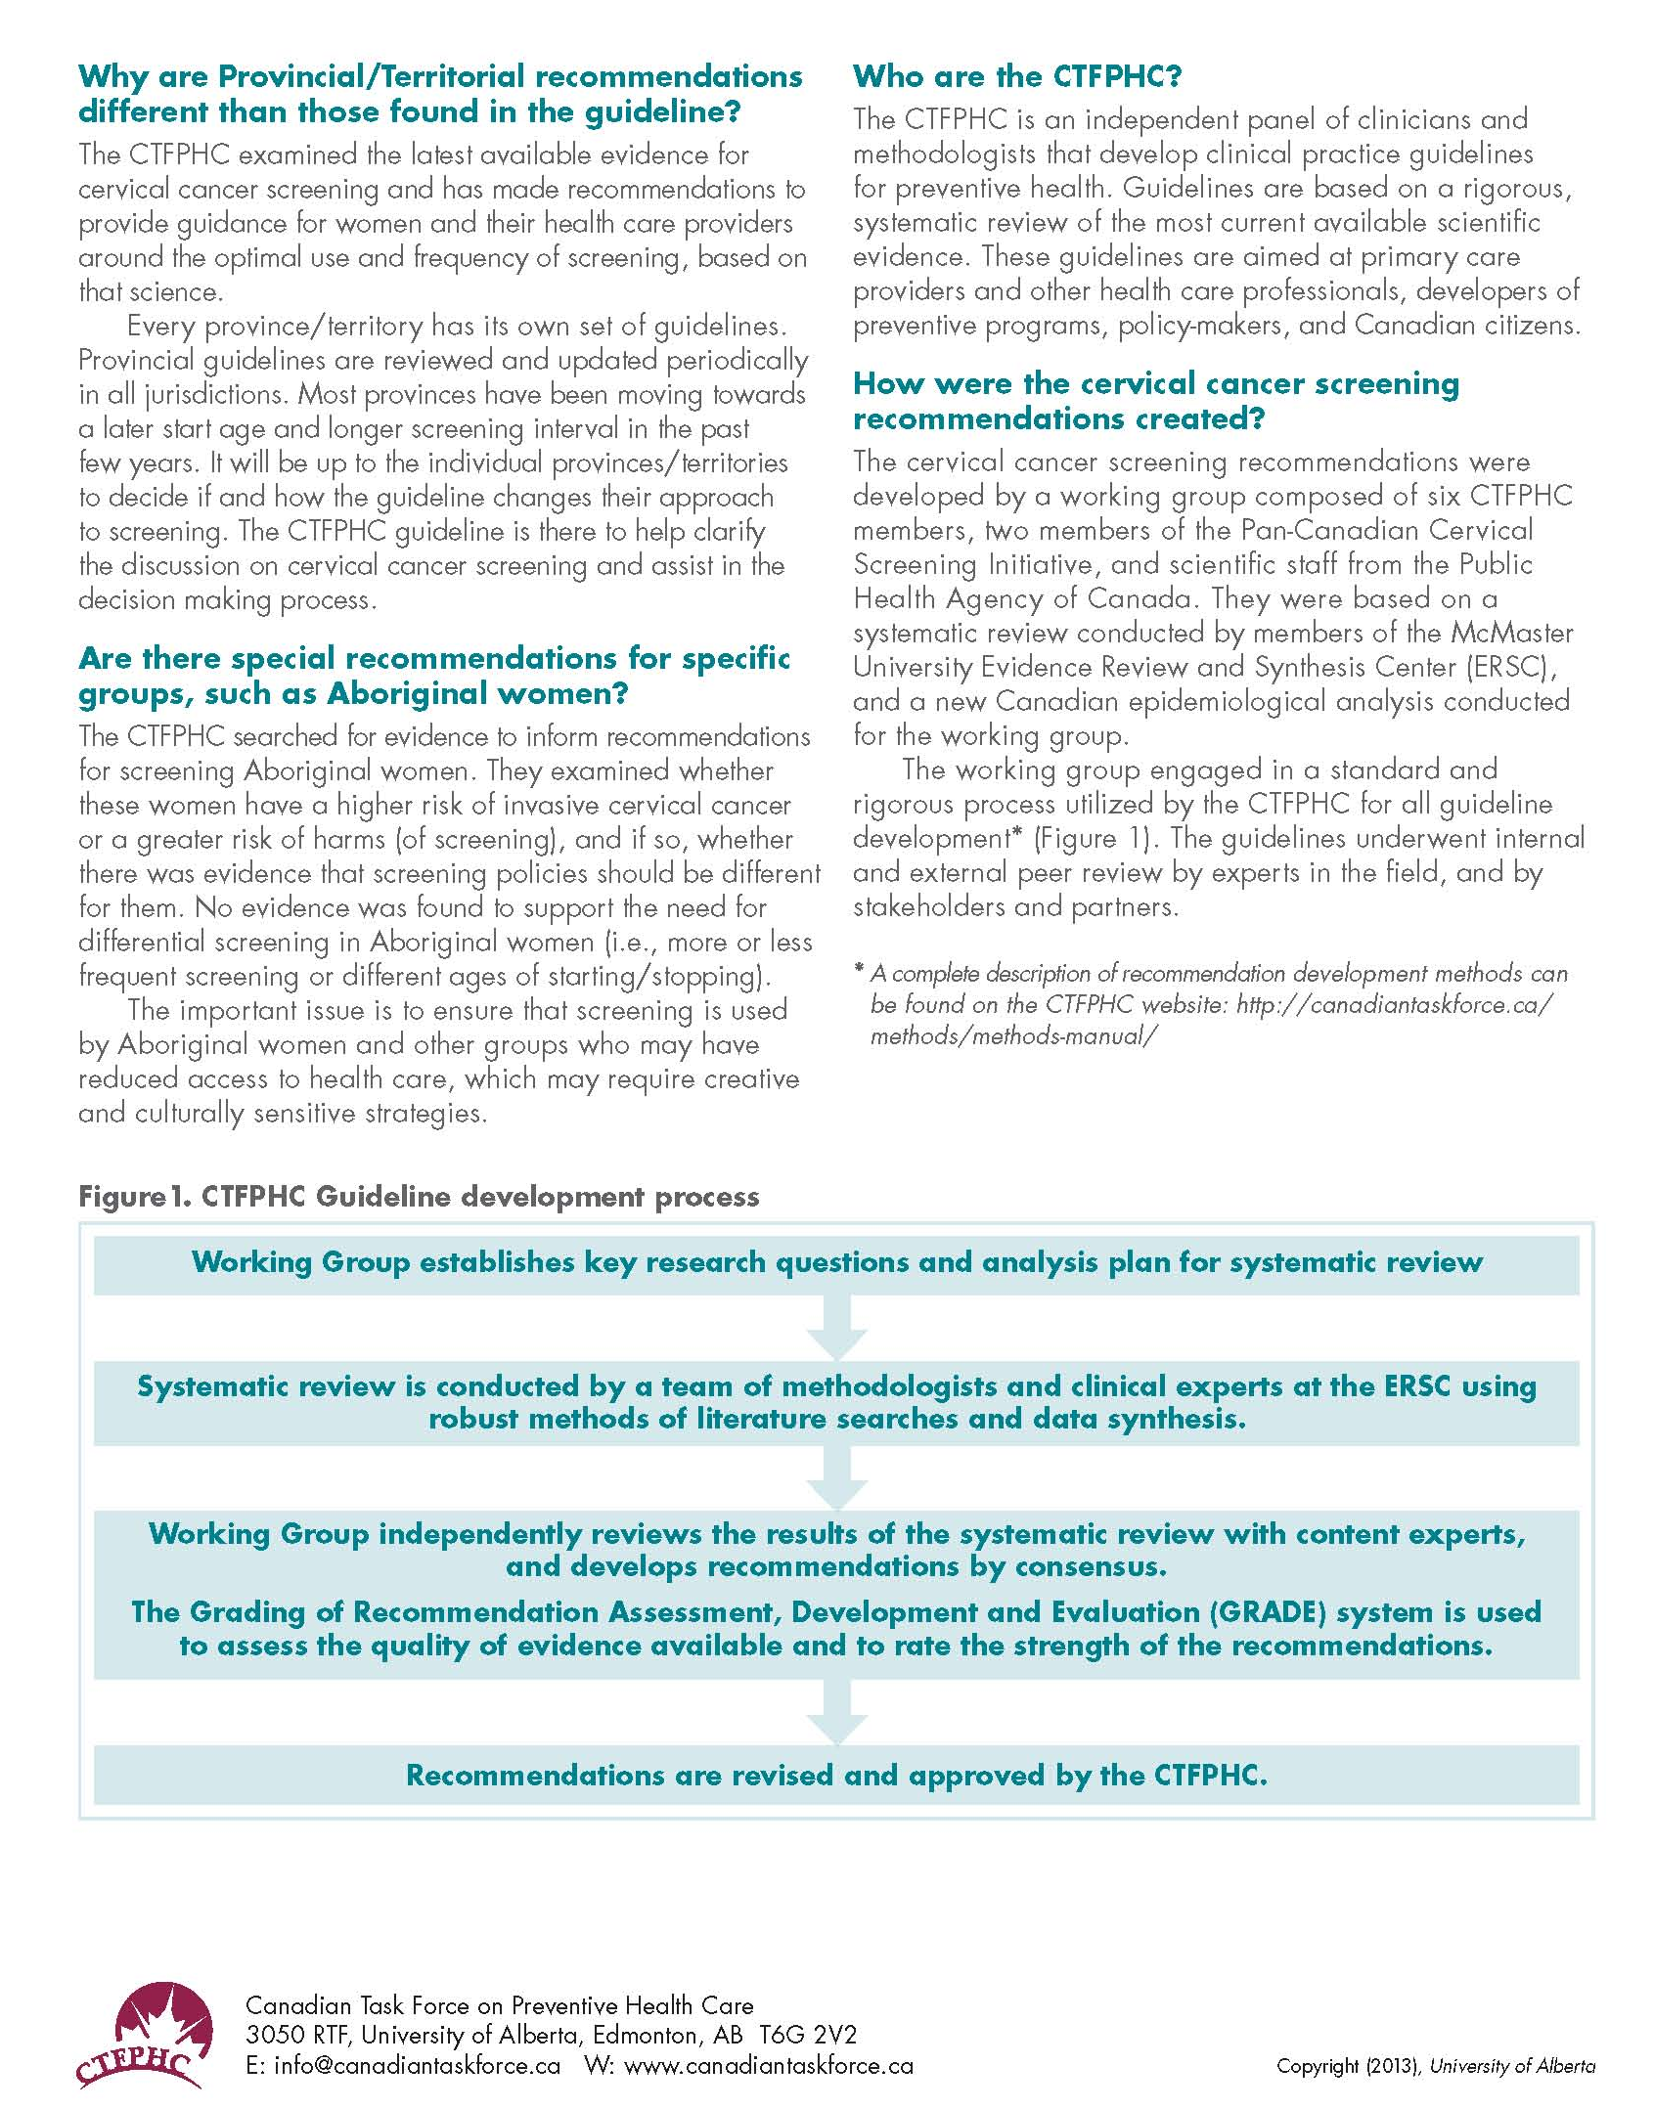

Slide 57
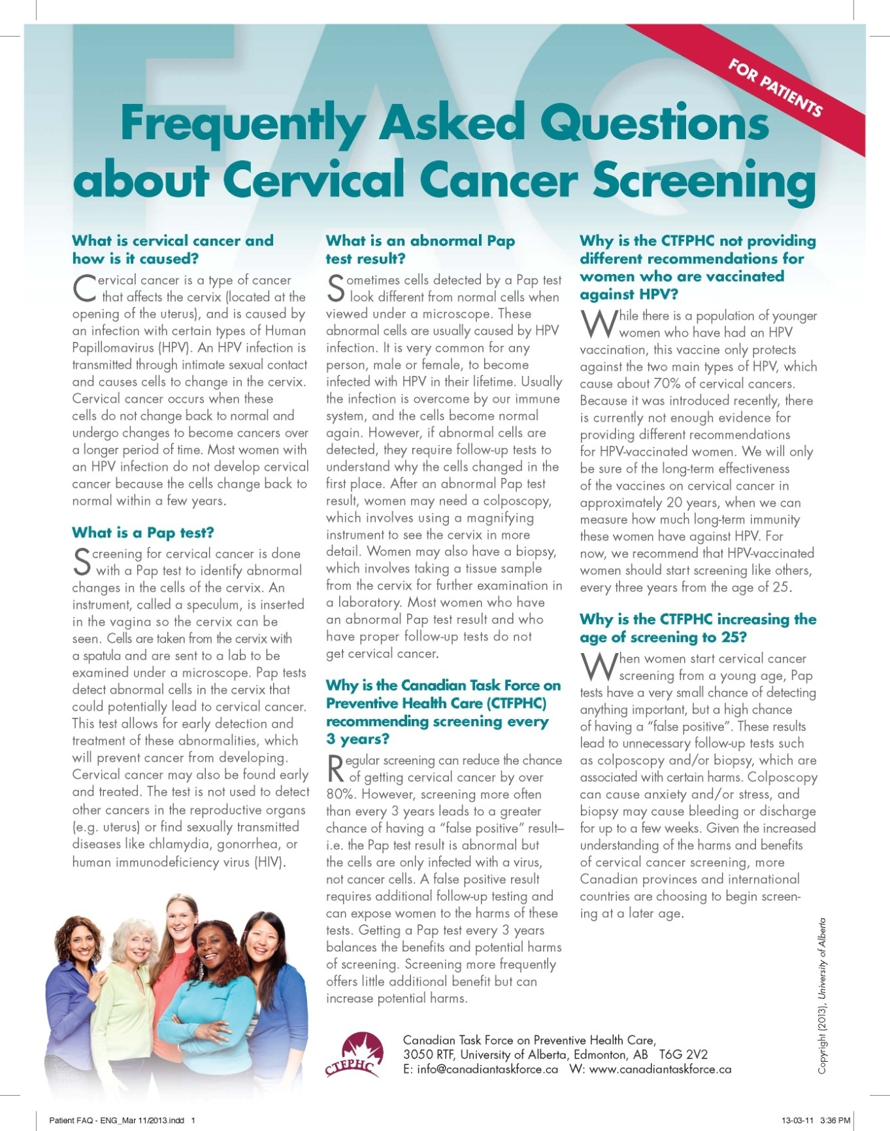

Slide 58
Questions & Answers

Slide 59
Extra Slides

Slide 60
GUIDELINE & PROGRAM COMPARISON: Canada
Screening for Cervical Cancer

Slide 61
CTFPHC vs Provincial/Territorial Programs (1)
Organization | <20 years | 20-24 years | 25-29 years | 30-69 years | 70+ years | HPV Testing* | Differences Task Force vs P/T
CTFPHC 2012 Canada* | Recommend against routine screening | Recommend against routine screening | Recommend routine screening every 3 years | Recommend routine screening every 3 years | Recommend routine screening every 3 years if there was no previous screening. Otherwise stop screening. | No recommendation made
British Columbia (June 2010 guideline) | Initiation of routine screening recommended 3 years after first sexual contact | Recommend initiation of routine screening at age 21. Women not sexually active by age 21 should delay screening until sexually active. Screen every 12 months until there are 3 consecutive negative results, then screen every 24 months. |  |  | Discontinue if 3 negative tests in past 10 years. If inadequately screened – conduct 3 annual pap tests. If results are negative screening may stop. | No recommendation made. Randomized control trial began in 2007 to evaluate HPV testing as primary screening tool (FOCAL study). | Screening start: BC - 3 yrs after first sexual contact, or age 21 CTFPHC – at age 25 How often to screen: BC - annually for first 3 years. If tests are normal, then every 2 years. CTFPHC - every 3 yrs Screening cessation: No difference
Draft tables: Pending review by provincial/territorial representatives on the Pan-Canadian Cervical Screening Initiative (partner in the Task Force cervical cancer screening guideline).
*Recommendations for primary (HPV testing alone), co-testing (with Pap test), or triage/reflex testing (after abnormal Pap test) were considered

Slide 62
CTFPHC vs Provincial/Territorial Programs (2)
Organization | <20 years | 20-24 years | 25-29 years | 30-69 years | 70+ years | HPV Testing* | Differences Task Force vs P/T
Alberta (November 2011guideline) | Do not recommend routine screening | Recommend initiation of routine screening at age 21 or 3 years after first intimate sexual activity, whichever occurs later. Within 5 years screen with 3 negative Pap tests at least 12 months apart then extend screening interval to every 3 years. |  |  | Women who have never been screened, screen with 3 annual Pap tests. If results are negative and satisfactory, discontinue screening. If last 3 tests done within the past 10 years were normal, discontinue screening. | Additional (triage) HPV testing is recommended for women 30 years and older with abnormal Pap test results in some circumstances. | Screening start: AB – at age 21 CTFPHC – at age 25 yrs How often to screen: AB - 3 normal results within 5 years then every 3 yrs CTFPHC - every 3 years Screening cessation: No difference.
Saskatchewan (January 2012 guideline) | Do not recommend routine screening | Recommend initiation of routine screening at age 21 or 3 years after first intimate sexual activity, whichever occurs later. Screen every 2 years until 3 consecutive normal results then extend screening to every 3 years. |  |  | Women who have never been screened, screen with 3 annual Pap tests. If results are negative and satisfactory, discontinue screening. If last 3 tests done within the past 10 years were normal, discontinue screening. | No recommendation made | Screening start: SK – at age 21 CTFPHC – at age 25 yrs How often to screen: SK - every 2 yrs until 3 normal then every 3 yrs CTFPHC - every 3 years Screening cessation: No difference
Draft tables: Pending review by provincial/territorial representatives on the Pan-Canadian Cervical Screening Initiative (partner in the Task Force cervical cancer screening guideline).
*Recommendations for primary (HPV testing alone), co-testing (with Pap test), or triage/reflex testing (after abnormal Pap test) were considered

Slide 63
CTFPHC vs Provincial/Territorial Programs (3)
Organization | <20 years | 20-24 years | 25-29 years | 30-69 years | 70+ years | HPV Testing* | Differences Task Force vs P/T
Manitoba (May 2012 guideline) | Recommend screening initiated 3 years after onset of sexual activity regardless of age. Screen every 2 years. |  |  |  | Cessation of screening at age 70 with history of 3 negative pap test results within the previous 10 years and no change in partner. | No recommendation made | Screening start: MB - 3 yrs after first sexual contact CTFPHC - age 25 How often to screen: MB - every 2 yrs CTFPHC - every 3 years Screening cessation: No differences
Ontario (May 2012 guideline) | Do not recommend routine screening | Recommend initiation of routine screening at age 21. Screen every 3 years. |  |  | Cessation of screening at age 70 with history of 3 negative pap test results within the previous 10 years. | Additional HPV testing (triage) is an optional test for women 30 years and older with abnormal Pap test results in some circumstances. Primary HPV screening with cytology triage is recommended and implementation is being considered. | Screening start: ON – at age 21 CTFPHC – at age 25 yrs How often to screen: No differences Screening cessation: No differences

Slide 64
CTFPHC vs Provincial/Territorial Programs (4)
Organization | <20 years | 20-24 years | 25-29 years | 30-69 years | 70+ years | HPV Testing* | Differences Task Force vs P/T
New Brunswick (June 2011 guideline) | Do not recommend routine screening | Recommend initiation of routine screening at age 21 or 3 years after first intimate sexual activity, whichever occurs later. Screen annually until there are 3 consecutive negative results, then screen every 24 - 36 months. |  |  | Cessation of screening at age 70 with history of adequate negative pap test results history in the previous 10 years. Women who have never been screened, screen with 3 annual Pap tests. If results are negative and satisfactory, discontinue screening. | Where available, additional HPV testing (triage) is an optional test for women 30 years and older with abnormal Pap test results in some circumstances. Recognize role of HPV testing, but advise evidence is still not strong enough to recommend it as the optimal primary screening tool. | Screening start: NB – at age 21 CTFPHC – at age 25 yrs How often to screen: NB - annually until 3 normal then every 3 yrs CTFPHC - every 3 yrs Screening cessation: NB - cease if adequate normal test results in past 10 years. CTFPHC – screen every 3 yrs until 3 normal pap tests then stop screening
Quebec (June 2011 guideline) | Do not recommend routine screening | Recommend initiation of routine screening at age 21. Screening is recommended every 2 to 3 years. |  |  | Among women who have had screening tests regularly, screening may cease at the age of 65 if the results of the last 2 tests conducted in the previous 10 years were negative. | Additional (triage) HPV testing is recommended for women 30 years and older with abnormal Pap test results in some circumstances. | Screening start: QC – at age 21 CTFPHC – at age 25 yrs How often to screen: QC: every 2-3 years CTFPHC: every 3 years Screening cessation: QC - Stop screening at age 65 yrs CTFPHC – stop screening at 70 yrs

Slide 65
CTFPHC vs Provincial/Territorial Programs (5)
Organization | <20 years | 20-24 years | 25-29 years | 30-69 years | 70+ years | HPV Testing* | Differences Task Force vs P/T
Nova Scotia (2009 guideline) | Do not recommend routine screening | Cervical cytology screening should be initiated within 3 years of first vaginal sexual activity or at age 21. Screen every 12 months until there are 3 consecutive negative results, then screen every 2 years. |  |  | Screening may be discontinued after the age of 75 ONLY if there is an adequate negative screening history in the previous ten years (i.e. 3 or more negative tests). | No recommendation made | Screening start: NS - 3 yrs after first sexual contact CTFPHC - age 25 How often to screen: NS - annually until 3 normal then every 2 yrs CTFPHC - every 3 yrs Screening cessation: NS - Stop screening at age 75 yrs CTFPHC – stop screening at 70 yrs
Prince Edward Island (current Health PEI website) Guidelines to be reviewed in 2013 | Recommend initiation of routine screening at age 18 or as soon as sexually active. Screen every 2 years until age 69 years. |  |  |  | Screening may be discontinued at age 70 years. | No recommendation made | Screening start: PE – 18 years CTFPHC - age 25 How often to screen: PE – every 2 yrs CTFPHC - every 3 yrs Screening Cessation: PE – discontinued at 70 years. CTFPHC – discontinued at 70 years if 3 negative tests in past 10 years.

Slide 66
CTFPHC vs Provincial/Territorial Programs (6)
Organization | <20 years | 20-24 years | 25-29 years | 30-69 years | 70+ years | HPV Testing* | Differences Task Force vs P/T
Newfoundland and Labrador (2011 guideline) | Do not recommend routine screening | Recommend initiation of routine screening at age 20, with annual screening until 3 consecutive negative Pap tests are obtained. Then extend interval to 3 years. |  |  | Screening may discontinue if there are 3 negative Pap tests within last 10 years. Women with little/no screening history should have 3 consecutive normal tests before cessation. | Additional (triage) HPV testing is recommended for women 30 years and older with abnormal Pap test results in some circumstances. | Screening start: NL – 20 years CTFPHC - age 25 How often to screen: NL – annual, then every 3 years CTFPHC - every 3 yrs Screening Cessation: No difference
Northwest Territories (March 2010 guideline) | Recommend initiation of routine screening 3 years after start of intimate sexual activity, or at age 21 years, whichever is earlier. Screen every 1 to 2 years (frequency depends on previous test results). |  |  |  | Women age 69 and older should cease screening if 3 or more normal smears in the last ten years. | In some circumstances, when there is an abnormal Pap test result, an additional HPV test is recommended for women 21-29 years (co-testing with additional Pap test), and for women 30 years and older (triage). | Screening start: NT – 3 years after first sexual activity, or age 21 (whichever is first). CTFPHC - age 25 How often to screen: NT – every 1-2 years CTFPHC - every 3 yrs Screening Cessation: NT – stop screening at 69 years CTFPHC – stop screening at 70 years
Yukon Territory | No guidelines found. The Pan-Canadian Cervical Cancer Screening Initiative “Cervical Cancer Screening in Canada—Monitoring and Program Performance” report (December 2011) notes the Yukon follows BC guidelines.
Nunavut | No guidelines found.

