Slide 1
Screening for impaired vision in community-dwelling adults aged 65 years and older in primary care settings (2018)
Canadian Task Force on Preventive Health Care (CTFPHC)

Slide 2
Use of Slide Deck
These slides are made available publicly following the guideline’s release as an educational support to assist with the dissemination, uptake and implementation of the guidelines into primary care practice
Some or all of the slides in this slide deck may be used in educational contexts

Slide 3
Canadian Task Force on Preventive Health Care (CTFPHC)
Task Force Members:
Brenda J. Wilson
Maria Bacchus
James A Dickinson
Scott Klarenbach
Brett D. Thombs
Public Health Agency:
Susan Courage *
Nicki Sims-Jones *
Alejandra Jaramillo *
Alberta Evidence Review and
Synthesis Centre:
Lisa Hartling*
Jennifer Pillay*
Tara MacGregor*
Robin Featherstone*
Ben Vandermeer*
Knowledge Translation Program, Li Ka Shing Knowledge Institute, St. Michael’s Hospital
*non-voting member

Slide 4
Overview of Webinar
Presentation
Background on Screening for impaired vision in community-dwelling adults aged 65 years and older
Methods of the CTFPHC
Key Findings
Recommendations
Implementation Considerations
Conclusions
Questions and Answers

Slide 5
BACKGROUND
Screening for impaired vision in community-dwelling adults aged 65 years and older in primary care settings

Slide 6
Background
13% of Canadians aged 75 years and older had a “seeing limitation”, 31% described as severe, compared with 0.5% of those aged 15 to 24 years, with 17% described as severe
The proportion of adults with vision impairment is expected to double in Canada by 2032 as the population ages
Impaired vision can have a negative impact on vision-related functioning and quality of life, which may be manifested by decreased participation in social, work or leisure activities as well as difficulty in family relationships, symptoms of depression, injuries from accidents including falls, or the loss of driving privilege
Comprehensive eye examinations for adults 65 years of age and older are covered by most provincial governments across Canada
Notes:
Brenda’s notes:
A key goal in healthy ageing is staying active and engaged for as long as possible. This means sustaining independence and preventing avoidable disability and decline in function.
This leads to an argument that we should be proactive in screening older people for physical or sensory impairments which might be amenable to improvement
One such area is vision. The evidence suggests that older people with impaired vision are at higher risk of fall-related injuries and social isolation (longer list of negatives)
There are many possible causes for impaired vision, many of which are amenable to improvement. The simplest causes are refractive errors, for which corrective lenses can be prescribed. While not all other causes are treatable, many are, especially if detected in the early stages. While optometrists are the primary eye care practitioners responsible for vision screening, it is up to individuals themselves to arrange for regular screening and/or consult them if they suspect visual problems.
It is possible that some people with impaired vision don’t realize they have a problem. Others may be aware of deteriorating vision but have not arranged screening through choice or because of barriers. This provides a rationale for considering whether there is a role for systematic screening for visual impairment in primary health care settings, to detect individuals who might benefit from referral to eye care practitioners for formal vision testing.

Slide 7
Guideline Scope
This guideline presents evidence-based recommendations on the prevention of vision-related functional limitations for community-dwelling adults aged 65 years and older by screening them for impaired vision in primary care settings such as physicians’ offices or clinics.
Updates the previous 1995 “Canadian Task Force on the Periodic Health Exam” guideline on vision screening, which made a grade B recommendation in support of screening for visual impairment in elderly patients with diabetes of at least 5 years’ duration
Notes:
It’s important to distinguish between formal vision testing, which is within the scope of practice of optometrists and other eye care professionals, and screening for potentially impaired vision, which is what this guideline was about.

Slide 8
METHODS
Screening for impaired vision in community-dwelling adults aged 65 years and older in primary care settings

Slide 9
Methods of the CTFPHC
Independent panel of:
Clinicians and methodologists
Expertise in prevention, primary care, literature synthesis, and critical appraisal
Application of evidence to practice and policy
Working Group
4 CTFPHC members
Establish research questions and analytical framework
Evidence Review and Synthesis Centre (ERSC)
Undertakes a systematic review of the literature based on the analytical framework
Prepares a systematic review of the evidence with GRADE tables

Slide 10
CTFPHC Review Process
Internal review process involving:
Guideline working group, CTFPHC, scientific officers, and ERSC staff
External review is undertaken at key stages:
Protocol, systematic review, and guideline
External review process involving key stakeholders
Generalist and disease-specific stakeholders
Federal and Provincial/Territorial stakeholders
Academic peer reviewers
CMAJ undertakes an independent peer review process to review guidelines prior to publication

Slide 11
What ‘Evidence’ Does The CTFPHC Consider?
Direct Evidence
Screening Review
(by Alberta ERSC)
Benefits and harms of screening
Patient focus groups: patient preferences and values related to key outcomes
Stakeholder survey: Feasibility, Acceptability, Cost, and Equity (FACE) tool

Slide 12
Research Questions
The systematic review for screening for impaired visual acuity
(2) key research questions on benefits and harms with (1) sub questions
(1) key question on cost-effectiveness of screening for unrecognized impaired vision not completed as there was no evidence for benefits
(1) key questions on screening test accuracy not completed as there was no evidence for benefits
Based on approach to integrating existing systematic reviews and update since 2012
For more detailed information, please access the systematic review www.canadiantaskforce.ca

Slide 13
Eligibility Criteria: Screening Review
Population: Community-dwelling older adults (ages >=65) with unrecognized vision problems
Language: English, French
 | KQ1
Study Type | Health outcomes & implementation outcomes: RCTs only; Harms: staged to RCTs, then controlled experimental, then controlled observational.
Interventions | Vision screening tests or charts, alone or within multicomponent screening/assessment (may include home- or online-based tools)
Outcomes | (1) Mortality, (2) potential adverse consequences of vision loss (loss of independence, fractures), (3) vision related functioning or quality of life (validated scales or individual questions on vision functional limitations), (4) visual acuity (mean change)

Slide 14
How Does the CTFPHC GRADE Evidence?
The “GRADE” System:
Grading of Recommendations, Assessment, Development & Evaluation
1. Quality of Evidence
2. Strength of Recommendation
Confidence that the available evidence correctly reflects the theoretical true effect
Quality of supporting evidence
Desirable and undesirable effects
Values and preferences
Resource use
High, Moderate, Low, Very Low
Strong, Weak
Notes:
The CTFPHC utilizes the GRADE system for providing clinical practice guideline recommendations based on a systematic review of the available evidence. The GRADE acronym stands for: Grading of Recommendations, Assessment, Development and Evaluation.
The GRADE system is composed of two main components:
1. The quality of the evidence: The quality of the evidence measures the degree of confidence that the available evidence correctly reflects the theoretical true effect of the intervention or service. It is graded as high, moderate, low or very low based on how likely further research is to change our confidence in the estimate of effect.
2. The strength of recommendation: The strength of the recommendation (strong/weak) is based on the quality of supporting evidence, the degree of uncertainty about the balance between desirable and undesirable effects, the degree of uncertainty or variability in values and preferences, and the degree of uncertainty about whether an intervention represents a wide use of resources.
How is the Strength of Recommendations Determined?
The strength of the recommendations (strong or weak) is based on four factors:
1. The quality of the supporting evidence
2. The certainty about the balance between desirable and undesirable effects
3. The certainty or variability in the values and preferences of individuals
4. The certainty about whether the intervention represents a wise use of resources

Slide 15
KEY FINDINGS
Screening for impaired vision in community-dwelling adults aged 65 years and older in primary care settings.

Slide 16
Key Findings: Screening* for impaired vision
Alberta ERSC Systematic Review found:
No evidence on the impact of vision screening on mortality, loss of independence, serious adverse effects from treatment, or on anxiety or stress;
Very low quality evidence of an uncertain effect of vision screening on reducing fractures;
Low quality evidence of no net benefit of screening on long term vision-related functioning;
Moderate quality evidence of no overall benefit of screening on mean change in high contrast visual acuity;
Moderate quality evidence from ten RCTs indicated no net benefit of screening on self-reported vision outcomes;
…. in primary care settings for community-dwelling adults aged 65 years and over
* Vision screening tests or charts, alone or within multicomponent screening/assessment (may include home- or online-based tools)

Slide 17
Patient Values and Preferences
CTFPHC-Commissioned Survey and Focus groups (15 patients Phase I &
20 in Phase II):
Patient preference findings were variable
Generally articulated a preference for screening for impaired vision even though likelihood of benefit is unclear
Some expressed concerns about the availability of screening at a population level and that a country-wide screening program might waste health care resources
Some expressed concern about the limited time available to complete vision screening tests during primary care physician appointments

Slide 18
RECOMMENDATION
Screening for impaired vision in community-dwelling adults aged 65 years and older in primary care settings.

Slide 19
Impaired Vision Guideline: Recommendation
For practitioners on preventive health screening in a primary care setting
Weak recommendation, low quality evidence
Applies to community-dwelling adults aged 65 years and over who live independently, are not in a known high risk group, and have not already disclosed visual problems to their practitioner
We recommend against screening for impaired vision in primary care settings

Slide 20
Overall Quality of Evidence
Overall quality of evidence supporting this recommendation is considered low (i.e. highly uncertain), given the:
Low quality evidence on screening for impaired vision in community-dwelling adults aged 65 years and over who live independently, are not in a known high risk group, and have not already disclosed visual problems to their practitioner

Slide 21
Rationale for Direction of Recommendation Against Screening
Overall, low quality evidence was available on the effectiveness of screening (benefits and harms) among adults 65 years of age and older:
Evidence of no overall benefit to patients from being screened, with the exception for the outcome of falls, which were slightly fewer among those screened.
In the judgement of the task force, benefit from screening older adults for impaired vision has not been demonstrated.
Delivering an intervention with no benefit carries an opportunity cost

Slide 22
Considerations for Re-Evaluating the CTFPHC Impaired Vision Screening Guideline
Emergence of new evidence to support screening the general population
Evolution of new technologies for conducting screening

Slide 23
Comparison: CTFPHC guideline vs. other recommendations
This guideline is consistent with the
recommendation on vision screening
for older adults from the United States
Preventive Services Task Force which
indicated there was insufficient information
to evaluate the outcome-based balance
of risks and benefits
Professional eye care associations generally recommend
that adults aged 65 years and older have regular objective vision testing by an optometrist or other eye professional, with frequency based on age and risk factors

Slide 24
Knowledge Gaps
Future trials should evaluate:
The effectiveness of screening older adults for impaired vision in relation to patient-important outcomes
Complex multi-component screening interventions which include vision screening require clarity about predicted interactions between vision and other components
Exploration of the impact of age, functional status and other population characteristics on the outcomes of vision screening interventions

Slide 25
IMPLEMENTATION CONSIDERATIONS
Screening for impaired vision in community-dwelling adults aged 65 years and older in primary care settings

Slide 26
Implementation Considerations
This recommendation applies to community-dwelling adults age 65 years and older. Subgroups of the population that are known to be at increased risk for impaired vision are not the focus of this recommendation, such as people with diabetes or glaucoma.
The recommendation does not apply to people who live in full-time residential care or who have a diagnosis of dementia. Professionals who care for these patients should be alert to their potential for impaired vision.
Some asymptomatic older adults may be interested in vision screening despite uncertain benefits. It is appropriate to remain alert to the potential benefits of a case-finding approach and to be open to discussion of vision screening
A knowledge translation tool for professionals is provided on the task force website to support such discussions.
Should a primary care provider and patient consider vision screening, thought should be given to the process of referrals for the patient to access treatment.

Slide 27
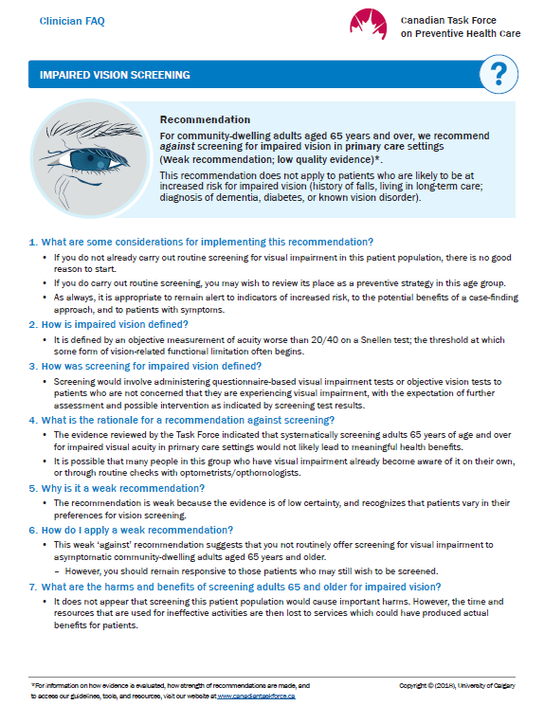
Knowledge Translation (KT) Tools
CTFPHC has created a Q&A KT tool to support the implementation of the guideline into clinical practice
After the public release, this tool will be freely available for download in both French and English on the website: www.canadiantaskforce.ca

Slide 28
CONCLUSIONS
Screening for impaired vision in community-dwelling adults aged 65 years and older in primary care settings

Slide 29
Conclusions: Key Points
Current evidence does not support screening adults 65 years of age and older for impaired vision by primary care providers as a way to prevent functional limitations or other major consequences of impaired vision
Primary care clinicians may consider confirming that older patients have had their vision checked by an optometrist or other ophthalmic primary care professional

Slide 30
More Information
For more information on the details of this guideline please see:
Canadian Task Force for Preventive Health Care website: http://canadiantaskforce.ca

Slide 31
Questions & Answers
Thank you

