Slide 1
Guideline on screening for depression during pregnancy and the postpartum period
Notes:
The Canadian Task Force on Preventive Health Care
Guideline on screening for depression during pregnancy and the postpartum period

Slide 2
Use of slide deck
These slides are public after guideline release to help with dissemination, uptake and implementation into primary care practice
Some or all of the slides may be used in educational contexts
Notes:
- These slides are made available publicly following the guideline’s release as an educational support to assist with the dissemination, uptake and implementation of the guidelines into primary care practice.
- Some or all of the slides in this slide deck may be used in educational contexts.

Slide 3
Perinatal and postpartum depressionscreening working group
Task Force members
Eddy Lang
Heather Colquhoun
John C. Leblanc
John Riva
Task Force spokespersons
Eddy Lang
Emily G. McDonald
Guylene Theriault (French)
External Support
Public Health Agency of Canada
Greg Traversy
Casey Gray
Evidence Review and Synthesis Centre
Ottawa Hospital Research Institute (OHRI)
Content experts
Bianca Lauria-Horner
Scott Patten
Simone Vigod
Brett Thombs

Slide 4
Overview of webinar
Presentation
Background
Methods
Recommendation
Evidence
Rationale
Knowledge gaps
Knowledge translation tools
Conclusions
Questions and answers
Notes:
- Overview of the Webinar
- Presentation
Background on depression during pregnancy and the postpartum period
Methods of the CTFPHC
Recommendation
Results
Rationale for recommendations
Knowledge gaps and next steps
Other national depression screening recommendations for pregnant and postpartum individuals
Conclusions
- Questions and Answers

Slide 5
Background
Notes:
- Background

Slide 6
Depression in pregnancy
Depression in pregnancy or in the first year after childbirth is a serious concern
If detected, there are effective treatments
Notes:
Depression during pregnancy and the post partum period is a serious health concern that can be treated if we are able to detect it.

Slide 7
Diagnostic criteria for depression
Depressed mood or less interest in activities
Significant distress or functional impairment almost daily for 2 weeks
Notes:
Major depressive disorder diagnostic criteria require patients to have at least 5 symptoms, including depressed mood or diminished interest in activities, and to be experiencing significant distress or functional impairment nearly every day for at least two weeks

Slide 8
Diagnostic criteria for depression
At least 5 symptoms:
Significant weight or appetite change
Insomnia or hypersomia
Fatigue, energy loss
Psychomotor agitation or retardation
Feelings of worthlessness
Poor concentration
Suicidal ideation
Notes:
Symptoms may include significant weight or appetite change, insomnia or hypersomnia, psychomotor agitation or retardation, fatigue or loss of energy, feelings of worthlessness or guilt, reduced concentration or indecisiveness, and thoughts of death or suicidal ideation

Slide 9
Prevalence in
pregnancy/postpartum
Point prevalence ranges from 1% to 6% from 1st trimester to 1 year post-partum
2008 US national survey of 14000+ people 18-50 years:
12 month period prevalence:
8% in pregnant people, 9% post-partum vs. 8% in nonpregnant people
Notes:
The available estimates of the prevalence of depression in the pregnancy or postpartum period vary.
A systematic review from 2005 estimated that the point prevalence of major depression during pregnancy and postpartum ranges from 1% to 6% at different time points (from the first trimester of pregnancy to one year postpartum)
A 2008 national survey from the USA reported that the 12-month period prevalence of depression was 8% among pregnant individuals and 9% in postpartum individuals, compared to 8% among non-pregnant individuals
References:
Gavin NI, Gaynes BN, Lohr KN, Meltzer-Brody S, Gartlehner G, Swinson T. Perinatal depression: a systematic review of prevalence and incidence. Rockville (MD): Agency for Healthcare Research and Quality; 2005.
Vesga-López O, Blanco C, Keyes K, Olfson M, Grant BF, Hasin DS. Psychiatric disorders in pregnant and postpartum women in the United States. Arch Gen Psychiatry 2008;65(7):805-15

Slide 10
Post-partum depression
Depression can have significant negative impact on the individual and baby:
Parent-infant interactions
Relationship with partners
Reduced breastfeeding
Poor parent-infant bonding
Developmental delays for baby
Notes:
Depression during pregnancy and the postpartum period can have far-reaching impacts on the childbearing individual and their infant individually, as well as parent-infant interactions and relationships with partners
Consequences for the childbearing individual include:
increased likelihood of future anxiety or depression
lower quality of life
increases in risky behaviours (e.g., tobacco smoking or alcohol consumption)
suicidal ideation
Impacts on the infant could include:
delays in physical and mental development including cognitive and language development
overall infant health concerns
Impacts on parent-infant interactions can include:
reduced breastfeeding
poor parent-infant bonding

Slide 11
Postpartum depression vs. "baby blues"
It is normal and common to have what is often called “baby blues” shortly after giving birth
Feelings of sadness, anxiety, and/ or being upset with their baby or partner. Other symptoms include unexpected crying, trouble sleeping, or loss of appetite.
Brought on by a large change in hormones after birth, loss of sleep, and increased stress.
Symptoms often get better within 1 - 2 weeks without any treatment.
Postpartum depression shares a lot of symptoms with “baby blues”, but it can be much more intense and requires treatment.
Notes:
It is normal and common to have what is often called “baby blues” a couple days after giving birth.
These are feelings of sadness, anxiety, and/ or being upset with their baby or partner. Other symptoms include unexpected crying, trouble sleeping, or loss of appetite.
It is mostly brought on by a large change in hormones after birth, loss of sleep, and increased stress.
These symptoms often get better within 1 - 2 weeks without any treatment.
Postpartum depression shares a lot of symptoms with “baby blues”, but it can be much more intense and requires treatment

Slide 12
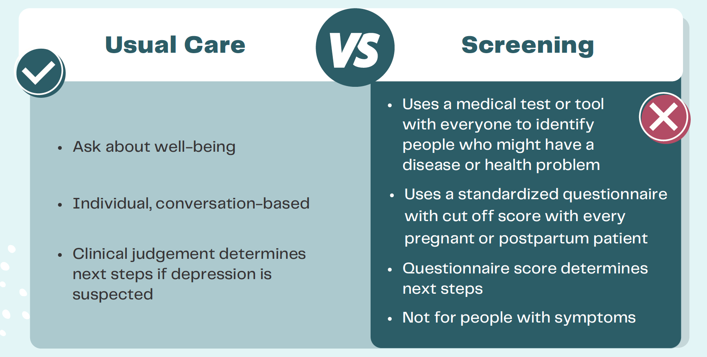
Usual care vs. screening
Usual clinical care
Discussion with patient about:
Current mood and well-being
History of mental illness
Symptoms, if any
Notes:
Usual clinical care during pregnancy and the postpartum period should include discussion with pregnant or postpartum people about their history of mental illness, current symptoms and well-being

Slide 13
What is screening for depression?
Routine use of questionnaire or small set of questions with a cut off score for every pregnant and postpartum patient to identify unrecognized depression
Further investigation of patients with scores above specific cut-off
Notes:
In addition to usual clinical care, screening for depression would involve the systematic administration of a screening instrument (most commonly a questionnaire or small set of questions) with a pre-defined cut-off score to all pregnant or postpartum people in a particular setting such as a clinic
Individuals who meet or exceed the cut-off score would be considered “screen positive” and would be further evaluated to see if they meet diagnostic criteria for depression, whereas those below the cut-off score would be “screen negative” and would not be further evaluated
Common depression screening instruments include the Patient Health Questionnaire (PHQ), and the Edinburgh Postnatal Depression Scale (EPDS) for postpartum and pregnant individuals

Slide 14
What is screening?
This differs from
Using questionnaires as prompts for discussion
Information gathering forms used to assess symptoms or monitor treatment
Notes:
We draw a distinction between standard questions posed in a systematic screening context and those integrated into usual care based on how a practitioner makes judgement about next steps. In systematic sceening, all patients meeting the cut-off score would be considered “screen positive”, and would be investigated further with diagnostic approaches.
In contrast, making a judgement about a patient’s status after a personalized assessment based on all information available to a practitioner would be considered as routine clinical care and not screening. For example, if a provider were to ask a patient “over the last 2 weeks, how often have you been bothered by: Little interest or pleasure in doing things; feeling down, depressed, or hopeless”, and then proceed using their clinical judgment based on the patient’s responses along with other information about the patient, this would not be considered screening given this would be a flexible and personalized approach as opposed to the systematic and structured approach of screening using an instrument with a cut-off score.
Once a clinician suspects depression and begins to investigate it, they are engaging in a diagnostic process whether or not they used a formal depression screening tool.
Note that depression symptom questionnaires can also be used for several purposes other than screening, including as part of a diagnostic assessment of people suspected of having depression, to track treatment progress or to check for relapse among people known to have depression

Slide 15
Goal of screening
To improve mental health in patients with depression that would not have been recognized without screening
Notes:
The goal of screening would be to identify and help individuals who, without a screening protocol, would have been identified later in their illness or not at all.

Slide 17
Current Canadian guidance
Usual clinical care
10 provinces and territories suggest asking patients about depression, anxiety or mood as part of usual clinical care
Guidance documents include best practice recommendations, care pathways and perinatal records
Notes:
Ten provinces and territories in Canada provide guidance documents (e.g., best practice recommendations, care pathways, perinatal records) that suggest asking patients about current depression, anxiety, or mood during pregnancy or the postpartum period as part of usual clinical care

Slide 18
Current Canadian guidance
Screening tools
Nine provinces and territories suggest primary care professionals use screening tools in pregnancy or postpartum
Edinburgh Postnatal Depression Scale (EPDS)
Notes:
Nine provinces and territories provide guidance documents that suggest primary care providers (e.g., public health nurses, family physicians, midwives) screen patients with instruments such as the EPDS during pregnancy or the postpartum period
This guidance includes recommended cut-off scores and follow-up actions as part of screening.
Among these nine provinces and territories, seven also provide a place to enter scores for depression screening instruments in medical record forms used during pregnancy or the postpartum period
Guidance on which questionnaires to use, when to administer them, and pre-defined cut-off scores varies across provinces and territories.

Slide 19
Guideline rationale: updated guidance
2013 – Task Force recommended against screening in pregnant and postpartum individuals
Practice varies across Canada
New guidance with patient input needed
Notes:
In 2013, the Canadian Task Force on Preventive Health Care recommended against screening for depression among perinatal or postpartum individuals
Given that practice continues to vary in Canada, updated guidance was developed based on a review of benefits and harms of screening, and taking into account patient preferences, to provide clarity for providers.
This guideline replaces the recommendation for pregnant and postpartum individuals from the 2013 guideline.

Slide 20
Guideline scope
Targeted to:
Primary care health professionals
Policymakers
Patients
Target Population | Pregnant people and those up to 1 year postpartum People who may have elevated risk of depression (e.g., trauma in early life, family history of depression)
Not covered by this guideline | People with personal history of depression Current diagnosis or treatment of depression or mental health disorder
Notes:
This recommendation provides guidance to primary care health professionals (e.g., clinicians, nurses, midwives or other providers who could serve as first point of contact for care during pregnancy or the postpartum period), policymakers, and patients on screening (as defined above) for depression in individuals during pregnancy and up to 1 year postpartum
The scope of this recommendation also extends to individuals who may be at an elevated risk of depression (e.g., trauma in early life, family history of depression
This recommendation does not extend to individuals with a personal history or current diagnosis of depression or another mental health disorder, those currently receiving assessment or treatment for mental health disorders, those receiving care in psychiatric or other mental health settings, or those who are seeking services due to symptoms of depression. This guideline does not address depression treatment.

Slide 21
Methods
Notes:
- Methods

Slide 22
Canadian Task Force on Preventive Health Care
Independent body of 12-15 clinicians and methodologists
Mandate:
Develop evidence-based clinical practice guidelines to support primary care providers deliver preventive healthcare
Ensure dissemination, uptake and implementation of guidelines
Notes:
The Canadian Task Force on Preventive Health Care is an independent body of up to 15 clinicians and methodologists.
The mandate is to develop evidence-based clinical practice guidelines that support primary care providers in the delivery of preventive healthcare.
Ultimately the goal of the Task Force is to improve the health of Canadians by making sure that primary care providers have access to clinical prevention guidelines that are based on the best available evidence.

Slide 23
Evidence Review and Synthesis Centres (ERSC)
Independent systematic review (SR) of the literature based on the working group’s analytical framework
Present evidence with GRADE tables to inform Task Force guidelines
Participate in working group and Task Force meetings (non-voting)
Notes:
- The Task Force works with Evidence Review and Synthesis Centres (ERSCs) who independently review the evidence.
- The ERSCs undertake a systematic review of the literature based on the analytical framework and prepare the final report and GRADE tables. GRADE: Grading of Recommendation, Assessment, Development and Evaluation.
- They also participate in working group and Task Force meetings (non-voting).

Slide 24
Notes:
This infographic provides an overview of the TF guideline process and who provides critical input at the topic selection, evidence synthesis, guideline, and dissemination stages. This includes a variety of internal and external stakeholder (more detail on next slide).

Slide 25
Guideline review process
Internal review process involving:
Guideline working group and other Task Force members
Content experts who support the working group
External stakeholder review undertaken at key stages:
Protocol, systematic review(s) and guideline
External stakeholder reviewer groups:
Generalist and disease-specific stakeholders
Academic peer reviewers
CMAJ undertakes an independent peer review process to review guidelines before accepting for publication
Notes:
The TF review process includes:
Internal review by the guideline working group and all other Task Force members
The Task Force also engages specialists/content experts to act as advisors to the working group throughout the process. Content experts are involved in meetings and review key documents, but do not vote or have input into the direction or strength of recommendations
External review is undertaken at 3 key stages:
Protocol, systematic review(s) and guideline
- External stakeholder reviewer groups include:
Generalist and disease specific stakeholders
Academic peer reviewers
- CMAJ undertakes an independent peer review process to review guidelines before accepting for publication

Slide 26
GRADE - rating evidence and grading recommendations
1. Certainty of Evidence
2. Strength of Recommendation
Certainty that the available evidence correctly reflects the true effect
Certainty of supporting evidence
Balance between desirable and undesirable
Patient values and preferences
Wise use of Resources
High, Moderate, Low, Very Low
Strong, Conditional
Notes:
What are we grading?
1. Certainty of Evidence
Degree of confidence that the available evidence correctly reflects the theoretical true effect of the intervention or service
High, moderate, low, very low
2. Strength of Recommendation
The balance between the certainty of supporting evidence; the certainty about the balance between desirable and undesirable effects; the certainty/variability in values and preferences of individuals; and the certainty about whether the intervention represents a wise use of resources
strong and conditional

Slide 27
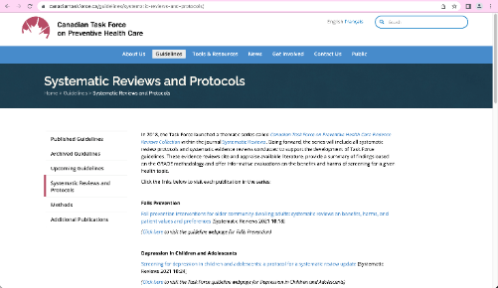
Screening effectiveness systematic review
1: Review will be published in Systematic Reviews
All reviews available on the Task Force website: https://canadiantaskforce.ca/guidelines/systematic-reviews-and-protocols/
Notes:
The systematic review that informed this guideline will be published in the journal Systematic Reviews at the same time that the guideline is published.
Reviews that inform Task Force guidelines can be found on the Task Force website, or through the journal’s Task Force collection.

Slide 28
Patient engagement
Recruited via Craigslist, Kijiji and other sites
2 phases of focus groups at St. Michael's Hospital, Toronto
Notes:
Patients were engaged in guideline development, recruited via advertisements on public advertisement websites (i.e., Craigslist and Kijiji), through two phases of focus groups conducted by the Knowledge Translation group at St. Michael’s Hospital

Slide 29
Patient engagement
Phase 1:
15 participants (6 pregnant, 9 postpartum, all self-identified as female)
Rated importance of outcomes in deciding whether to be screened
Phase 2:
14 participants (4 pregnant, 10 postpartum, all self-identifed as female)
Rated importance of outcomes with evidence for benefits and harms of depression screening from systematic review
Notes:
Phase 1 – during protocol development
15 participants (6 pregnant and 9 postpartum, all identifying as female) assessed the importance of key outcomes in deciding whether to be screened for depression via online survey
This was followed by three focus groups and two interviews via teleconference to gather these participants’ rationale for their ratings and discuss factors that impacted the importance of outcomes
Outcomes rated as critical or important by focus group participants (described below) and working group members were considered during guideline development
Phase 2 – after the systematic review was complete
14 different participants (4 pregnant and 10 postpartum, all identifying as female) were asked to rate the importance of outcomes when presented with synthesized evidence for benefits and harms of depression screening via online survey
This was followed by four focus groups and two interviews via teleconference to gather participants’ rationale for their ratings and discuss factors that impacted the importance of outcomes
Phase 2 allows us to identify whether patients, fully informed of the estimated benefits and harms from the review, might rate the importance of outcomes differently

Slide 30
Recommendation
Notes:
Recommendation

Slide 31
Recommendation
We recommend against the use of screening questionnaires with cut-off scores for all pregnant and postpartum people up to 1 year after childbirth
(Conditional recommendation; very low-certainty evidence)
We emphasize usual care that includes questions about, and attention to, mental health and well-being in pregnancy and the postpartum period
It is uncertain whether screening all individuals during this period would confer benefit above usual clinical care.
Notes:
The task force recommends against instrument-based depression screening using a questionnaire with cut-off score to distinguish “screen positive” and “screen negative” administered to all individuals during pregnancy and the postpartum period (up to 1 year after childbirth) (conditional recommendation, very low-certainty evidence).
This recommendation assumes that, as part of usual care during pregnancy and the postpartum period, care providers will inquire about and be attentive to mental health and wellbeing.

Slide 32
Implementation
Clinicians in primary care settings are advised to exercise usual clinical care to ask about mood and well-being
Given the health implications of depression, it is essential that providers exercise clinical vigilance regarding mental health
Notes:
The term ‘screening’ in this recommendation refers to a routine process in which primary care providers administer an instrument such as a questionnaire to every pregnant or postpartum individual not already reporting symptoms of depression and then use a cut-off score to determine a follow-up action for those at or above the cut-off score
The task force definition of screening in this context means that the recommendation against screening emphasizes the importance of good clinical practice where clinicians should inquire and be alert to changes in physical and mental health symptoms of their patients.
Given the health implications of depression during pregnancy and the post-partum period, it is essential that providers inquire about and be attentive to mental health and wellbeing

Slide 33
Implementation
Jurisdictions may reconsider screening in settings where it is currently used
If desired, clinicians may consider using questionnaires for discussion prompts (without engaging in formal screening by using cut off score for subsequent actions)
Notes:
As screening practices vary across Canada, jurisdictions may reconsider the use of such screening in settings where it is currently implemented.
If providers are uncertain about how to engage in these discussions with patients, they may consider referring to questionnaires for discussion prompts (without engaging in formal screening by using the questionnaire score for determining subsequent actions).

Slide 34
Implementation
The task force recommends against the addition of such a screening process because of the absence of evidence that it adds value beyond discussions about overall well-being, depression, anxiety and mood that are currently a part of established perinatal clinical care."
– Pregnancy and Postpartum Depression Working Group

Slide 35
Evidence
Notes:
- Results

Slide 36
Available Evidence
Postpartum
1 RCT that evaluated systematic depression screening of 462 postpartum women two months after giving birth using the EPDS in Hong Kong
Data on the outcomes of screening that were evaluated at 6 months after giving birth were very uncertain due to very serious risk of bias issues as well as imprecision due to only having one small trial.
This very low certainty means that the true effects of screening are likely substantially different from the study data
Notes:
We found 1 randomized controlled trial that evaluated systematic depression screening among postpartum individuals (described as “mothers” or “women” in the study) in Hong Kong (n = 462)
Participants were randomized to receive screening with the EPDS by nurses (n=231) or no such screening (n=231) at 2 months postpartum. Both groups received usual clinical care, including inquiring about feelings, appetite, sleep, childcare, and suicidal ideation
All participants identified as potentially depressed (based on EPDS score ≥10 or clinical assessment in the intervention group or based on clinical assessment alone in the control group) were to be offered counselling or management by a community psychiatric team
Outcomes were assessed at 6 months postpartum (i.e. 4 months after randomization)
Data on the critical and important outcomes were very uncertain, including for:
Number depressed
Depression symptoms
General health score
Reported or observed capacity to parent
Parent-child stress
Marital stress
Infant hospitalizations
The effects of screening on all of these outcomes were very uncertain due to very serious risk of bias concerns (use of self-reported outcome measures and selective outcome reporting) as well as imprecision concerns due to there being only a single small trial
This very low certainty means that the true effects of screening are likely substantially different from the study data
There was low certainty evidence indicating little to no difference in mean infant body weight at 6 months
No adverse events were noted in the study

Slide 37
Available Evidence
Pregnancy
No trials comparing depression screening with questionnaire to no screening in pregnancy
Notes:
We did not find any trials that compared questionnaire-based depression screening to no screening during pregnancy.
We also did not identify any trials evaluating other outcomes of interest (i.e. suicidality, false positive screens, overdiagnosis, overtreatment, or labelling/stigma) (in either population)

Slide 38
Patient values and preferences
Notes:
- Patient values and preferences

Slide 39
Patient values and preferences
Participants expressed concern that:
They may not recognize their symptoms of depression or
May lack initiative to seek care from primary care clinician
Notes:
Participants expressed concerns that they might not recognize their own symptoms of depression or take the initiative to seek input from their primary care provider and expressed a preference for being screened

Slide 40
Patient values and preferences
In survey, rated preference for screening fairly high
However
During focus groups to explore survey ratings, participants had strong preference for discussion with their healthcare provider about mood and well-being which is different than a formal screening process
Notes:
Although participants rated their preference to be screened quite high, during focus groups, it was noted that "participants felt most strongly about having a discussion with a healthcare provider about their mental health and wellbeing" and that "discussion about depression with a primary health care provider during the pregnancy and [postpartum] period is critical," which does not suggest a formal screening process.

Slide 41
Patient values and preferences
Patients felt a discussion about depression with a health care provider in pregnancy and after giving birth is critical
Notes:
Thus, patient engagement suggested that discussions with healthcare providers about depression are important to patients.

Slide 42
Feasibility and acceptability
The Task Force believes a recommendation against screening with questionnaire and cut-off is feasible
Extent to which primary care clinicians are currently using questionnaires is unknown
Primary care providers are trained in recognizing signs and symptoms of depression
Supporting discussions about mental health and well-being in the context of usual care is consistent with patient values and should be acceptable to most.
The Task Force recognizes that the recommendation against may contradict practice/policy in some regions
Notes:
In the judgement of the task force, a recommendation against screening is feasible.
Primary care providers are trained in the signs and symptoms of depression during pregnancy and the postpartum period, as well as processes for assessment, treatment, and referral (as required) as part of usual clinical care.
The extent to which primary care providers are using questionnaire-based screening across Canada as part of usual clinical care is unknown.
Given the results of our patient engagement, the Task Force judges that the recommendation against screening for depression using questionnaires administered to all pregnant and postpartum people should be acceptable to most patients as long as providers continue to inquire about mental health and wellbeing as part of usual care
The task force recognizes that a recommendation against screening may contradict current practice or policy in some jurisdictions. As such, they recognize that some providers may feel discomfort about de-implementing screening due to concerns about ‘missing’ cases of this important health issue.

Slide 43
Equity
Some marginalized people report barriers to disclosing mental health symptoms or concerns to health care providers e.g.,
Unsure how to raise topic of depression
Concerns about stigma
Aversion to medications, psychotherapy
The recommendation against could result in some people with depression being missed
However, these barriers to disclosure might still exist with a questionnaire
Notes:
The impact on equity of a recommendation against screening is unknown.
Some marginalized individuals report barriers to disclosing depressive symptoms or concerns with their health care provider (e.g., being unsure how to bring up the topic of depression, concerns about stigma, aversion to antidepressant medications or psychotherapy), in which case a recommendation against screening may result in some individuals with depression not being identified, although some of these barriers may still exist when using screening questionnaires.

Slide 44
Rationale
Notes:
Rationale for recommendation

Slide 45
Rationale
Conditional recommendation based on very low-certainty evidence on benefits and limited evidence of harms
the additional benefit of screening all patients with a questionnaire with a cut-off score compared to usual care (which should include inquiry into mood and mental health) during primary care visits is very uncertain
No evidence of harms identified in systemic review, but some evidence from other sources
Notes:
This conditional recommendation is based on the very low-certainty evidence on the effect of screening on benefit outcomes and limited evidence of harms.
The supporting systematic review suggests that the additional benefit of screening all patients with a questionnaire with a cut-off score compared to usual care (which should include inquiry into mood and mental health) during primary care visits is very uncertain.
Although no evidence was found on the harms of screening in our systematic review, evidence from other sources described below suggest the time and focus on screening could reduce opportunities to discuss other aspects of health during a perinatal primary care encounter as providers would be evaluating and potentially referring all patients who screen positive, in many cases unnecessarily.
Screening could lead to an increase in false positives, false negatives, unnecessary referrals and diagnostic evaluation, and overdiagnosis for some patients.

Slide 46
Rationale
A recent individual patient data meta-analysis provides accuracy information for the EPDS, the tool used in the one trial we identified
Based on a prevalence of 8%, screening 100 patients with the EPDS using the common cut-off score of 13 would result in:
5
3
true positives​
false negatives
5
87
false positives​
true negatives
Notes:
A false positive can occur when the patient meets a screening cut-off score and is sent for additional psychiatric evaluation, which finds they do not actually meet the diagnostic criteria for depression
A recent individual patient data meta-analysis provides accuracy information for the EPDS, the tool used in the one trial we identified. Based on a prevalence of 8%, screening 100 patients with the EPDS using the common cut-off score of 13 would result in 5 true positives, 3 false negatives, 5 false positives, and 87 true negatives, meaning that some patients who are screened will be sent for an unnecessary additional assessment

Slide 47
Rationale
Overdiagnosis could occur in patients with mild temporary symptoms, who might meet a screening cut-off score, leading to further evaluation and possible referral to specialty mental health services, but who would not benefit as the symptoms would subside on their own
Notes:
Overdiagnosis could occur in patients with mild temporary symptoms, who might meet a screening cut-off score, leading to further evaluation and possible referral to specialty mental health services, but who would not benefit as the symptoms would subside on their own

Slide 48
Rationale
Potential unintended harms:
Time and focus on screening could detract from other health concerns at primary care visit
Screening could lead to false positives, false negatives, unnecessary referrals, overdiagnosis
Resource implications as 10% of all patients screened with questionnaire and cut-off require more assessment or referral
Notes:
Given the significant challenges to accessing mental health services in Canada, the unnecessary redirection of resources from the treatment of patients with mental health disorders could be an unintended harm of screening.
Spending even 1-2 minutes per clinical encounter reviewing the results of a formal screening instrument with no proven value could consume a significant amount of time during a 15-minute encounter. In the task force’s view, this could detract from the ability of the clinician to have a meaningful and empathetic discussion about the health of the patient.
Given that about 10% of all patients screened using a questionnaire and cut-off score would have to receive additional assessment or referrals, the resource implications also extend beyond the initial clinical encounter.

Slide 49
Rationale
The task force is mindful of the resource constraints faced by our primary health care system and as such makes recommendations against interventions when the resource implication of a particular health intervention are certain to be important and benefits have not been demonstrated
Notes:
The task force is mindful of the resource constraints faced by our primary health care system and as such makes recommendations against interventions when the resource implication of a particular health intervention are certain to be important and benefits have not been demonstrated, hence the conditional recommendation against screening

Slide 50
Gaps and next steps
Notes:
Knowledge gaps and next steps

Slide 51
Knowledge gaps
Very little evidence
Only 1 RCT assessing benefits of screening with questionnaire vs. no screening
More research is needed
Outcomes should include maternal and infant benefits and harms
Notes:
There is only 1 randomized controlled trial assessing the benefits and harms of questionnaire-based screening for depression versus no screening during the postpartum period
There were none during pregnancy.
Trials that compare screening to usual clinical care, where those identified as depressed in either arm receive the same level of care, are needed in order to isolate the effectiveness of screening as an intervention
The outcomes examined in these trials should include both maternal and infant-related benefits and harms
As experiences of pregnancy and the postpartum period can vary based on factors such as culture, ethnicity, socioeconomic status, geographic region, and other social determinants of health, studies that reflect and provide evidence for the diversity of the Canadian population would also be helpful

Slide 52
Tools
Notes:
Tools

Slide 53
Knowledge translation (KT) tools
Notes:
Knowledge translation (KT) tools

Slide 54
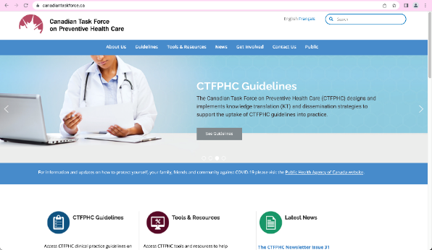
Knowledge Translation Tools
KT tools to help clinicians and patients understand the depression screening guideline
At publication, tools will be freely available for download in both French and English at: http://canadiantaskforce.ca
Notes:
Knowledge Translation
An infographic and FAQs for clinicians and patients have been developed to help understand the guideline.
After the public release, these tools will be freely available for download in both French and English on the website: http://canadiantaskforce.ca.

Slide 55
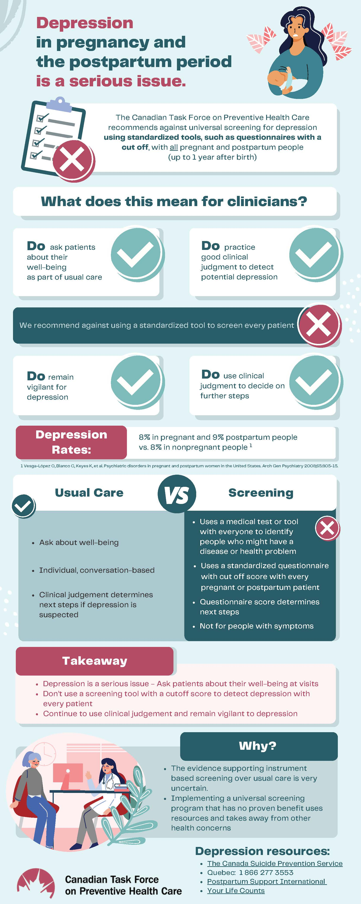
Tools
Clinician infographic
Patient-facing web page and tools
Notes:
The infographic was developed to help clinicians with the takeaway message for practice

Slide 56
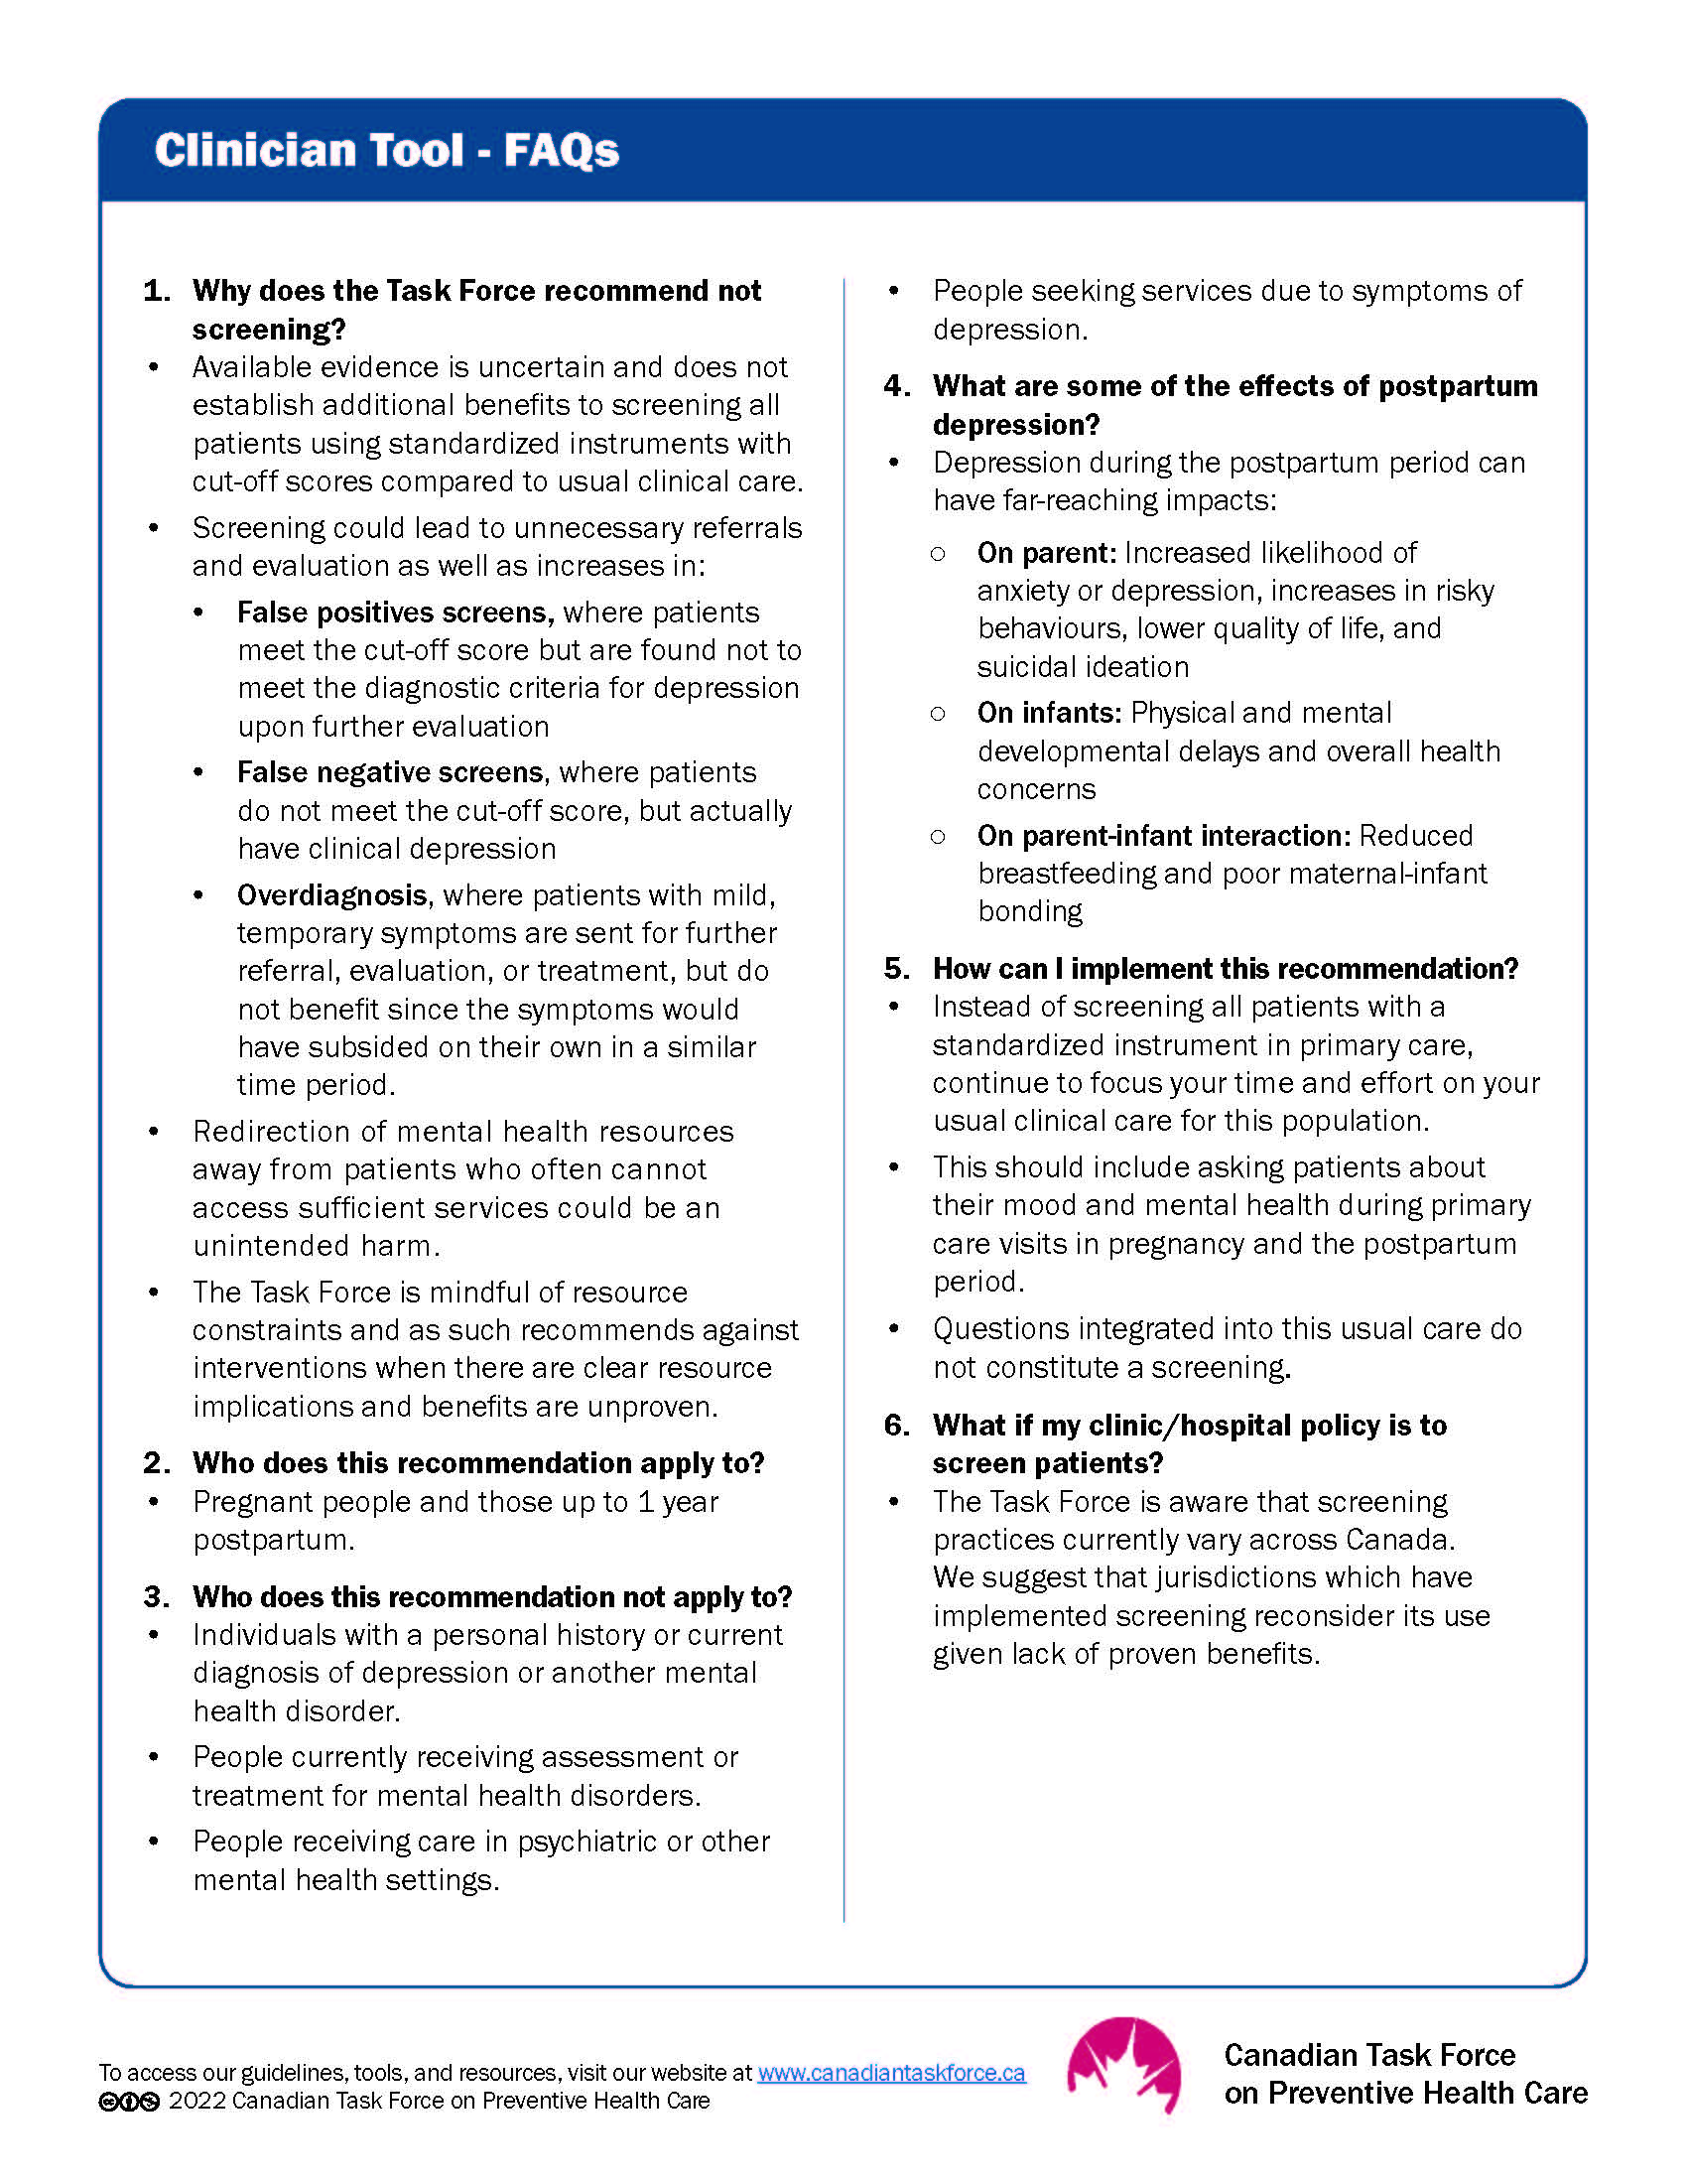
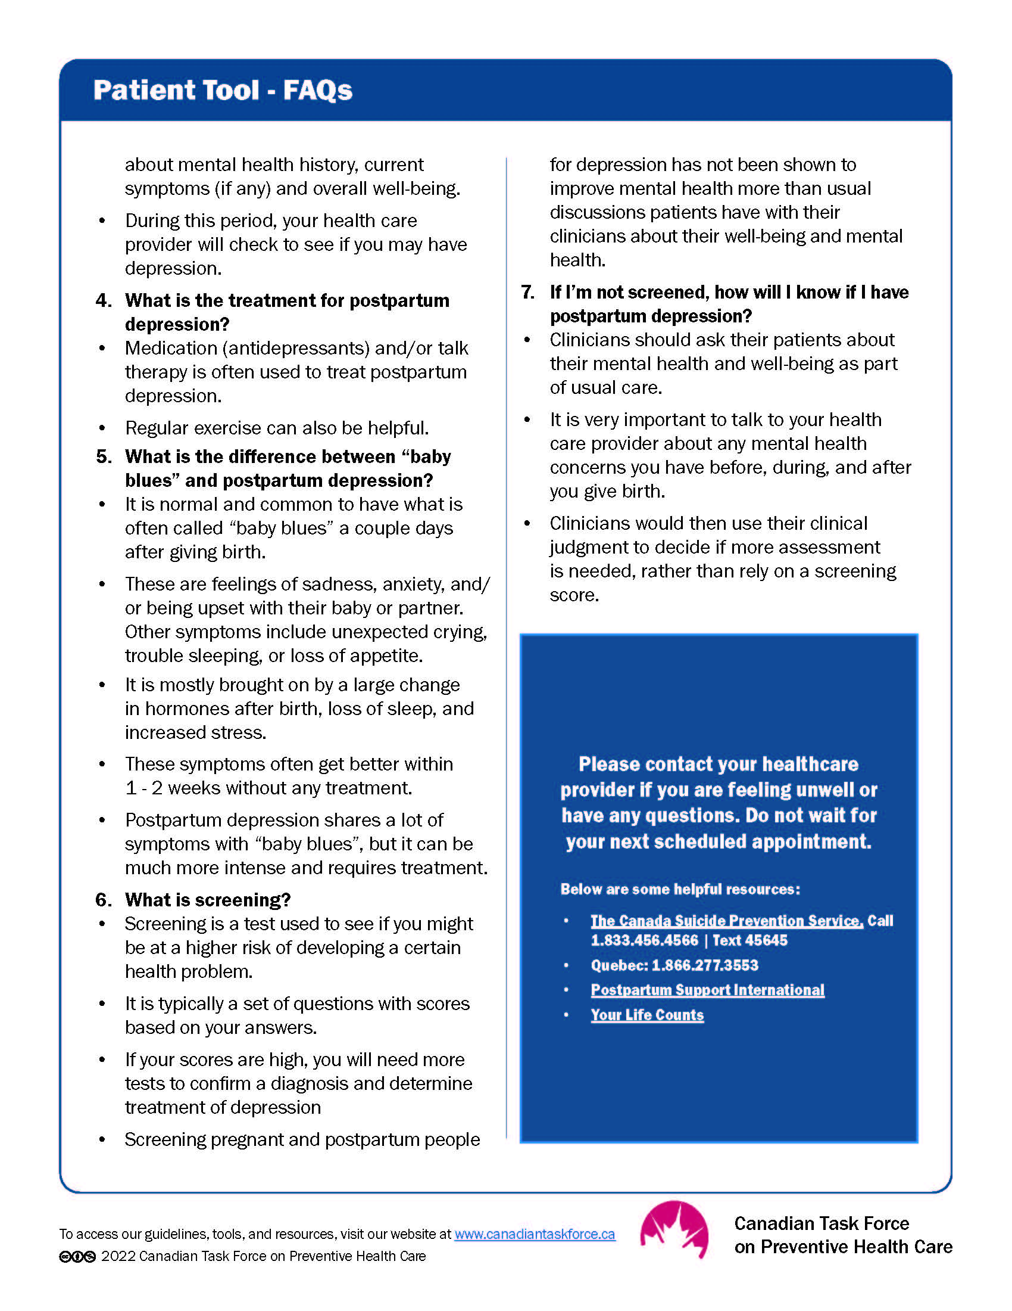
Tools
Notes:
Clinician and patient FAQs to guide discussions with patients

Slide 57
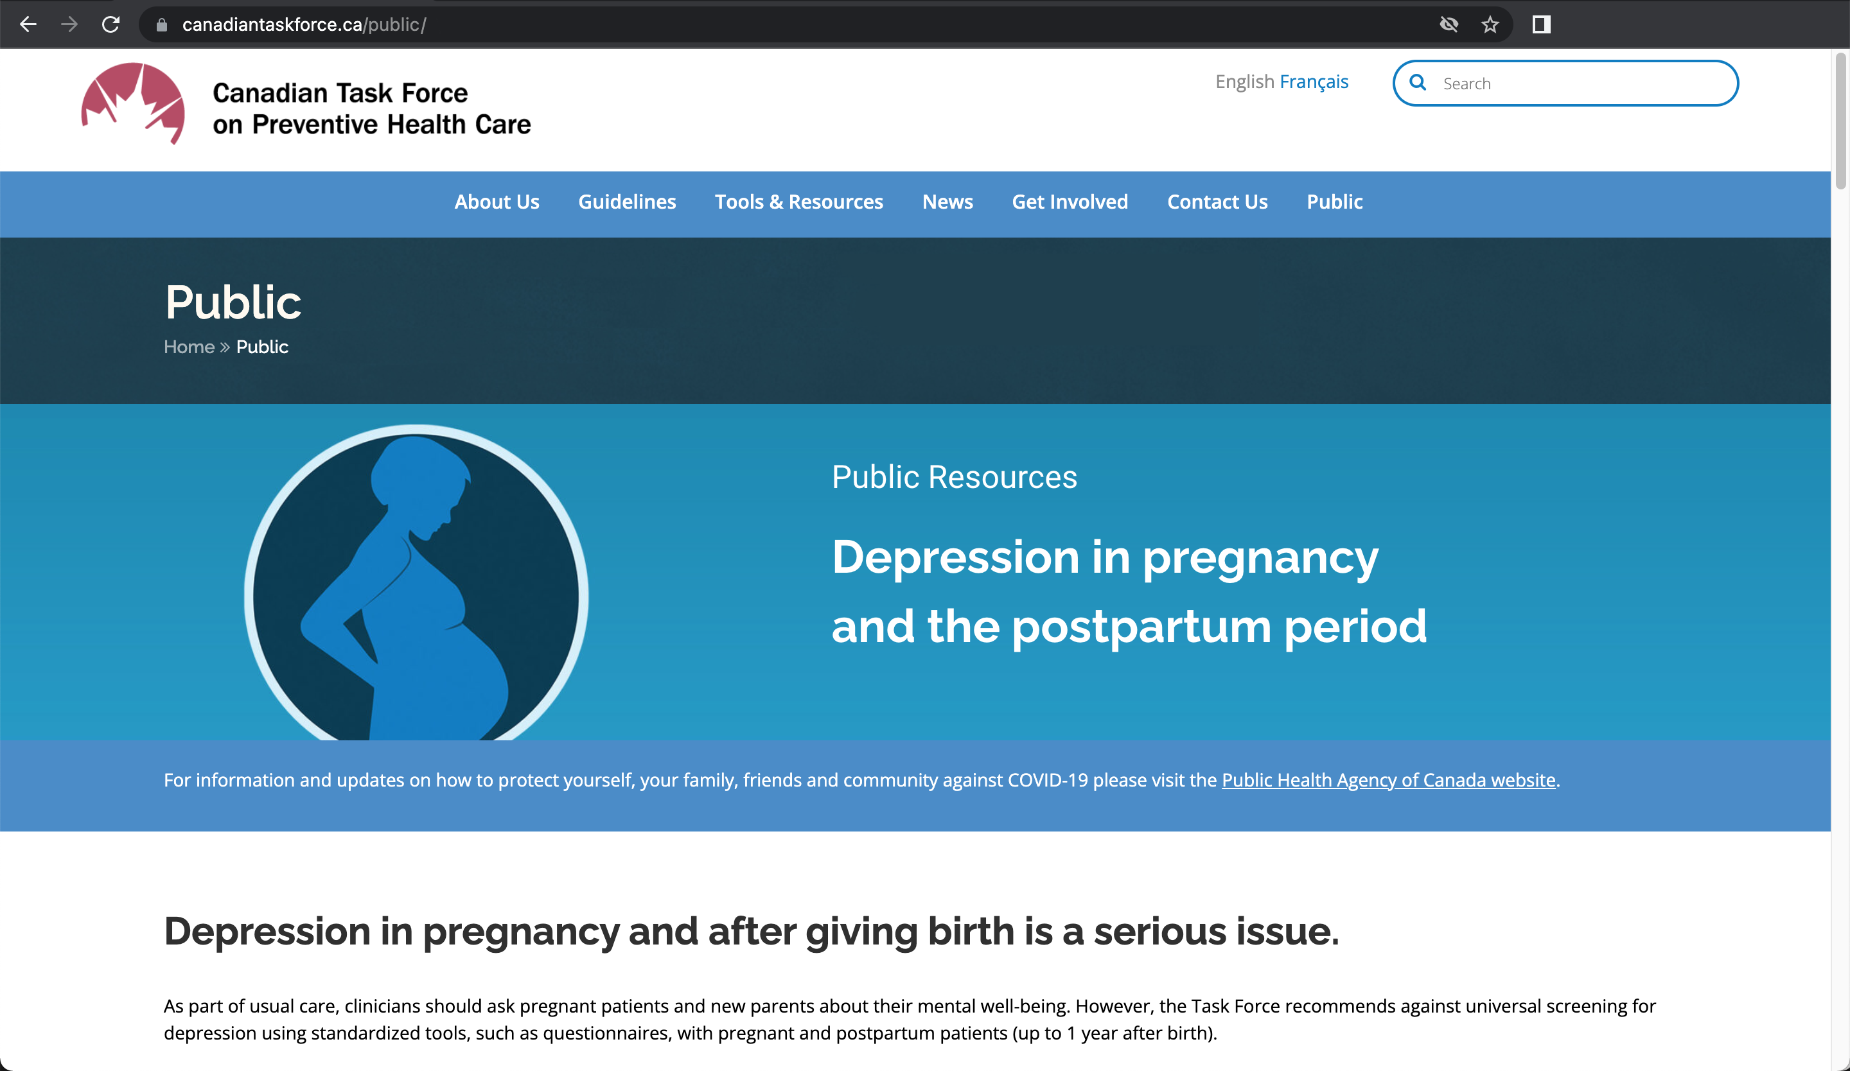
Tools
Notes:
Public page with accessible, relevant resources for patients

Slide 58
Communications
Social media posts
News release
Stakeholder
communications
Follow @cantaskforce​

Slide 59
Conclusions
Notes:
Conclusions

Slide 60
Task Force recommends
Ask about the mental health and well-being of patients at visits during pregnancy and the postpartum period
Don’t use a screening instrument or tool with a cut-off score to detect depression
Use all clinical information to make a mental health assessment
Usual clinical care and vigilance to patient mental health in pregnancy and postpartum period
Notes:
It is important that this conditional recommendation against screening is not interpreted as a recommendation against inquiry into mental health and wellbeing. The Task Force recommends against systematic screening using instruments with cut-off scores but emphasizes the importance of inquiry and attention to mental health and wellbeing during pregnancy and the postpartum period.

Slide 61
Depression in pregnant and postpartum people is devastating, with a massive burden for families and it’s critical to detect it. We need to do all we can to support and treat people with depression. Exercising good clinical practice where clinicians ask about and are alert to changes in physical and mental health symptoms of their patients is key. ”
– Dr. Eddy Lang, chair, PPPD Working Group

Slide 62
More information
For the guideline, related clinician and patient tools, visit :
http://canadiantaskforce.ca
Notes:
For more information on the details of this guideline please see:
Canadian Task Force for Preventive Health Care website: http://canadiantaskforce.ca

Slide 63
Questions and answers
Notes:
Questions & Answers
Thank you

Slide 64
The GRADE system
Notes:
Evidence tables

Slide 65
The “GRADE” system: Grading of Recommendations Assessment Development & Evaluation
Notes:
The Task Force uses GRADE to develop recommendations.

Slide 66
GRADE process - define and collect
Define questions re: populations, alternative management strategies and patient-important outcomes
Characterise outcomes as critical or important to developing recommendations
Systematic search for relevant studies
Estimate effect of intervention on each outcome based on pre-defined criteria for eligible studies
Assess certainty of evidence associated with effect estimate
Notes:
The GRADE process involves:
- Defining questions in terms of populations, alternative management strategies and patient-important outcomes.
- Characterising outcomes as critical or important to developing recommendations.
- Completing a systematic search for relevant studies.
- Developing a pre-defined criteria for eligible studies generate best estimate of the effect of the intervention on each critical and important outcome.
- Assessing the certainty of evidence associated with the effect estimate.

Slide 67
GRADE – rating certainty of evidence
GRADE Approach:
Hierarchy of evidence certainty: RCTs > Observational studies
Rating of certainty by outcome is reduced based on:
Study limitations (Risk of Bias)
Imprecision
Inconsistency of results
Indirectness of evidence
Publication bias likely
Notes:
The GRADE Approach:
- RCTs start as high-certainty evidence and observational studies as low-certainty evidence.
- RCT data is prioritized over observational.
- Rating of certainty is modified downward for each outcome across studies in relation to:
Study limitations (Risk of Bias)
Imprecision
Inconsistency of results
Indirectness of evidence
Publication bias likely
- Rating of certainty can also be modified upward for each outcome across studies based on certain factors, although these did not apply to any of the data for this topic.

Slide 68
Direct vs. indirect evidence
Direct evidence –studies examining the effects of screening vs. no screening or usual care
When direct evidence is unavailable, the Task Force may also examine indirect evidence
Indirect evidence is less certain:
linked to the outcome of interest (e.g. depression symptoms are dependent on the effectiveness of treatment) or
related to the screening intervention of interest
Notes:
Ideally, direct evidence should be examined which consists of studies examining the effects of screening versus no screening.
When direct evidence is unavailable the task force may also examine indirect evidence.
Indirect evidence is either linked to the outcome (e.g. treatment) or related to the intervention (e.g. different screening interventions) but this indirectness decreases the certainty of evidence.

Slide 69
Other screening recommendations
Notes:
Other depression screening recommendations for pregnancy or the postpartum period

Slide 70
Other national screening recommendations
US Preventive Services Task Force
Recommends screening pregnant and postpartum individuals, assuming adequate systems in place to ensure accurate diagnosis, effective treatment, and appropriate follow-up
UK National Screening Committee
Recommends against systematic antenatal and postnatal population screening program for mental health problems
National Institute for Health and Care Excellence (England)
Recommends considering using the EPDS or PHQ-9 as part of a full assessment if the individual answers positively to questions about recent depression symptoms
Scottish Intercollegiate Guidelines Network
Enquiry about depressive symptoms should be made, at minimum, on booking in and postnatally at 4 to 6 weeks and 3 to 4 months. The EPDS may be used in the antenatal and postnatal period as an aid to clinical monitoring and to facilitate discussion
Centre of Perinatal Excellence (Australia)
Recommend screening using the EPDS

