Slide 1
Recommendations on screening adults​ for depression with a screening tool
Update to the 2013 recommendations

Slide 2
Important confidentiality notice
By staying on this call, you agree to keep all information from the presentation and question and answer period confidential until the recommendations are publicly released
Release date: October 20, 2025
Notes:
Just a reminder about confidentiality. By staying on this call, you agree to keep all information from the presentation and question and answer period confidential until the recommendations are publicly released on October 20, 2025

Slide 3

Slide deck
Slides like these will be made public after guideline release to help with dissemination, uptake and implementation into practice
The views expressed herein do not necessarily represent the views of the Public Health Agency of Canada
Notes:
- These slides are made available publicly following the guideline’s release as an educational support to assist with the dissemination, uptake and implementation of the guidelines into primary care practice.
- Some or all of the slides in this slide deck may be used in educational contexts.
- The views do not necessarily represent the views of the Public Health Agency of Canada

Slide 4

Overview of webinar
Presentation
  Methods
  Background
  Recommendation
  Evidence
  Rationale
  Knowledge translation tools
  Conclusion
Questions and answers
Notes:
- Overview of the Webinar
- Presentation
Methods
Background on depression
Recommendation
Evidence
Rationale for recommendation
Tools
Conclusion
- Questions and Answers

Slide 5
Methods
Notes:
- Methods

Slide 6



Canadian Task Force on Preventive Health Care (CTFPHC): Who are we and what do we do?
  Independent panel of volunteer clinicians and methodologists
    6 family physicians, 4 specialists, 2 nurse practitioners
  Mandate:
  Develop evidence-based clinical practice guidelines to support primary care providers in delivering preventive healthcare
  Goal:
  To improve the health of Canadians with evidence-based clinical practice guidelines for primary care
Notes:
The Task Force is an independent panel of up to 15 volunteers that develops evidence-based clinical practice guidelines for primary care.
Our mandate is to develop evidence-based clinical practice guidelines to support primary care providers in delivering preventive healthcare
The Task Force's goal is to improve the health of Canadians with evidence-based clinical practice guidelines for primary care

Slide 7



Who worked on this guideline?
Eddy Lang
Working Group Chair
Heather Colquhoun
Science team: PHAC (non-voting)
John Leblanc
Greg Traversy
Casey Gray
Notes:
The Task Force Working Group on these recommendations is shown including two non-voting people who provided scientific expertise and support from the Public Health Agency of Canada.
The next slides list the many others involved in this guideline.

Slide 8



Content experts on depression screening – non-voting
Bianca Lauria-Horner, MD
Associate professor, Department of Psychiatry Dalhousie University
Scott Patten, MD
Professor, Cumming School of Medicine, University of Calgary
Cuthbertson & Fischer Chair in Pediatric Mental Health, Alberta Children's Hospital Research Institute
Brett Thombs, PhD
Canada Research Chair
Professor, Department of Psychiatry, McGill University
Senior Investigator, Lady Davis Institute for Medical Research, Jewish General Hospital
8

Slide 9

Patients/Public
Phase 1
16 adult citizens rated importance of harms and benefits of screening
2 focus groups (14 adults) and 2 interviews about outcomes
Phase 2
18 adults given data from systematic review on outcomes
18 adults (4 focus groups) on values and preferences
Public and clinician feedback on guideline tools
Notes:
For phase 1, 16 adults (3 identifying as male, 13 identifying as female; aged 22–63 yr) rated the importance of key harms and benefits of screening for depression and indicated their preference for being screened for depression in an online survey. Next, the knowledge translation group held 2 focus groups (n = 14; 10 and 4 participants per group) and 2 interviews by teleconference to gather qualitative data regarding the survey question topics.
Phase 2 activities were much the same as phase 1 activities, except that participants in phase 2 received information from the systematic review about the relative likelihood of each outcome. Eighteen adults (5 identifying as male, 13 identifying as female; 5 had been diagnosed with or were receiving treatment for depression; aged 22–56 yr; 4 with a high school education, 14 with a postsecondary education) completed the online survey. Thereafter, 4 focus group sessions (n = 18; 2–7 participants per group) were held via teleconference to gather qualitative data on participants’ perceptions of the screening outcomes, and their overall values and preferences for screening.

Slide 10

Interest holder engagement
72 different interest holder groups (generalist and disease specific- organizations, federal/provincial/territorial reviewers) were invited to comment on the draft guideline
12 interest holders provided feedback
All comments and responses will be available on our website
Peer review and input from the Canadian Medical Association Journal
Notes:
150 Interest holders were invited to provided, with 29 interest holders providing feedback. All comments and responses will be available on our website
We also had extensive input with CMAJ and its peer reviewers.

Slide 11
Conflicts of interest
Scott Klarenbach, who was a task force member but not a member of the topic working group, is the director of the Real World Evidence Unit, University of Alberta, and director and co-chair of the Real World Evidence Consortium (with University of Calgary and Institute of Health Economics). He did not vote on the draft guideline for submission, nor any changes made to the guideline in response to peer review, or approve resubmission, and as such is not listed as a contributing author.
No other working group or task force members declared interests relevant to this guideline.
Brett D. Thombs was a member at the start of the guideline and declared an intellectual interest related to his funded research program and publications on the subject of depression screening. He acted as a content expert for this guideline; he did not participate in discussions on the recommendation nor provide input on the direction or strength or vote on the recommendation.
Notes:
Conflicts of interest were managed according to the Task Force's COI policy which outlines different requirements for Task Force members and non-voting experts. We did not judge any disclosures to represent competing interests that precluded participation of task force members or clinical experts. Content experts do not provide input into or vote on direction or strength of recommendations.

Slide 12
Conflicts of interest
Disclosures for experts
No relevant interests were declared by Dr. Patten
Dr. Lauria-Horner disclosed receiving payment for an advisory role at the Mental Health Commission of Canada. The task force determined that this disclosure did not represent a conflict of interest that would preclude participation as a clinical or content expert.
Dr. Thombs retired from the task force during the guideline development process but acted as a content expert for this guideline as described in the previous slide.

Slide 13

What did we try to answer?
Is screening adults for depression in primary care effective?
What are the benefits and harms
of screening?

Slide 14

Who are the recommendations for?
Primary care providers
Other health professionals in non-mental health care settings who are first point of contact for mental health
Policy-makers
Patients
Notes:
These recommendations provide guidance to primary care professionals, including physicians, nurses, and others who serve as a first point of contact

Slide 15

What did we look for?
Studies
that directly assess the impacts of depression screening using instruments with cut-off scores to determine next steps vs. not screening, on patient-important outcomes = what matters to Canadians
need to make the same care and treatment options available to both screening and non-screening participants to draw conclusions
  Otherwise, impossible to determine if any accrued benefits or harms were due to the screening intervention or to added care options for only the intervention arm
Notes:
We examined data on patient-important outcomes (benefits and harms) related

Slide 16

We looked for these benefits and harms
Potential benefits
CRITICAL
  Reduced symptoms of depression or diagnosis of major depressive disorder
  Improved health-related quality of life, and lower suicidality (i.e., suicidal ideation, attempt, or completion)
IMPORTANT
  Improved day-to-day functionality
  Less time lost at work or school
  Less impact on lifestyle behaviour (e.g., alcohol abuse, smoking, drugs, gambling)

Slide 17

We looked for these benefits and harms
Potential harms
IMPORTANT
  Increased false-positive results (i.e., positive screen in absence of a depressive disorder)
  Increased overdiagnosis or overtreatment
  Increased harms of being labelled or stigma
  Increased harms of treatment.

Slide 18






How did we do it?
Notes:
GRADE (Grading of Recommendations Assessment, Development and Evaluation) provides a standard methodology for assessing the certainty of the evidence and making recommendations. It is used extensively around the world and helps minimize bias during each step of guideline development.

Slide 19
Facts about depression

Slide 20
Depression facts
Major depressive disorder: 10% lifetime prevalence in people without bipolar disorders
Depressive episodes: increased in Canadians aged 15 + since 2012
12-month prevalence of major depressive episodes from 4.7% in 2012 to 7.6% in 2022
Depression has a negative effect on people’s emotions, thoughts and well-being
Is often diagnosed, managed, and treated in primary care

Slide 21
Antidepressant use
In 2022, about 1 in 6 Canadians (17%) prescribed an antidepressant
  Women and older adults tend to use them more often than others
  In Canadians aged 71+, 1 in 3 women and 1 in 5 men prescribed an antidepressant per year
Study of 30 OECD countries found a significant increase in antidepressant use
  The mean Defined Daily Dose value rose from 52.42 in 2010 to 69.5 in 2020
  Steep increase in Canada, Estonia, Finland, Greece, Italy, Latvia, and Portugal
IQVIA [Internet]. 2024 [cited 2024 Apr 10]. Tendances de l’utilisation des antidépresseurs et des anxiolytiques au Canada, 2019-2022https://www.iqvia.com/fr-ca/
International Trends in Antidepressant Consumption: a 10-year Comparative Analysis (2010–2020)

Slide 22
People/groups at higher risk of depression
Childhood trauma
Chronic medical conditions
Indigenous
LGBTQ2+
Substance use disorders
Higher in women than men (4.9% vs 2.8%)

Slide 23
Recommendations

Slide 24
Who does the guideline apply to?
The guideline does NOT apply to adults with:
A history of depression
Current depression
Symptoms of depression
Symptoms of other mental health disorders
This guideline applies to adults with:
Normal risk of depression
Higher risk of depression (e.g., due to childhood trauma, family history)

Slide 25
Screening vs. usual care
Screening
Uses a medical test or tool (e.g., questionnaire with cut off score) to find people at risk of a disease or health problem
Done with every adult
For people without symptoms
Usual care
Asks about mental health and well-being regularly
Conversation-based
Questions asked in usual care are not screening

Slide 26

Strong recommendation
The Canadian Task Force on Preventive Health Care recommends against routine instrument-based depression screening (using a questionnaire with a cut-off score to distinguish “screen positive” and “screen negative” status) with all adults aged 18+
(strong recommendation, very low-certainty evidence)
Notes:
The task force recommends strongly in favour of primary care practitioner advice, individual or group counselling in person or by telephone from a trained cessation counsellor, mobile phone text messaging interventions, and self-help materials
These all provide at least a small benefit for smoking cessation with few to no harms identified (more information to come on balance of benefits and harms)

Slide 27
Strong recommendations with low certainty
GRADE guidance:
  When low quality evidence suggests benefit and high-quality evidence suggests harm or a very high cost
Task Force implementation of GRADE guidance:
  When resource implications are certain to be important and benefits have not been shown or require substantial speculation about chains of events that might lead to benefits, the task force will make a strong recommendation against a new service in the context of low certainty in the evidence, suggesting that it should not be offered

Slide 28
Strong recommendations with low certainty
How does this relate to this guideline?
  Routine screening of adults not widely implemented
  Evidence of either no impact of screening on key patient-important health outcomes, or very uncertain impact
  Certainty that routine screening would lead to false positives and increased resource use

Slide 29
Overall approach
In recommending against routine screening among adults, the task force emphasizes the importance of good clinical practice whereby clinicians
  ask about their patients' well-being and remain alert to patients with risk factors for depression or expressing symptoms of depression
  and provide further assessment as clinically indicated

Slide 30
What does this mean for clinicians?
Ask patients about their mental health and well-being as part of usual care
Practice good clinical judgement to detect potential depression
Don’t use a standardized tool with a cut-off score to screen every patient
Be vigilant for depression
Use clinical judgment to decide on further steps rather than screening instrument scores

Slide 31
Evidence
Notes:
- Results

Slide 32

How did we do it?
Systematic review – on benefits and harms of screening for depression in adults aged 18+
  Includes pregnant and postpartum people
  Primary care and non-mental health settings

Slide 33

Evidence
3 randomized controlled trials (RCTs) that isolated the effects of screening for depression in primary care settings
  US: adults recently diagnosed with acute coronary artery syndrome (ACS)
  UK: adults consulting for osteoarthrits symptoms (OSA)
  Hong Kong: mothers at 2 months postpartum

Slide 34
Evidence
Symptoms of depression
  1 trial (ACS): Probably little to no difference in depressive symptoms with screening (moderate certainty)
  2 trials: Very uncertain evidence whether screening impacts depressive symptoms
Health-related quality of life
  1 trial (ACS): Little to no impact from screening
  1 trial (OSA): Very uncertain impact of screening

Slide 35
Evidence
Harms from antidepressant treatment not different between arms (1 trial)
Other benefits and harms of screening (e.g., false positives) were not directly measured

Slide 36
Evidence
Using accuracy data to estimate potential screening harms (i.e., false positives):
  Individual patient data meta-analysis on accuracy of the PHQ-9 tool using the common cut-off score of 10:
    Would result in 9 true positives, 2 false negatives, 13 false positives, and 76 true negatives

Slide 37




How do we compare to other national guidelines?
2013 Canadian Task Force on Preventive Health Care
Recommends against routine instrument-based screening in all adults
National Institute for Health and Care Excellence (England)
Does not include a recommendation on screening all adults.
Recommends that health and social care professionals be alert to depression and consider asking patients depression identification questions if depression is suspected (especially for people with a history of depression or a chronic health problem associated with functional impairment).
UK National Screening Committee
Screening not currently recommended
US Preventive Services Task Force
Recommends screening for depression in the adult population, including pregnant and postpartum people, as well as older adults.

Slide 38
Benefits and harms
Rationale
Notes:
Rationale for recommendations

Slide 39
Rationale
The recommendation against screening all adults aged 18+ for depression using a questionnaire is strong.
Based on moderate-certainty evidence that screening probably has little to no impact on symptoms of depression or health-related quality of life from 1 trial
Very uncertain evidence on the impact of screening from 2 other trials

Slide 40

Rationale
False positives
Can occur when a patient meets cut-off score and is referred for psychiatric evaluation when they do not meet diagnostic criteria for depression
In a meta-analysis of the screening tool PHQ-9 used in the included RCTs:
  22% of patients screened would be referred or have additional assessments (with 9% being true positives)

Slide 41

Rationale
Overdiagnosis
Over detection in patients with mild, temporary symptoms who might meet a screening cut-off score
  leads to further evaluation and possible referral to specialty mental health services
  would not benefit as symptoms would subside on their own, or who do not experience functional impairment (e.g., in social or occupational roles) or distress from their symptoms

Slide 42

Rationale
Overdiagnosis
No trials estimated overdiagnosis and therefore the magnitude is unknown and can only be hypothesized
Given the high rate of false positives, it is likely to occur to some extent

Slide 43
Rationale
Feasibility
The Task Force considers a recommendation against screening all adults feasible as most provinces and territories do not have screening recommendations (March 2025)
Acceptability
Physicians not currently screening are expected to find this acceptable
This would be a change in practice for physicians who are screening (e.g. task reduction)

Slide 44
Rationale
Equity
Universal screening could affect equity if resources are directed away from people with known mental health issues to screen all adults and further investigate screen positives

Slide 45

Resource use
Most provinces and territories do not have recommendations on screening all adults for depression
BC refers to screening in its primary care guideline, for people presenting with symptoms of major depressive disorder
The Task Force considers screening to be a process to identify cases in people without symptoms

Slide 46
Resource use
There would be costs to implementing screening programs for all adults without symptoms for:
  Administering screening tools
  Additional clinician time to screen, triage and assess patients who screen positive

Slide 47
Resource use
Because screening for depression has not been shown to be of more benefit than usual care, the additional resources do not appear to be justified
Resource needs for a recommendation against screening are uncertain but would be expected to be none to minimal

Slide 48
Rationale
The Task Force considered:
Resource constraints affecting primary care in Canada
Burden of engaging in activities that use scarce resources or limit access to primary care, with unproven benefit
Screening all adults can lead to false positives, unnecessary referrals and treatment
  May prevent people with mental health issues accessing care
Notes:
In making this recommendation, the Task Force considered

Slide 49
Knowledge translation tools

Slide 50
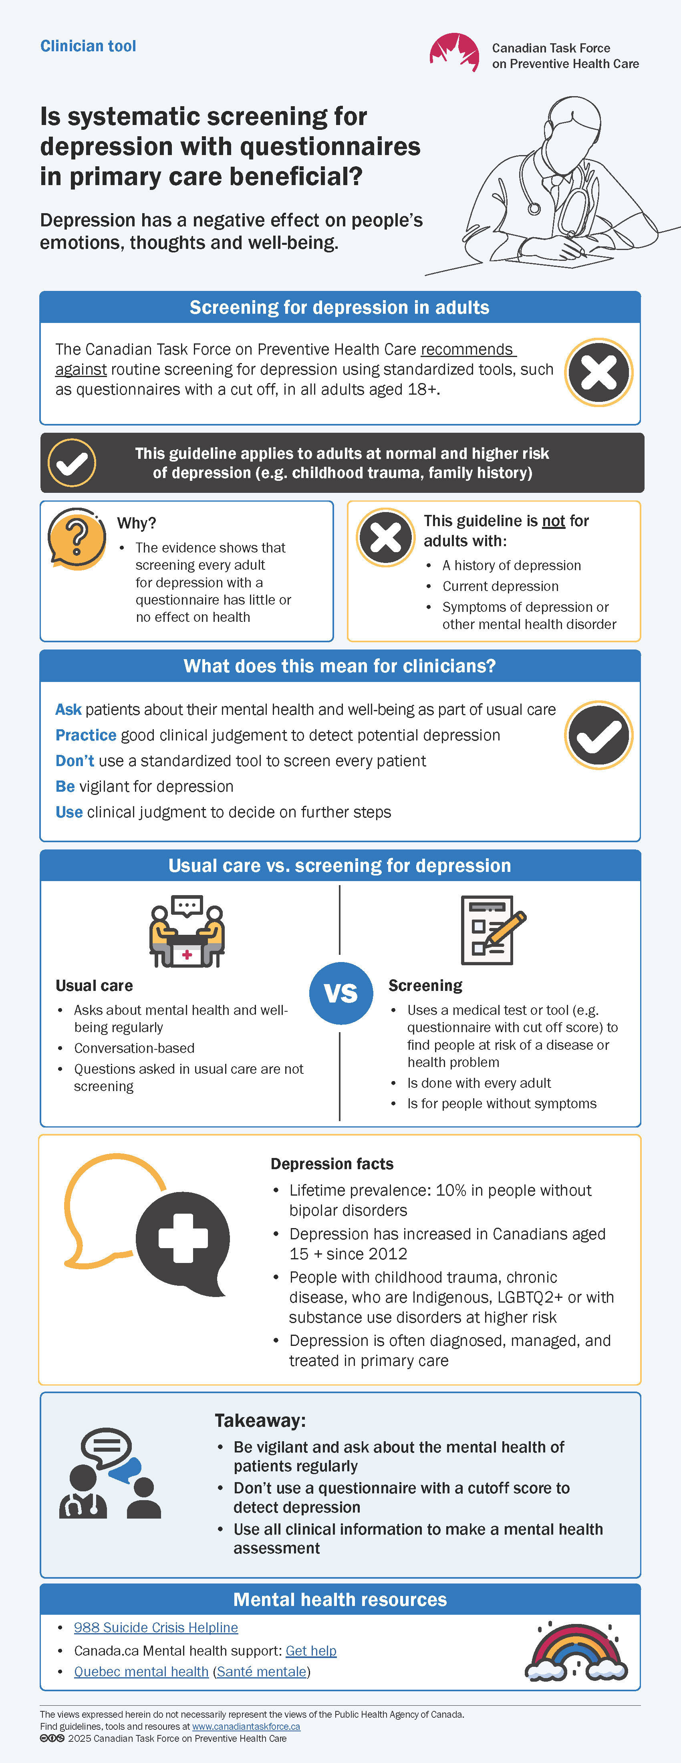
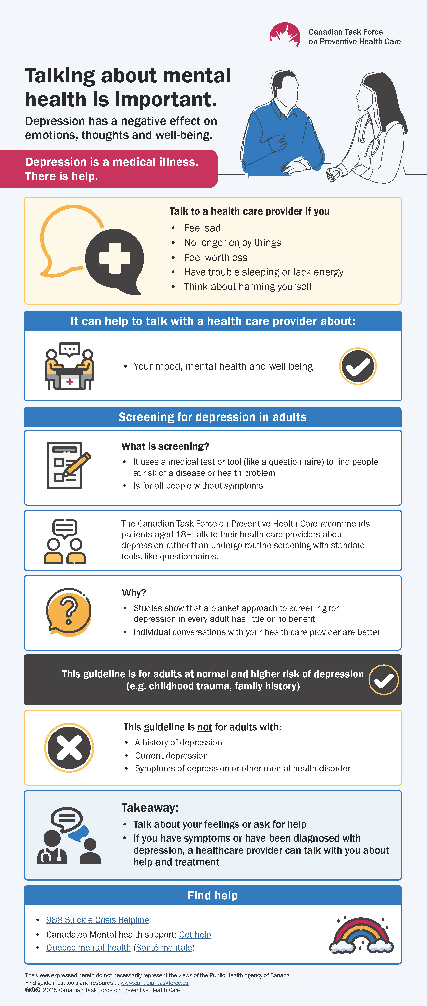
Tools
Patient infographic
Clinician infographic
Public web page
Notes:
A number of tools have been developed to help share the messages in this guideline
The infographic shown on the slide here was developed to help practitioners with the takeaway messages for practice

Slide 51

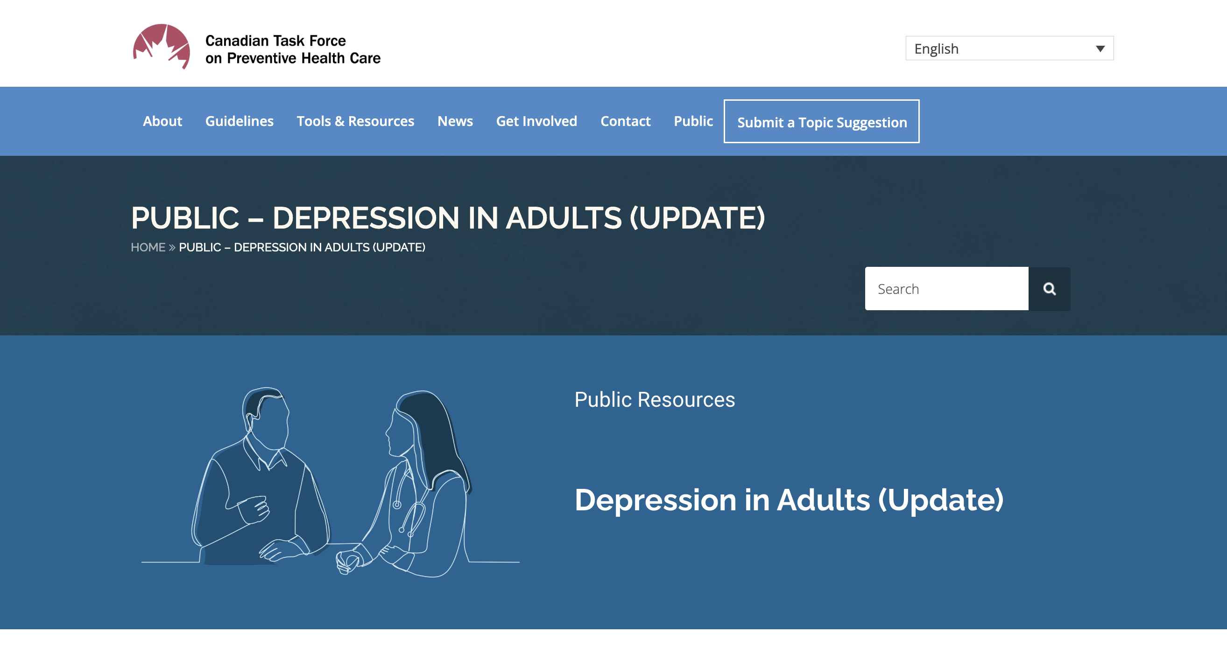
Tools
Notes:
The public page will also be available with accessible, relevant resources for patients

Slide 52
Conclusions
Notes:
Conclusions

Slide 53

Strong recommendation
The recommendation against screening all adults with a tool, such as a questionnaire, emphasizes the importance of good clinical care and vigilance about patient well-being

Slide 54

Takeaway
Be vigilant and ask about the mental health of patients regularly
Don’t use a questionnaire with a cutoff score to detect depression
Use all clinical information to make a mental health assessment
The Task Force has created infographics for patients and clinicians that summarize the guideline
Notes:
To implement this guideline, primary care providers should be

Slide 55


Thank you!
Depression can significantly affect people’s health and well-being and sadly, is becoming more common. However, evidence shows that a blanket approach to screening every adult with a questionnaire has little or no effect on health. Given the substantial challenges people in Canada face accessing mental health care, we do not recommend interventions unless they show benefit. Instead, be vigilant and ask about patients’ mental health as part of usual care.
– Dr. Eddy Lang, Chair,
Adult Depression Working Group

Slide 56

More information
For the guideline, clinician and public infographics and links to systematic reviews, visit
http://canadiantaskforce.ca
Notes:
For more information on the details of this guideline please see:
Canadian Task Force for Preventive Health Care website: http://canadiantaskforce.ca

Slide 57

Questions ?​

