Slide 1
Recommendations on interventions for tobacco smoking cessation in Canadian adults​

Slide 2
Important confidentiality notice
By staying on this call, you agree to keep all information from the presentation and question and answer period confidential until the recommendations are publicly released.
Release planned for August 25, 2025
Notes:
Just a reminder about confidentiality. By staying on this call, you agree to keep all information from the presentation and question and answer period confidential until the recommendations are publicly released on August 25, 2025

Slide 3

Slide deck
Slides like these will be made public after guideline release to help with dissemination, uptake and implementation into practice
The views expressed herein do not necessarily represent the views of the Public Health Agency of Canada
Notes:
- These slides are made available publicly following the guideline’s release as an educational support to assist with the dissemination, uptake and implementation of the guidelines into primary care practice.
- Some or all of the slides in this slide deck may be used in educational contexts.
- The views do not necessarily represent the views of the Public Health Agency of Canada

Slide 4



Canadian Task Force on Preventive Health Care (CTFPHC): Who are we and what do we do?
  Independent panel of volunteer clinicians and methodologists
    6 family physicians, 4 specialists, 2 nurse practitioners
  Mandate:
  Develop evidence-based clinical practice guidelines to support primary care providers in delivering preventive healthcare
  Goal:
  To improve the health of Canadians with evidence-based clinical practice guidelines for primary care
Notes:
The Task Force is an independent panel of up to 15 volunteers that develops evidence-based clinical practice guidelines for primary care.
Our mandate is to evelop evidence-based clinical practice guidelines to support primary care providers in delivering preventive healthcare
The Task Force's goal is to improve the health of Canadians with evidence-based clinical practice guidelines for primary care

Slide 5

Today’s plan
Who worked on the recommendations?
What were our questions?
How did we answer those questions?
The recommendations and their rationale
Tools for the recommendations
Notes:
This slide provides an overview fo today's presentation

Slide 6





Who worked on these recommendations?
Brett Thombs
Working Group Chair
Stéphane Groulx
Donna Reynolds
Working Group Vice-Chair
Brenda Wilson
Science team: PHAC (non-voting)
Eddy Lang
Greg Traversy
Julie Wu
AND...
Notes:
The Task Force Working Group on these recommendations is shown including two non-voting people who provided scientific expertise and support from the Public Health Agency of Canada.
In addition, the next slides show the many others involved in this guideline.

Slide 7


Clinical experts on tobacco cessation – non-voting
Steven L. Bernstein, MD (EM)
Chief Research Officer, Dartmouth Health and Associate Dean of Clinical Research
Director of the C. Everett Koop Institute at the Geisel School of Medicine at Dartmouth
Peter Selby, MBBS, FCFP, MHSc,
Professor, Vice-Chair of Research & Head of the Division of Mental Health and Addiction, Department of Family and Community Medicine (DFCM), University of Toronto
Professor, Department of Psychiatry and Dalla Lana School of Public Health, U of T
Senior Medical Consultant, Centre for Addition and Mental Health (CAMH)
AND...
7
Notes:
Dr. Bernstein previously served as Professor and Vice Chair of Research in the Department of Emergency Medicine at the Yale School of Medicine and Professor of Public Health (Chronic Disease Epidemiology) in the Yale School of Public Health in New Haven, Connecticut where he developed screening and treatment interventions for tobacco users in hospital settings and programs to train providers in tobacco control.
Dr. Selby is the Giblon Professor, Vice-Chair of Research and Head of the Division of Mental Health and Addiction in the Department of Family and Community Medicine (DFCM) at the University of Toronto. He is also a Professor at DFCM, the Department of Psychiatry and the Dalla Lana School of Public Health at U of T. He is a Clinician Scientist in the Addictions Division and Campbell Family Mental Health Research Institute, and a Senior Medical Consultant at the Centre for Addition and Mental Health (CAMH) in Toronto. Additionally, he is completing his term as the Chair of the Medical Education Council for the American Society of Addiction Medicine.

Slide 8

Patients/Public
Phase 1
19 adult citizens rated patient-important outcomes.
  Most said they smoked daily or planned to quit
Phase 2
8 adult members of the Task Force Public Advisory Network (TF-PAN) gave input on public messages
Public and clinician feedback on guideline tools
AND...
Notes:
Patients were engaged in guideline development, recruited via advertisements on public advertisement websites (i.e., Craigslist and Kijiji), through two phases of focus groups conducted by the Knowledge Translation group at St. Michael’s Hospital in 2 phases
Phase 1: Rating the importance of benefits and harm outcomes
Phase 2: Providing input on the guideline's key messages for the public

Slide 9

Interest holder engagement
150 interest holders were invited to comment on the draft guideline
29 interest holders provided feedback
All comments and responses will be available on our website
AND...
Peer review & input from the Canadian Medical Association Journal
Notes:
150 Interest holders were invited to provided, with 29 interest holders providing feedback. All comments and responses will be available on our website
We also had extensive input with CMAJ and its peer reviewers.

Slide 10

Summary
Clinician-scientist
(smoking cessation programs)
Task Force members
KT team Toronto
Public advisors
Clinician-scientist (tobacco addiction)
Interest Holders
2 content experts
Recommendations​
Evidence Review and Synthesis Centre
Science team
Team from Knowledge Synthesis and Application Unit, University of Ottawa
Notes:
Here is a summary of those involved in the guideline, and adds the evidence review and synthesis centre from the University of of Ottawa.

Slide 11
Conflicts of interest
Task Force members declared no conflicts of interest or financial relationships beyond their work and support of the task force
Steven L. Bernstein declared no conflicts of interest
Notes:
Conflicts of interest were managed according to the Task Force's COI policy which outlines different requirements for Task Force members and non-voting experts. We did not judge any disclosures to represent competing interests that precluded participation of task force members or clinical experts. Content experts do not provide input into or vote on direction or strength of recommendations.

Slide 12
Conflicts of interest – Dr. Peter Selby
Disclosures
Grants/Research Support: Pfizer Inc, Canadian Partnership Against Cancer, Ontario Neurotrauma Foundation, Patient-Centred Outcome Research Institute, Canadian Institutes of Health Research, Cancer Care Society, Health Canada, Canadian Cancer Society Research Institute (CCSRI), Medical Psychiatry Alliance, Ontario Ministry of Health and Long-Term Care, Public Health Agency of Canada, Juvenile Diabetes Research Foundation, Brain Canada Foundation, National Research Council of Canada, New Frontiers in Research Fund.
Speaking Engagements/Honoraria (content not subject to sponsor approval): University of Ottawa, Veterans Affairs Canada, American Society of Addiction Medicine, VRGT, University of Rochester Medical Center, The Lung Health Foundation, University of Toronto (DFCM), Winter Dental Clinic, ECHO, Ontario College of Family Physician, Queen’s University, Quitpath Yukon, Government of Singapore, Canadian Public Health Association, Vitalité Health Network New Brunswick, Horizon Health Network, Mayo Clinic, Sioux Lookout-NOSM Local Education Group (SLLEG), Royal College of Physicians and Surgeons of Canada, Canadian Partnership Against Cancer, Battle River Treaty 6 Healthcare, Lung Association of Nova Scotia, Exchange Summit, Toronto Public Health, Ontario Association of Public Health Dentistry.
Travel and accommodation coverage related to speaking engagements: Queen’s University, Government of Singapore, American Society of Addiction Medicine, Health Canada, Canadian Society of Addictions Medicine, E-Cigarette Summit UK, Sioux Lookout-NOSM Local Education Group (SLLEG), University of Ottawa.
Other: (Received drugs free/discounted for study through open tender process): Kenvue, Haleon and Pfizer Inc.
NO TOBACCO or VAPING or ALCOHOL or FOOD INDUSTRY FUNDING

Slide 13
Facts about tobacco smoking

Slide 14

Tobacco smoking
#1 cause of preventable disease and death in Canada
Increases risk of cancers, lung disease, heart disease, strokes and more
Contains 7000+ chemicals & 70 carcinogens
Often takes many times to quit
Often takes different interventions to quit
Is highly addictive and hard to stop
Notes:
Tobacco smoking is the leading cause of preventable disease and death in Canada because of the increased risk of many types of cancer, respiratory disease, cardiovascular disease, and other health conditions
Most of the harm from cigarettes is due to inhalation of cigarette smoke that contains more than 7000 chemicals, of which about 70 are carcinogens
People who smoke tobacco regularly do so because of the highly addictive nature of nicotine. This drives ongoing smoking even among people who may desire to quit

Slide 15



Who smokes
2022: 11% of Canadians age
15 years and older smoke
13% of males,
9% of females
75% smoke daily
Source: 2022 Canadian Tobacco and Nicotine Survey at https://www.canada.ca/en/health-canada/services/canadian-tobacco-nicotine-survey/2022-summary.html
Notes:
In 2022, 11% of Canadians aged 15 or older were currently smoking tobacco (13% of males and 9% of females), and approximately 75% of them were smoking daily

Slide 16

People/groups with higher rates of smoking
Single, separated, divorced or widowed
Gay or bisexual
First Nations, Inuit or Metis
Lower levels of education
Workers in jobs that do not require training or specific education level
Mental health issues
Substance use disorders
Notes:
Populations in Canada with higher smoking prevalence include people who are single, separated, divorced, or widowed; identify as gay or bisexual; identify as First Nations, Inuit or Métis; have lower levels of education; are workers whose jobs do not require training or a specific level of education; or have mental health diagnoses or substance use disorders

Slide 17


Quitting smoking
Improves health and leads to a longer life
Improves mental health and quality of life
Lowers the risk of heart disease, stroke and cancer
People who smoke will try several times using different interventions
Notes:
Quitting smoking increases life expectancy and improves mental health and quality of life. People often will try several times to quit before being successful long term.

Slide 18
Tobacco Cessation Guideline:
What did we do?

Slide 19

What did we try to answer?
1
What are the benefits and harms of interventions to promote cessation of tobacco smoking among adults?
What are the benefits and harms of electronic-cigarettes for tobacco smoking cessation in adults?
2
Notes:
The two key questions for this guideline related to the benefits and harms of different interventions for smoking cessation. We addressed e-cigarettes as a separate question as we took a different approach to the evidence for this question (de novo review versus overview of reviews). This will be covered in more detail in later slides.

Slide 20


Who are the recommendations for?
Primary care providers
Other health professionals who are first contact for people who smoke
People who smoke regularly or occasionally
People who are motivated and not motivated to quit smoking
Notes:
These recommendations provide guidance to primary care professionals, including physicians, nurses, and others who serve as a first point of contact for individuals who smoke, on smoking cessation for non-pregnant adults aged 18 years or older who currently smoke tobacco cigarettes. This includes those who smoke regularly or occasionally and those motivated or not motivated to quit.
Although this guideline is primarily aimed at primary care providers, the task force recognizes that addressing tobacco-related inequities likely requires a broader range of stakeholders to organize cessation efforts strategically so that that those who experience the greatest inequities can be supported to quit smoking. As such, this guideline may also be of use outside of primary care settings (e.g., by the public or policymakers).

Slide 21



What did we look for?
Tobacco smoking cessation interventions most likely to be considered in primary care
  Commercial tobacco cigarettes (includes hand-rolled)
Patient-important outcomes = what matters to Canadians
Benefits and harms of e-cigarettes for smoking cessation
Notes:
We examined data on patient-important outcomes (benefits and harms) related to a wide variety of tobacco smoking cessation interventions that could feasibly be delivered or referred to from primary care.

Slide 22



We looked for these benefits and harms
Benefits
Smoking cessation at 6+ months (critical)
Quality of life (critical)
Reduction in tobacco smoking
Potential harms
Adverse events
Weight gain
Negative mood changes
Loss of social group
Notes:
Potential benefits of interventions were required to be reported at least 6 months from the quit date or initiation of the intervention if the quit date was not specified
Outcomes were measured in various ways (e.g., self-report vs biochemical validation for cessation – this is reported in the evidence review and taken into account for certainty
Outcomes were rates according to GRADE by the guideline working group members, content experts, and patients engaged in focus groups.
Outcomes rated as critical or important by both the focus group participants and working group members were considered during guideline development.
After we considered outcome ratings from the public engagement, 2 expert advisors, and task force members, the final outcome list included smoking cessation as a critical outcome. Reduction in smoking, quality of life, adverse events, weight gain, changes in emotional state, and loss of social group were considered important.

Slide 23

What was not in scope?
Not apply to traditional or ceremonial tobacco by Indigenous peoples
Not apply to pregnant, or breast/chest-feeding individuals
Not address recommendations on stopping other tobacco or nicotine products (e.g. pouches)
Not address prevention of tobacco/nicotine use in this guideline
Notes:
The recommendations apply to commercial tobacco cigarettes (including hand-rolled cigarettes) produced for individual consumption regardless of place of manufacture and not to traditional or ceremonial use.
This guideline does not provide recommendations on interventions to promote cessation of other tobacco products (e.g., pouches).

Slide 24






How did we do it?
Notes:
GRADE (Grading of Recommendations Assessment, Development and Evaluation) provides a standard methodology for assessing the certainty of the evidence and making recommendations. It is used extensively around the world and helps minimize bias during each step of guideline development.

Slide 25

How did we do it?
2 evidence syntheses on benefits and harms of smoking cessation options:
Review of reviews - Summarize existing Cochrane systematic reviews on benefits and harms
  Allowed us to manage the large evidence base on smoking cessation interventions
  Additional search to June 24, 2024
Notes:
For the overview, Cochrane reviews focusing on smoking cessation interventions that could be directly delivered or referred to by primary care practitioners in Canada, compared to no intervention, placebo, or usual care controls, were included.
To identify updates to Cochrane reviews included in the guideline prior to publication, we carried out an additional search on June 24, 2024 (Appendix 2 of the guideline).
Link to publication: https://systematicreviewsjournal.biomedcentral.com/articles/10.1186/s13643-024-02570-9

Slide 26

How did we do it?
2. Systematic review on benefits and harms of e-cigarettes
  Updated the 2016 Cochrane review (now a living systematic review) to January 7, 2025
  Randomized Controlled Trials were included if:
    Comparator = no intervention or usual care
    Included adults
    Targeted to people who smoke
  Observational studies also included to examine harms
Notes:
We then did a systematic review of primary studies on the benefits and harms of e-cigarette interventions
Although Cochrane has since transformed its review into a living systematic review, it had not yet done so when we developed our evidence review protocol
Randomized controlled trials comparing e-cigarettes with or without nicotine to placebo, no intervention, or usual care were selected for inclusion to evaluate tbenefits. To explore harms associated with e-cigarettes, randomized and non-randomized trials, as well as comparative observational studies (i.e., prospective, and retrospective cohort, case–control) were selected for inclusion.
Link to publication: https://systematicreviewsjournal.biomedcentral.com/articles/10.1186/s13643-024-02572-7

Slide 27
Recommendations – Behavioural and Pharmacotherapy

Slide 28

Considerations
'Menu of options' approach
Grouped into broad recommendations for intervention options:
  Behavioural
  Pharmacotherapy
  Combined
  e-cigarettes
  Not doses, duration, etc. or ranking
Focus on patient preferences for interventions shown to be effective
Notes:
We used a "menu of options" approach recognizing that quitting smoking is highly personal. This allowed us to list options that work and those that don't work so the focus is on helping choice of options.
We made broad recommendations for intervention types, rather than doses, lengths or rankings. This was an intentional approach to the guideline and how we assessed the evidence. The broad recommendations include behavioural, pharmacotherapy, combined behavioral and pharmacotherapy, and e-cigarettes.
The task force considered that many individuals who smoke will attempt multiple different interventions before finding an approach that works best for them and that patient preferences (e.g., desire to avoid medication), expressed through shared decision-making are more likely to drive individual decisions about smoking cessation than knowing which interventions may be optimal compared to others.
This guideline therefore provides a menu of evidence-based interventions that can be provided or referred to by providers to help adults choose options that are accessible to them and best fit with their values and preferences.

Slide 29

Overall approach & recommendation
As part of good clinical care, providers are expected to be knowledgeable about their patients’ smoking status.
We recommend that all people who smoke tobacco cigarettes be encouraged to stop and be offered one or more of our recommended smoking cessation interventions (strong recommendation, high certainty).
Notes:
The primary recommendation:
As part of good clinical care, providers are expected to be knowledgeable about their patients’ smoking status. We recommend that all people who smoke tobacco cigarettes be encouraged to stop and be offered one or more of our recommended smoking cessation interventions (strong recommendation, high certainty).
Individuals who smoke should be engaged in shared decision-making about which interventions to use. With shared decision-making, healthcare providers engage in a collaborative process to help people who smoke to make choices that align with evidence and their own values and preferences.

Slide 30
In other words...
Know your patients’ smoking status as part of good clinical care
Encourage all patients who smoke to quit
Offer one or more recommended smoking cessation options
Engage in shared-decision making to determine best option(s) based on individual values and preferences
Notes:
This summarizes our approach and recommendation in non-GRADE language.

Slide 31
Strong recommendation
Behavioural options:
Beneficial with limited to no harms
Primary care advice
Individual or group counselling by trained cessation counsellor (in person or telephone)
Text messaging interventions
Self-help materials
Notes:
The task force recommends strongly in favour of primary care practitioner advice, individual or group counselling in person or by telephone from a trained cessation counsellor, mobile phone text messaging interventions, and self-help materials
These all provide at least a small benefit for smoking cessation with few to no harms identified (more information to come on balance of benefits and harms)

Slide 32

Strong recommendation
Pharmacotherapy:
Beneficial with limited harms
Nicotine replacement therapy
  patch, gum, lozenges, inhaler or spray, used alone or together
Varenicline
Bupropion
Cytisine (a natural health product)
Notes:
We strongly recommend nicotine replacement therapy, varenicline, bupropion, and cytisine as pharmacotherapy options
These options all increased smoking cessation rates, with some potential harms or side effects (more to come on this in subsequent slides)
Cytisine is a plant-based alkaloid that has been used in Europe since the 1960s for smoking cessation. It is available over the counter as a natural health product in Canada and works through the same mechanism as varenicline.

Slide 33
Strong recommendation
Combinations:
Beneficial with limited to no harms
Behavioural and pharmacotherapy options
Notes:
We also strongly recommend interventions combining behavioural approaches with the aforementioned pharmacotherapy options.

Slide 34

Conditional recommendations
Behavioural:
“Suggest for”: Interactive computer-based or online programs with direct behavioural support
  Benefit depends on type and extent of support; no harms data
“Suggest against”: Interactive computer-based or online programs without additional support i.e., fully automated or self-directed
  No benefit; no harms data
Additional support seems to improve
smoking cessation
Notes:
When it comes to computer-based or online interventions using interactive programs (i.e., two-way flow of info between the individual and the application, as opposed to online self-help), the extent of benefit depended on whether there was additional behavioural support provided or not.
We suggest interactive computer-based programs where additional support can be provided, but suggest against those that do not provide additional support.

Slide 35
We do not recommend
Strong recommendation
Acupuncture
Hypnosis
Laser therapy
Electric current stimulation to head
Ear acupressure
St. John’s Wort
S-Adenosyl-L-Methionine (SAMe)
Notes:
We recommend strongly against several interventions
All of these interventions either have evidence suggesting little to no benefit, or are very uncertain as to whether they help people quit smoking.
There are harms associated with unsuccessful attempts to quit and continuing to smoke, given the prolonged exposure to tobacco smoke.
A strong recommendation is therefore made against St. John’s Wort and S-Adenosyl-L-Methionine, based on the lack of evidence of benefit, as well as resource implications and opportunity costs if people who smoke use these interventions instead of interventions with evidence of benefit.
Evidence on the effects on smoking cessation of most other therapies compared to placebo or sham was of very low certainty. In the case of acupuncture, there may be little to no benefit. A strong recommendation is therefore made against offering these interventions based on the same rationale.
This guideline discourages the use of interventions without evidence of benefit; providers should encourage people who smoke to select a recommended intervention without discouraging them from attempting to quit.

Slide 36
Option Summary
Most behavioural options recommended
  Primary care advice, counselling by trained cessation counsellor, text messaging interventions, self-help materials, interactive-online programs with support
Pharmacotherapy options recommended
  NRT, varenicline, bupropion and cytisine
Combined therapies recommended
List of therapies not recommended
  Interactive-online programs without support, Acupuncture, hypnosis, laser therapy, electric stimulation to head, ear acupressure, St John's wort, SAMe
Notes:
This slide summarizes the past few slides and answers the first question of our guideline after we weighed the benefits and harms. Now we will move to e-cigarettes.

Slide 37
Recommendations –
e-cigarettes

Slide 38

Considerations – e-cigarettes
Evidence of benefit for cessation
Few harms over short-term
Many people use
Some may not be willing to try other options
Continued smoking has well-established harms
Notes:
In our review, the Task Force recognizes there are some important caveats and considerations regarding e-cigarettes.
There is evidence of benefit for smoking cessation and few harms identified over the short term (we will discuss this in subsequent slides).
Many individuals are already using e-cigarettes to attempt to quit smoking. For these individuals, the choice may be between attempting to quit using e-cigarettes with advice and support of a healthcare provider versus doing this alone without informed guidance.
The Task Force also weighed the concerns of continuing to smoke and the well-established harms versus the option of quitting with e-cigarettes

Slide 39
Considerations – e-cigarettes
Concerns and uncertainties
No long-term data on harms
Uncertain impact on relapse
Lack of approved products
Potential public health or societal impacts
Many other safe and effective options
Notes:
Yet, there are several concerns and uncertainties, including no long term data on harms, which is important as we know from several studies that individuals who use e-cigarettes to quit often continue using them long-term. Potential harms or side-effects were rated as being important for decision-making by both the task force and patients.
Some data suggest that individuals who use e-cigarettes to quit may be more likely to relapse, and dual use is common
Providers cannot direct patients to an approved e-cigarette product with a verified formulation (e.g., for nicotine concentration and other excipients or additives), thus individuals will ultimately use what is available to them in the recreational market.
In the judgment of the task force, there are uncertain public health and societal impacts of normalizing e-cigarettes as a population approach to cessation. The task force is concerned that this could, for instance, inadvertently increase uptake of vaping among youth and nicotine addiction in the general population.
At the same time, other safe and proven options exist.

Slide 40



Conditional recommendation
We suggest against using e-cigarettes,
except under certain circumstances.
Can be considered for those:
  who have unsuccessfully tried other interventions
  are unwilling to try other interventions
  or express a strong preference for e-cigarettes
Practitioners may then engage in shared
decision-making about using e-cigarettes
with or without nicotine
Notes:
We suggest against using e-cigarettes for smoking cessation except in certain circumstances (conditional recommendation, low certainty).
For people who have unsuccessfully attempted other interventions, are otherwise unwilling to try other interventions, or express a strong preference, practitioners may engage in shared decision-making regarding the possible use of e-cigarettes with or without nicotine.
The task force makes a conditional recommendation against e-cigarettes for smoking cessation (versus a strong recommendation against their use) because of well-established harms of continued smoking and some individuals may be willing to attempt to quit with e-cigarettes but not with other strategies. Many individuals are already using e-cigarettes to attempt to quit smoking. For these individuals, the choice may be between attempting to quit using e-cigarettes with advice and support of a healthcare provider versus doing this alone without informed guidance.
The task force recommends that e-cigarette use not be encouraged as a smoking cessation intervention for most people, rather that people who smoke should be directed towards other interventions with proven effectiveness (i.e., strong recommendation for their use). However, e-cigarettes can be considered for specific individuals based on shared decision-making with their primary care provider.

Slide 41
Information for shared decision-making
People who choose to use e-cigarettes to quit smoking should be informed of the uncertainties, including:
No approved therapeutic products with consistent formulations
No long-term safety data
Ongoing use of e-cigarettes with nicotine will not address nicotine addiction
Notes:
People who decide to use e-cigarettes to quit smoking should be informed of the uncertainties related to e-cigarettes. These include the lack of approved therapeutic products with consistent formulations, the lack of long-term safety data, and that ongoing use of e-cigarettes with nicotine does not address their addiction to nicotine since it would continue to be consumed.
Note: This guideline does not assess the benefits or harms of nicotine pouches for smoking cessation since this information was not available during development

Slide 42
Recommendations –
Comparison to others

Slide 43









How do we compare to other national guidelines?
US Preventive Services Task Force (2021)
Scottish Intercollegiate Guidelines Network (2017)
Royal Australian College of General Practitioners (2021)
New Zealand Ministry of Health (2021)
Haute Authorite de Sante (2022)
National Institute for Health and Care Excellence (England) (2025)
World Health Organization (2024)
CANADAPPT (2011)
Canadian Cardiovascular Society (CCVS) (2025)
Notes:
We examined a number of other recommendations from guideline bodies within Canada and around the world.
CANADAPPT (Canadian Action Network for the Advancement, Dissemination and Adoption of Practice-informed Tobacco Treatment) guideline: https://intrepidlab.ca/en/canadaptt/PublishingImages/Pages/CAN-ADAPTT-Guidelines/CAN-ADAPTT%20Canadian%20Smoking%20Cessation%20Guideline_website.pdf

Slide 44



How do we compare to other national guidelines?
Behavioural and pharmacotherapy interventions
  Largely align
  Difference: we, NICE, and CCVS include cytisine as a recommended pharmacotherapy.
e-cigarettes
  Similar to CCVS, Australia and France
    Recognize e-cigarettes are a potential option, but with important caveats; other interventions suggested as a first approach
  US: ”I” recommendation; recommends to use other interventions
  NZ: Recommends with caveats
Notes:
With respect to behavioural and pharmacotherapy interventions, there is largely alignment across guidelines and with our recommendations. One are where we may be slightly different, is in recommending cytisine, which was also included in the latest updates from NICE and the Canadian Cardiovascular Society in 2025.
Our approach to e-cigarettes is similar to the Canadian Cardiovascular Society, Australia and France, where a cautious approach is recommended. The US issued an "I" recommendation in 2021, and is in the process of updating their recommendations. New Zealand more clearly recommends e-cigarettes as an option, but includes similar caveats to ours.

Slide 45
Benefits and harms
Rationale
Notes:
Rationale for recommendations

Slide 46
How did we weigh benefits and harms - principles
"Smoking cessation" outcome was critical for driving recommendations
  Health benefits are substantial
  Most commonly reported outcome
Across all interventions, we considered the well-established harms of continuing to smoke AND:
  Need to intervene with options that improve quitting
  Unproven or ineffective options are lost opportunities to quit
Notes:
Recommendations were primarily driven by data on smoking cessation. There are substantial health benefits for people who quit smoking, and smoking cessation was the most reported outcome.
For all interventions, we considered well-established negative outcomes (e.g., cancer, cardiovascular and respiratory disease) that arise if one continues to smoke. This suggests that there is a need to intervene with something that has evidence that it can increase smoking cessation (even if evidence is uncertain). It also means that there is an important opportunity cost if someone tries to quit using something that isn’t shown to be effective, versus one of the many available options that are proven.

Slide 47
Weighing benefits and harms - behavioural
Benefits
Primary care practitioner advice, counselling (in person, group or telephone) from a trained cessation counsellor, mobile phone text messaging interventions, and self-help materials
  all provide at least a small benefit for smoking cessation
  often low certainty
  consistency in direction of effects across similar interventions improves confidence
Harms
Practitioner advice, counselling (in person, group, or telephone), self-help materials, or internet interventions
  none identified/no evidence
Mobile phone-based interventions (1 RCT)
  no difference in accidents or thumb/finger pain
Notes:
Our overview of reviews found that all of the recommended behavioural interventions effectively increased cessation by at least a small amount, across several RCTs.
While most data on benefits were of low certainty, the consistency in direction of effects across similar interventions provided greater overall certainty in the balance of benefits and harms
No data on harms were identified in our overview of reviews for practitioner advice, individual or group counselling from a trained smoking cessation counsellor, self-help materials, or Internet interventions.
Data on mobile phone text messaging interventions suggested little to no increase in either car accidents or joint pain.

Slide 48

Weighing benefits outcomes - pharmacotherapy
Benefits
Bupropion, cytisine, NRT, and varenicline
  Increased quitting by a small to large amount
Combined pharmacotherapy and behavioural interventions were also effective
St. John’s Wort
  Decreased smokers quitting by a small amount (data very imprecise)
S-Adenosyl-L-Methionine had
  Very uncertain impact on cessation
Notes:
Effective pharmacotherapy options were bupropion, cytisine, NRT, and varenicline with effect sizes ranging from small to large across many RCTs. Combination interventions were also effective.
One RCT provided very low certainty evidence for the effect of S-Adenosyl-L-Methionine on smoking cessation
Two RCTs reporting on St. John’s Wort for smoking cessation found that the intervention may result in fewer smokers quitting, compared with placebo, although the effect estimate was very imprecise

Slide 49
Weighing harms - pharmacotherapy
Relevant Harms: Small increase in adverse events
Bupropion: anxiety, insomnia
Cytisine: nausea, dry mouth, sleep problems
NRT: palpitations, chest pain
Varenicline: nausea, insomnia, abnormal dreams, headaches
  Serious adverse events (most not treatment-related)
Overall: The Task Force judged that the small increase in harms was clearly outweighed
by the benefits of quitting smoking.
Notes:
An updated Cochrane review on bupropion suggested there may be a small increase in adverse events which could constitute a small harm.
There were similar rates of mild adverse events (e.g., nausea, restlessness, insomnia, irritability) across groups in trials of cytisine based on our initial overview. However, an updated Cochrane review on cytisine suggested there may be a small increase in adverse events such as nausea, dry mouth, sleep dysfunction which could constitute a small harm.
Nicotine replacement therapy likely results in a small harm from increased palpitations or chest pains, but may result in little to no harm from other adverse events, such as hiccups, gastrointestinal disturbances, skin irritation from patches, throat irritation, or runny nose.
Varenicline results in small harms from increases in nausea, insomnia, abnormal dreams, headaches, and serious adverse events were considered by trial authors to be unrelated to treatment. Studies found little to no difference in depression or suicidal ideation.
Regarding the SAEs, the review has limited information: "Our analysis of reported serious adverse events occurring during or after active treatment suggests there may be a 25% increase in the chance of SAEs among people using varenicline (RR 1.25; 95% CI 1.04 to 1.49; 29 trials, 15,370 people; high‐quality evidence). These events include comorbidities such as infections, cancers and injuries, and most were considered by the trialists to be unrelated to the treatments."
https://www.cochranelibrary.com/cdsr/doi/10.1002/14651858.CD006103.pub7/full

Slide 50
Weighing benefits and harms – Other therapies
Benefits
Evidence showed there may be no benefit for acupuncture
Very uncertain whether any benefits for hypnotherapy, continuous auricular stimulation, laser therapy, and electrostimulation
Harms
Lack of evidence on harms for hypnotherapy, acupuncture, continuous auricular stimulation, laser therapy, or electrostimulation
Notes:
Benefits data on hypnotherapy, continuous auricular stimulation, laser therapy, and electrostimulation were all very uncertain.
Acupuncture may have little to no effect on cessation.
No evidence on harms was identified for hypnotherapy, acupuncture, continuous auricular stimulation, laser therapy, or electrostimulation

Slide 51

Weighing benefits and harms – e-cigarettes
Benefits
With nicotine: May help with quitting smoking at 6+ months (small to moderate)
Without nicotine: May help with quitting smoking at 6 months (small)
Notes:
11 RCTs reported on the benefits of e-cigarettes. Due to clinical and methodological heterogeneity (i.e., different types of e-cigarettes, their doses and combinations, duration of interventions, varied outcome reporting) our evidence centre did not combine the studies in a meta-analysis.
One key RCT (n=657) (28) found that nicotine e-cigarettes with behavioural support may result in a small smoking cessation benefit compared to non-nicotine e-cigarettes with behavioural support (32 more per 1000, 95% CI 19 fewer to 196 more; low certainty). A second key RCT (n=999) found that nicotine e-cigarettes with behavioural support and nicotine patch access likely results in a small cessation benefit compared to non-nicotine e-cigarettes with behavioural support and nicotine patch access (30 more per 1000, 95% CI 1 more to 79 more; moderate certainty) (29). This RCT also found a moderate cessation benefit when nicotine e-cigarettes with behavioural support and nicotine patch access were compared to nicotine patch and behavioural support alone (46 more per 1000, 95% CI 2 fewer to 200 more; low certainty).
Six other studies that examined similar comparisons (sample size 80 to 837) reported on smoking cessation and reduction but were all of very low certainty
For non-nicotine e-cigarettes one key RCT (n=624) examined non-nicotine e-cigarettes with behavioural support and nicotine patch access versus behavioural support and nicotine access alone (29). Non-nicotine e-cigarette use may result in a small cessation benefit (16 more per 1000, 95% CI 12 fewer to 109 more; low certainty).
Two other studies that examined similar non-nicotine e-cigarette comparisons (n=249 and n=140) were of very low certainty
There were minor differences in study inclusion criteria and the meta-analyses undertaken between our review and the Cochrane living systematic review on e-cigarettes, likely because our review was focused on primary care settings; however, conclusions on effects aligned

Slide 52
Weighing benefits and harms – e-cigarettes
Harms
No increased harms in mostly short-term studies:
  adverse events (e.g., dry mouth or throat, nausea, headache, insomnia, irritability, cough, shortness of breath)
  serious adverse events
  no differences in smoking-related diseases at 4 years with nicotine e-cigarettes compared with traditional tobacco smoking (cohort study)
Overall: The Task Force judged that the "considerations and uncertainties" of e-cigarettes was concerning enough to outweigh the benefits, except under certain circumstances.
Notes:
Fourteen RCTs and 1 cohort study provided data on e-cigarette harms, almost all at 3 to 6 months of follow-up. They found little to no difference in adverse events (e.g., dry mouth or throat, nausea, headache, insomnia, irritability, cough, shortness of breath) compared to control groups.
There were also similar rates of serious adverse events with no treatment-related events in 2 RCTs, and no difference in the magnitudes of weight gain for both nicotine and non-nicotine e-cigarettes.
One RCT provided data on adverse events at 12 months that was of very low certainty, and a cohort study reported no serious adverse events or differences in smoking-related diseases at 4 years with nicotine e-cigarettes compared with traditional tobacco smoking (certainty could not be evaluated)
Conclusions from the Cochrane living systematic review on potential harms were similar

Slide 53
Other Considerations: "FACE"
Feasibility
Occurs in primary care
Options available
E-cigs are used for quitting
Acceptability
Many want to quit
Many have tried to quit
Menu of options provides what works, what does not
Cost (Resources)
Behavioural interventions often covered or free (e.g., quit lines)
Pharmacotherapy has limited coverage/rebates including NRT;
Cytisine not covered
Some may need to pay out-of-pocket
e-cigarettes are not covered
Equity
Interventions may decrease some tobacco-related health inequities
Cost and access could limit benefit for marginalized groups
Barriers could worsen smoking-related health inequity
Notes:
Behavioural and pharmacotherapy smoking cessation interventions are already utilized in primary care in Canada, and e-cigarettes are already used by some people for smoking cessation. Thus, selecting a suitable intervention is anticipated to be feasible, although there may be cost barriers for some interventions. Limited coverage for pharmacotherapy and counselling and limited access to primary care could impact feasibility for some individuals.
Most people who smoke cigarettes have some interest in quitting, and many have accessed behavioural or pharmacological cessation assistance, implying acceptability to individuals who smoke and providers, although side effects of pharmacotherapy and some of the unknowns around e-cigarettes may be a concern for some.
Inequities in harms caused by tobacco use are likely the result of multiple social determinants of health, access to tobacco products, tobacco industry influence, broader tobacco control policies, and availability of cessation aids. Interventions need to be accessible and delivered in a culturally competent manner to address inequities. Some of the barriers related to cost and access could limit the potential for marginalized groups to benefit. Those at highest risk of smoking related harm have the greatest potential to benefit; however, if uptake is relatively higher in socially advantaged groups, health disparities may be increased further.

Slide 54
Knowledge translation tools

Slide 55
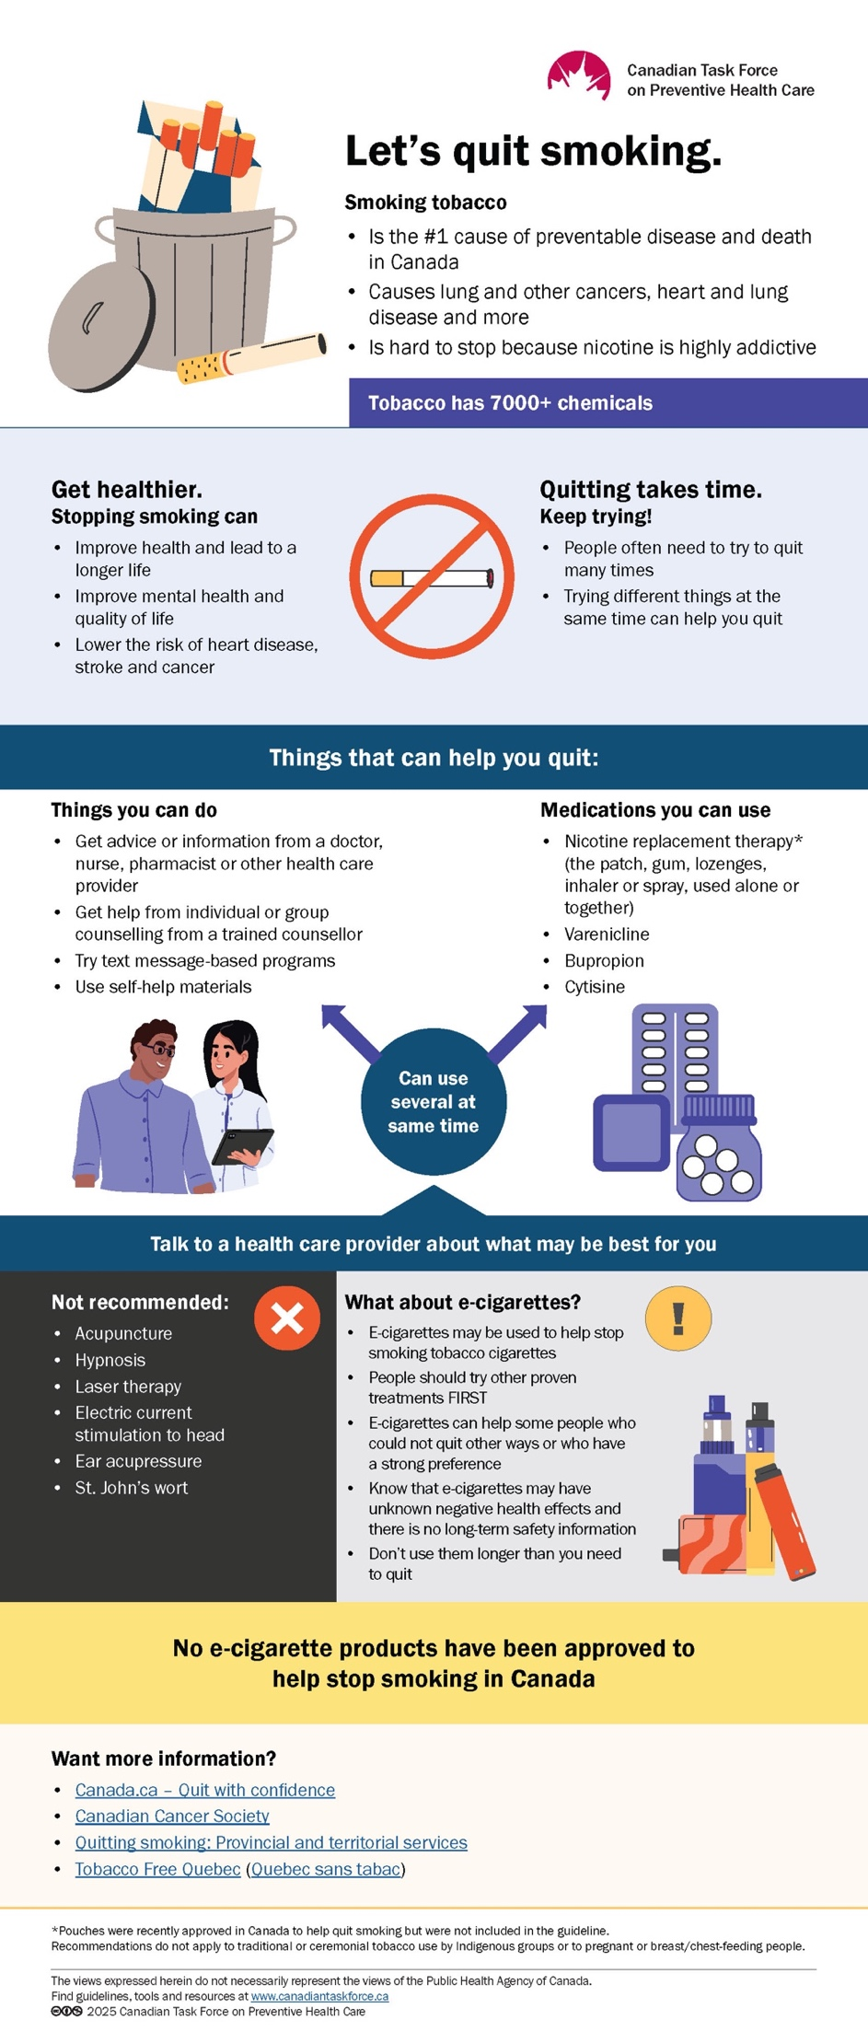
Tools
Patient infographic
Patient-clinician discussion tool
Public web page
Notes:
A number of tools have been developed to help share the messages in this guideline
The infographic shown on the slide here was developed to help practitioners with the takeaway messages for practice

Slide 56
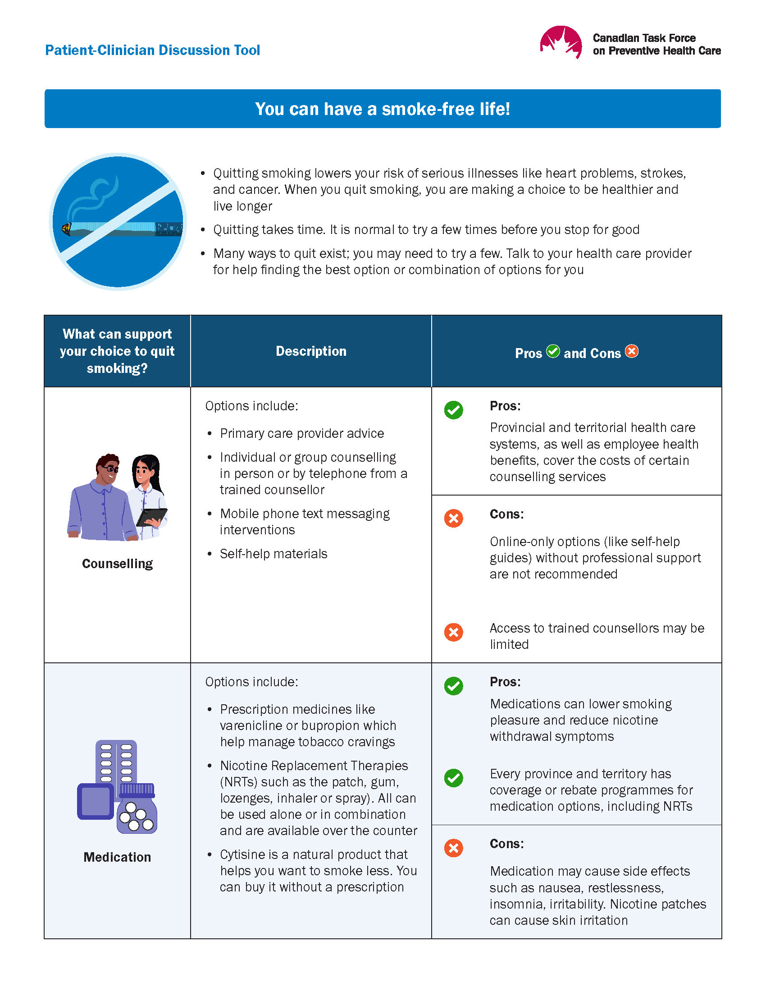
Tools
Notes:
The patient-clinician discussion tool can be used to help with shared decision making on the best options based on patient preferences

Slide 57

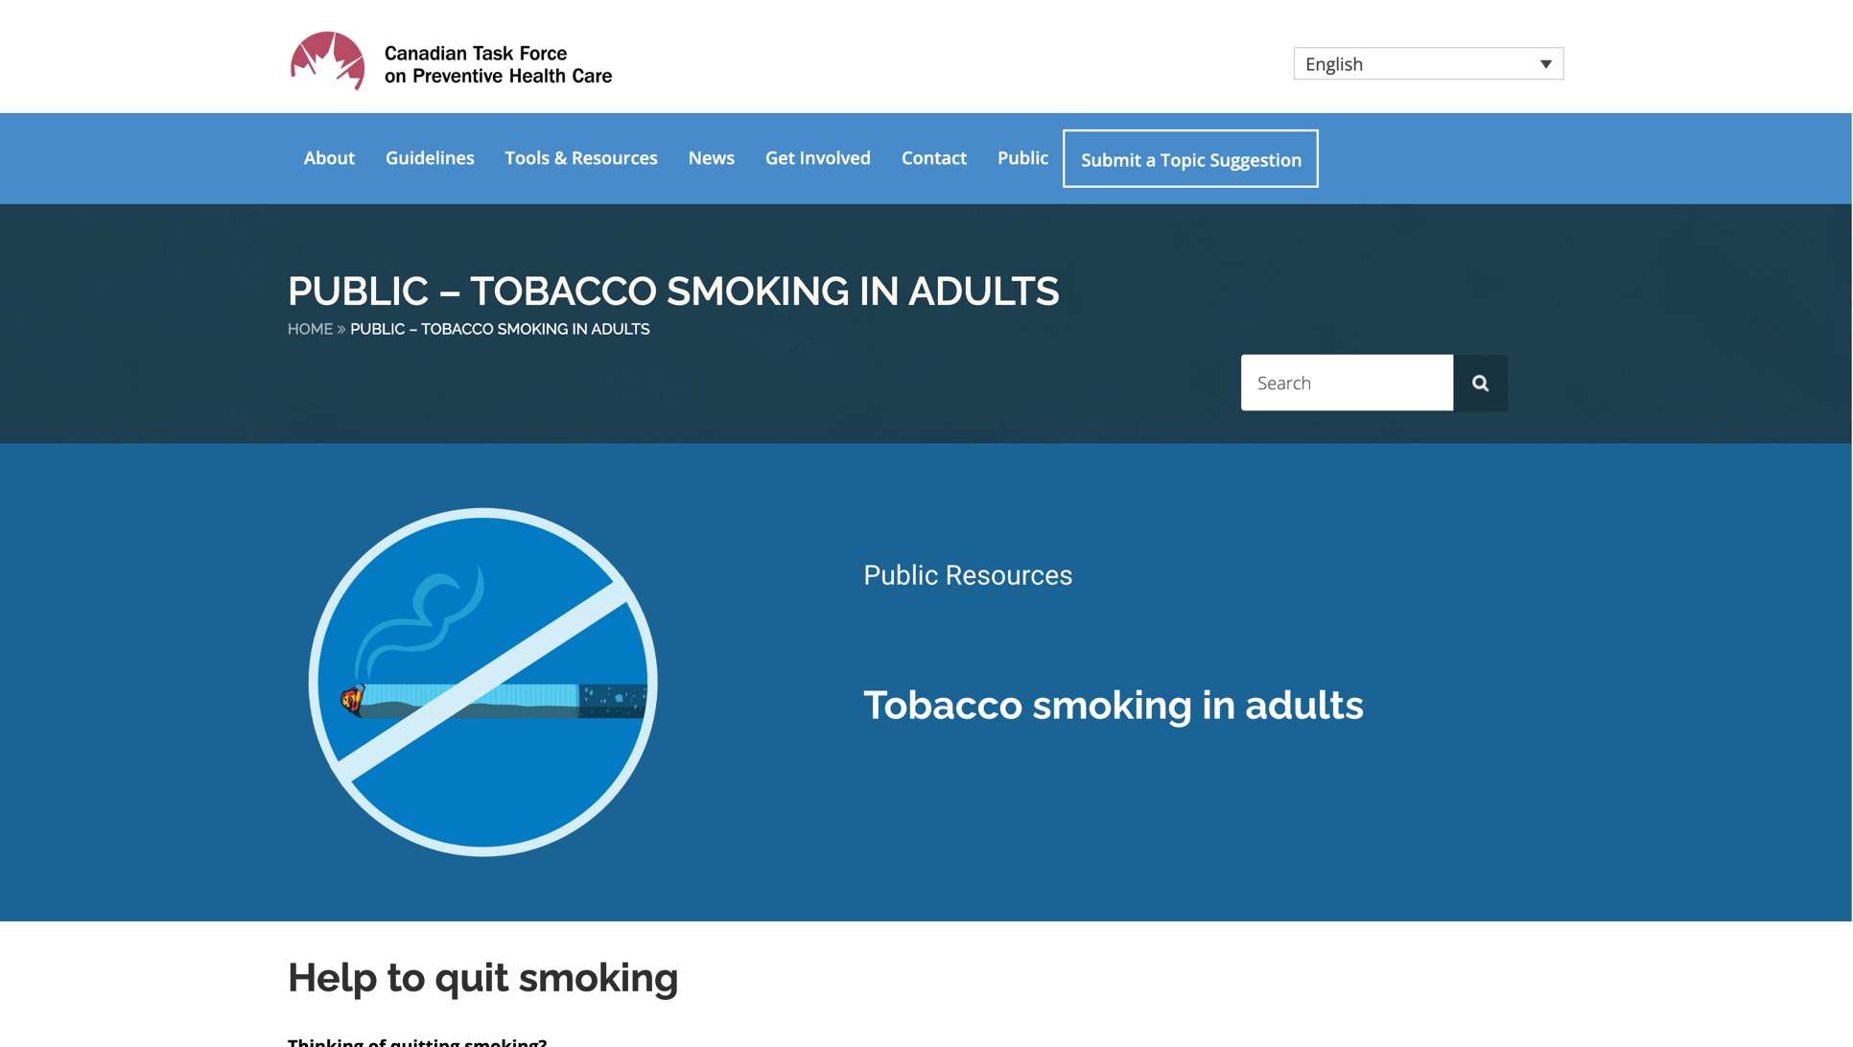
Tools
Notes:
The public page will also be available with accessible, relevant resources for patients

Slide 58
Conclusions
Notes:
Conclusions

Slide 59


Menu of options:
Strong recommendations FOR…
Behavioural: Primary care advice, counselling by trained cessation counsellor, text messaging interventions, self-help materials
Pharmaceutical: Nicotine replacement therapy, varenicline, bupropion, cytisine
Combination of above
Notes:
The menu of effective options that are strongly recommended in the guideline includes a number of behavioural, pharmaceutical and combined approaches.

Slide 60

Menu of options:
Conditional recommendations FOR…
Behavioural: Interactive computer-based or online programs with direct behavioural support
Notes:
Interactive computer-based or online programs are also suggested if they have a behavioural support component.

Slide 61

Strong recommendations AGAINST…
Acupuncture
Hypnosis
Laser therapy
Electric current stimulation to head
Ear acupressure
St. John’s Wort
S-Adenosyl-L-Methionine (SAMe)
Notes:
This guideline discourages the use of interventions without evidence of benefit; We strongly recommend against a number of these interventions. Providers should encourage people who smoke to select a recommended intervention without discouraging them from attempting to quit.

Slide 62


Menu of Options:
Conditional recommendations AGAINST…
Behavioural: Interactive computer-based or online programs without additional support
e-cigarettes, except under certain circumstances
  have unsuccessfully tried other interventions
  are unwilling to try other interventions,
  express a strong preference for e-cigarettes
Notes:
We suggest against interactive computer-based or online programs without a behavioural support component as it's not clear that these will provide benefit.
The task force recommends that e-cigarette use not be routinely encouraged as a smoking cessation intervention and that individuals who smoke ideally be directed towards other interventions with proven effectiveness and strong recommendations. However, for people who have already unsuccessfully attempted other interventions, are otherwise unwilling to try other interventions, or express a strong preference, primary healthcare providers may engage in shared decision-making regarding the possible use of e-cigarettes (with or without nicotine). People who wish to use e-cigarettes to quit cigarette smoking should be informed about the benefits and uncertainties.

Slide 63

What's next?
Practitioners: Share information
For people who smoke, use the menu of options to engage them in shared-decision on effective options to help them quit
Notes:
Practitioners can use this guideline and associated tools to support patients in selecting effective options

Slide 64

What's next?
Adults who smoke: Get informed
There are many effective options to help you quit smoking. Speak with a health care practitioner to discuss what options are best for you.
Notes:
For people who smoke – the resources accompanying the guideline can help them understand options to discuss with a care provider

Slide 65

What's next?
Programs: Share information
We encourage everyone to use the guideline and related tools to help people quit.
The menu of options approach helps people choose effective interventions that are suitable for them.
Notes:
Smoking cessation programs may use this guideline to develop resources for people who smoke or otherwise support them in selecting interventions that can help them quit.

Slide 66
Takeaway
Everyone who smokes should be encouraged to quit
Many people will try to quit multiple times with different interventions
There are effective options to help people quit smoking
Notes:
Overall, the task force strongly recommends primary care providers encourage individuals who smoke to quit by using 1 or more recommended interventions. The menu of effective options that is included in the guideline can be used during shared decision-making to identify the most suitable interventions for people who smoke.
Many individuals need to attempt quitting multiple times with different interventions or combinations of interventions before being successful and may learn from preceding attempts or change their preferences for different interventions.

Slide 67
Takeaway
Ask about your patients’/clients' smoking status
Advise them to quit if they smoke
Offer 1 or more recommended interventions
Engage in shared decision-making
  SDM should help patients choose the recommended options that align with their values and preferences, and consider their smoking behaviours and lifestyle
The Task Force has created tools to help patients and clinicians choose the right options
Notes:
To implement this guideline, primary care providers should be knowledgeable about their patients’ smoking status and should therefore ask patients if they smoke and advise them to quit if they do.
Shared decision-making should be used to help guide individuals to interventions, including potential combinations of interventions, that are effective, most closely fit their values and preferences and are accessible.
With shared decision-making, healthcare providers engage in a collaborative process to help people who smoke to make choices that align with evidence and their own values and preferences, smoking behaviours, and life circumstances.

Slide 68


Thank you!
In my practice, many people who smoked cigarettes said they wanted to quit, and some had tried things that we now know don’t work. Having a variety of effective options to offer patients helps us gain confidence on knowing what can work, and what options are best for them. Quitting smoking is just an intervention away.
– Dr. Donna Reynolds, Vice-chair,
Tobacco Cessation Working Group

Slide 69

More information
For the guideline, clinician and public tools and links to systematic reviews, visit
http://canadiantaskforce.ca
Notes:
For more information on the details of this guideline please see:
Canadian Task Force for Preventive Health Care website: http://canadiantaskforce.ca

Slide 70
Questions ?​

